Slide 1
What is the Importance of Cereblon to the Mechanism of Action of Immunomodulatory Drugs and CELMoDs® in Multiple Myeloma (MM)?
Krina Patel, MD, MSc
Associate Professor
UT MD Anderson Cancer Center
Houston, Texas

Slide 2
Disclaimer
The views and opinions expressed in this educational activity are those of the faculty and do not necessarily represent the views of TotalCME, Inc., the CME providers, or the companies providing educational grants. This presentation is not intended to define an exclusive course of patient management; the participant should use their clinical judgment, knowledge, experience, and diagnostic skills in applying or adopting for professional use any of the information provided herein. Any procedures, medications, or other courses of diagnosis or treatment discussed or suggested in this activity should not be used by clinicians without evaluation of their patient's conditions and possible contraindications or dangers in use, review of any applicable manufacturer’s product information, and comparison with recommendations of other authorities. Links to other sites may be provided as additional sources of information.

Slide 3
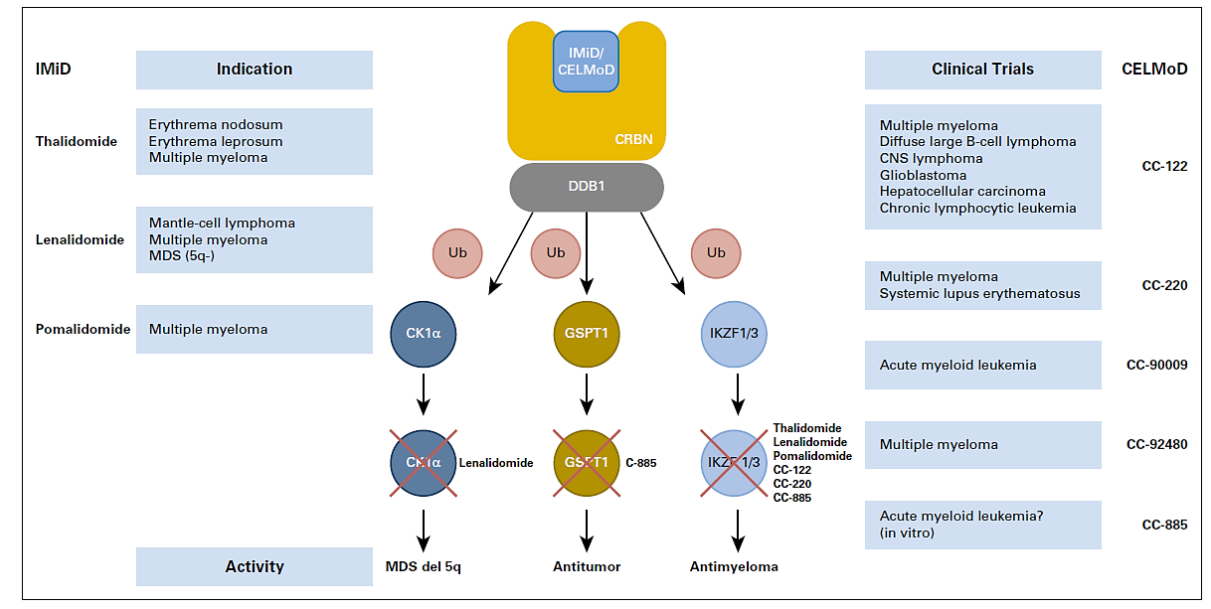
Cereblon
®

Slide 4
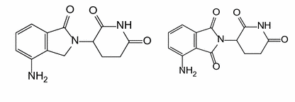
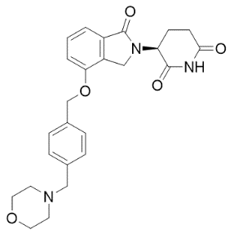
Novel Cereblon E3 Ligase Modulators (CELMoD® agents) in Development
LEN and POM
(a subgroup of CELMoD® agents)
helped to transform therapy and drive
survival in MM¹⁻³
Rational selection of molecules based on
deep scientific understanding of CRBN and MM biology: iberdomide (IBER; CC-220) and mezigdomide (CC-92480)⁴⁻⁶
2019 and 2020: First clinical data for IBER and CC-92480 in MM
LEN
POM
IBER
CC-92480
Iberdomide (IBER; CC-220) and mezigdomide (CC-92480) are investigational products,
currently not approved by any regulatory agency.
CRBN, cereblon; IBER, iberdomide; LEN, lenalidomide; MM, multiple myeloma; POM, pomalidomide.

Slide 5
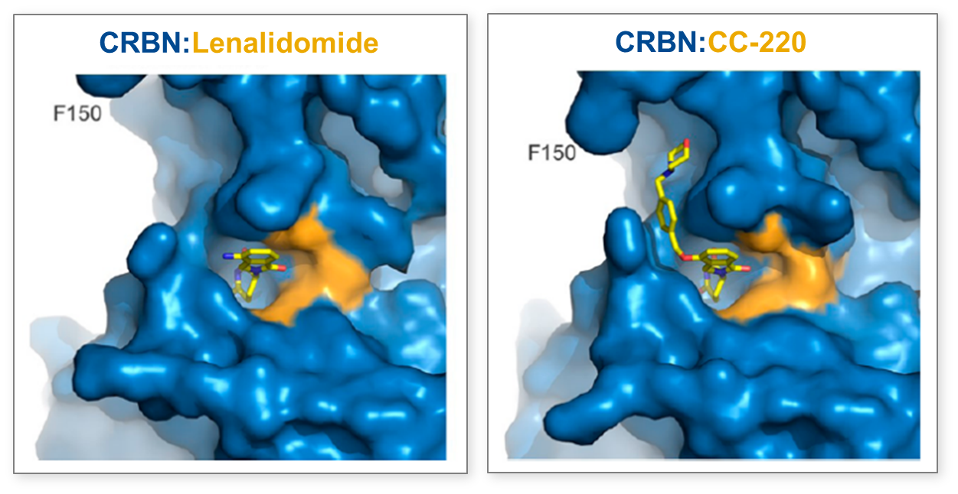
Novel CELMoD® Agent: Iberdomide (preclinical data)
Binding-surface interactions with CRBN
IBER has enhanced affinity for binding to CRBN due to the following:
Rapid protein degradation
Increased depth of protein degradation
At lower concentrations than needed with LEN or POM
→ Increased efficacy in preclinical studies
CRBN: LEN
CRBN: IBER
In preclinical models,
IBER is a novel CELMoD® agent that:
Co-opts CRBN to enable enhanced degradation of target proteins; 20 times higher affinity than LEN or POM
Is 20-fold more efficient than LEN
or POM in degrading substrates
EC₅₀, nM | Ikaros | Aiolos
LEN | 67 | 87
POM | 24 | 22
IBER | 1 | 0.5

Slide 6
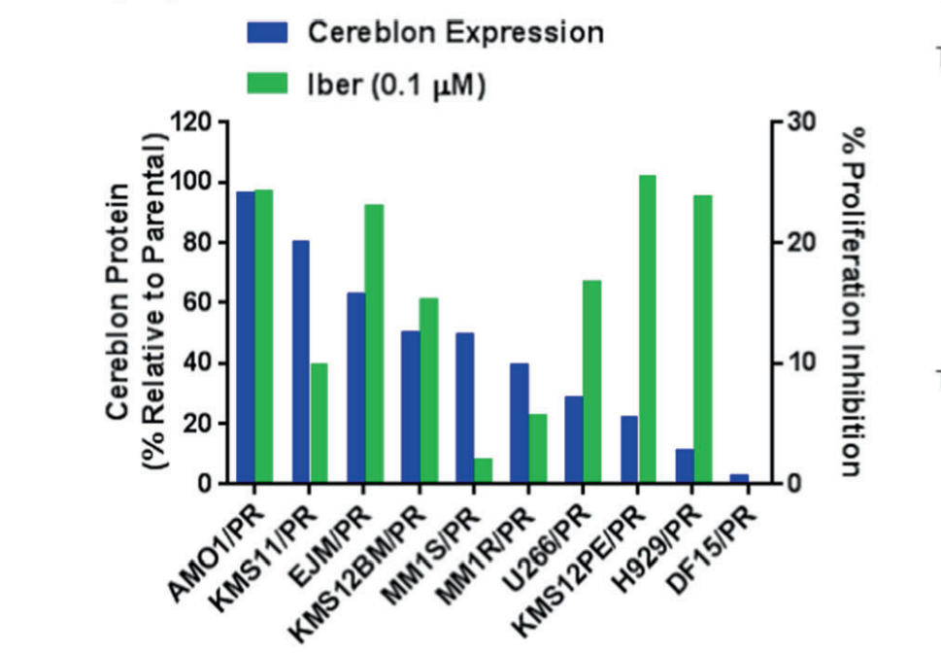
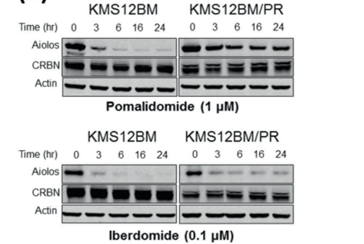
Iberdomide Inhibits Proliferation in POM-Resistant Cell Lines
KMS12BM
KMS12BMª
120
30
Time (h)
0
3
6
16
24
0
3
6
16
24
CRBN expression
IBER (0.1 µM)
Aiolos
100
CRBN
80
20
Actin
CRBN protein
(% relative to parental)
60
Proliferation inhibition (%)
POM (1 µM)
40
10
KMS12BM
KMS12BMª
20
Time (h)
0
3
6
16
24
0
3
6
16
24
Aiolos
0
0
CRBN
AMO1ª
KMS11ª
EJMª
H929ª
KMS12BMª
DF15ª
MM1Sª
MM1Rª
U266ª
Actin
KMS12PEª
IBER (0.1 µM)
POM-resistant cell lines have lower CRBN levels;
some also have mutations in the CRBN gene

Slide 7
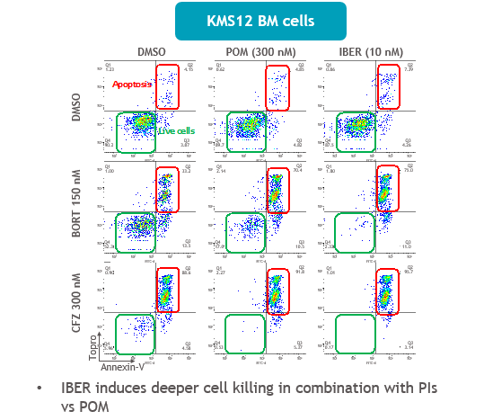
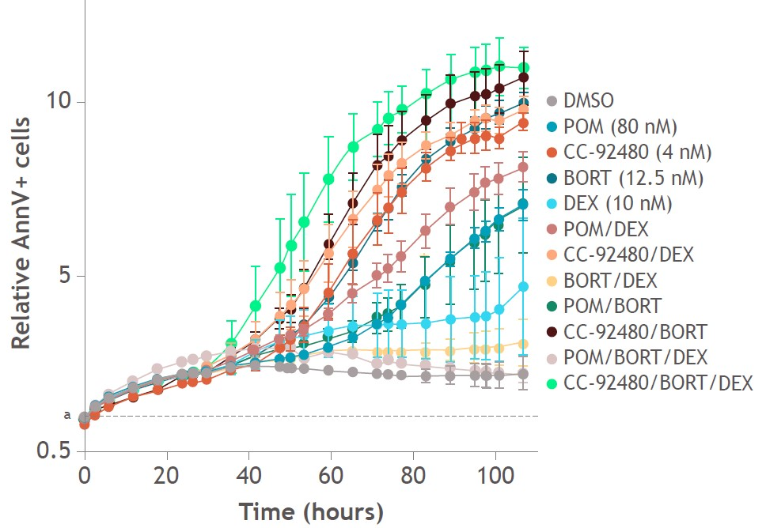
Iberdomide (IBER) and Mezigdomide (CC-92480) Synergize With Other Anti-Myeloma Agents
Preclinical studies indicate that IBER and mezigdomide synergize with other anti-MM agents including PIs and DARA, demonstrating deep induction of apoptosis and enhanced antibody-dependent cellular cytotoxicity
KMS12 BM cells
Pro-apoptosis
CC-92480 increased induction of apoptosis compared with POM (40% vs 20%)
IBER induces deeper cell killing in combination with PIs vs POM

Slide 8
Take Home Points
All IMiDs and CELMoDs® bind Ikaros family of zinc-finger proteins (IKZF1 Ikaros zinc-finger protein 1 and IKZF3 Aiolos zinc-finger protein 3)
Iberdomide has a higher affinity than either lenalidomide or pomalidomide for CRBN and more potently degrades IKZF1 and IKZF3
CC-92480 has a unique and rapid degradation profile stemming from the enhanced efficiency to drive the formation of a protein-protein interaction between Ikaros and Aiolos and CRBN
Both iberdomide and mezigdomide induce cytotoxic effects in a CRBN-dependent fashion that ultimately leads to the induction of apoptosis—even in the context of low or mutated CRBN protein

