Slide 1
Emerging Iberdomide-Based Combinations in Multiple Myeloma
Sagar Lonial, MD
Chair and Professor
Department of Hematology and Medical Oncology
Chief Medical Officer, Winship Cancer Institute
Emory University School of Medicine
Atlanta, GA

Slide 2
Disclaimer
The views and opinions expressed in this educational activity are those of the faculty and do not necessarily represent the views of TotalCME, Inc., the CME providers, or the companies providing educational grants. This presentation is not intended to define an exclusive course of patient management; the participant should use their clinical judgment, knowledge, experience, and diagnostic skills in applying or adopting for professional use any of the information provided herein. Any procedures, medications, or other courses of diagnosis or treatment discussed or suggested in this activity should not be used by clinicians without evaluation of their patient's conditions and possible contraindications or dangers in use, review of any applicable manufacturer’s product information, and comparison with recommendations of other authorities. Links to other sites may be provided as additional sources of information.

Slide 3
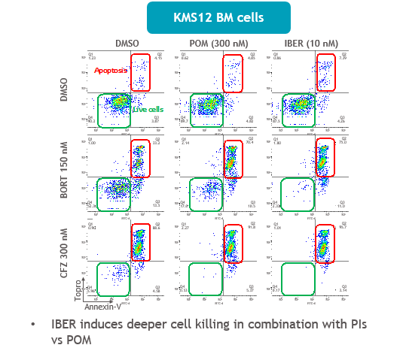
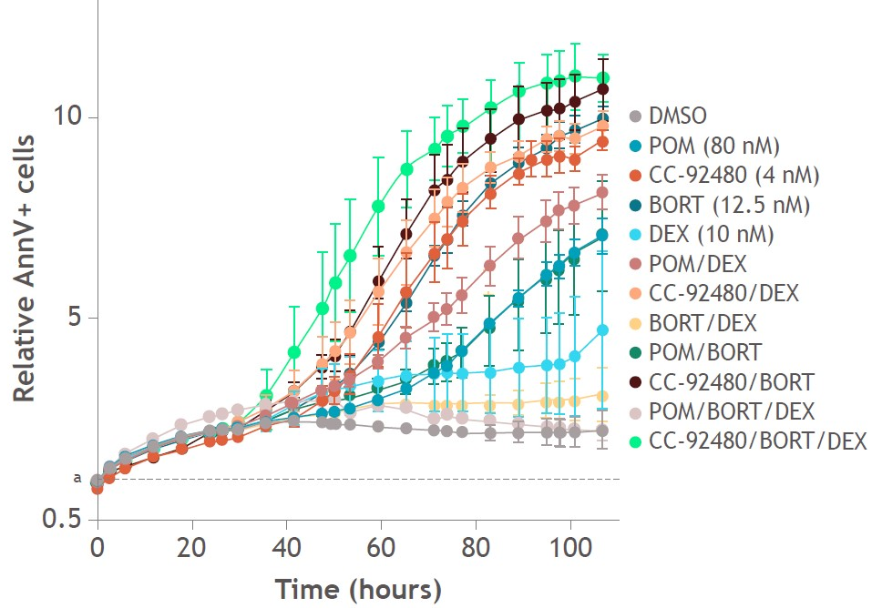
Iberdomide (IBER) and Mezigdomide (CC-92480) Synergize with Other Anti-Myeloma Agents
Preclinical studies indicate that IBER and mezigdomide synergize with other anti-MM agents including PIs and DARA, demonstrating deep induction of apoptosis and enhanced antibody-dependent cellular cytotoxicity
KMS12 BM cells
Pro-apoptosis
CC-92480 increased induction of apoptosis compared with POM (40% vs 20%)
IBER induces deeper cell killing in combination with PIs vs POM

Slide 4
CC-220-MM-001: Iberdomide in Combination with DEX and DARA, BORT, or CFZ (Cohorts E, F and G) in Patients with RRMM
ORRª
45.9%
ORRª
56.0%
ORRª
50.0%
IBER + DEX in combination with DARA or BORT or CFZ showed a favourable safety profile in patients with heavily pretreated RRMM; TEAEs were mainly haematologic and well manageable
The RP2D was determined at 1.6 mg in the IberDd cohort, while dose evaluation continues in the IberVd and IberKd cohorts
Efficacy was observed even among patients refractory to IMiD® agents, DARA, and PIs
CBR
54.1%
CBR
64.0%
CBR
50.0%
DCR
89.2%
DCR
88.0%
DCR
87.5%

Slide 5
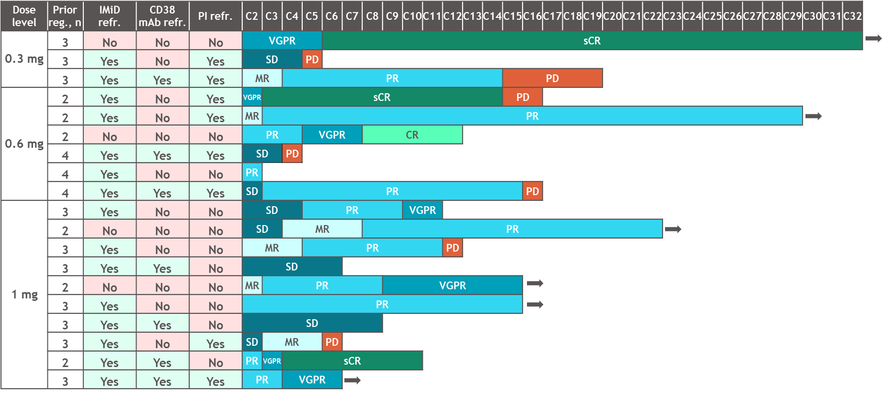
CC-92480-MM-002: Mezigdomide (CC-92480) + BORT + DEX
Response
ORRª 73.7%
CBR
78.9%
sCR
CR
VGPR
PR
MR
SD
PD
On treatment
at time of
data cut-off
Median time to response was 1.17 (range, 0.7–4.9) months and median DOR was 10.4 (95% CI, 9.5–NR) months

Slide 6
CELMoD® Based Combinations
Clear preclinical synergy with common multiple myeloma agents
Clinical trial suggests that iberdomide combinations are active and safe
Clinical trial suggests that mezigdomide (CC-92480) combinations are active and safe

