Slide 1
How Does the Safety and Tolerability With Iberdomide Compare to Current IMiD Therapies?
Krina Patel, MD, MSc
Associate Professor
UT MD Anderson Cancer Center
Houston, Texas

Slide 2
Disclaimer
The views and opinions expressed in this educational activity are those of the faculty and do not necessarily represent the views of TotalCME, Inc., the CME providers, or the companies providing educational grants. This presentation is not intended to define an exclusive course of patient management; the participant should use their clinical judgment, knowledge, experience, and diagnostic skills in applying or adopting for professional use any of the information provided herein. Any procedures, medications, or other courses of diagnosis or treatment discussed or suggested in this activity should not be used by clinicians without evaluation of their patient's conditions and possible contraindications or dangers in use, review of any applicable manufacturer’s product information, and comparison with recommendations of other authorities. Links to other sites may be provided as additional sources of information.

Slide 3
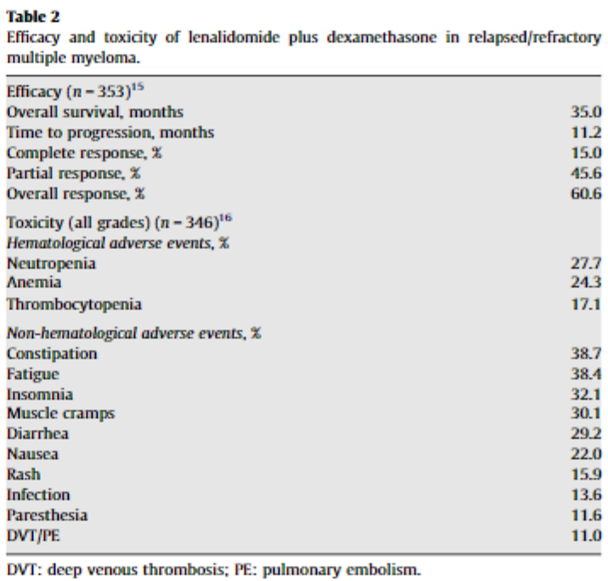
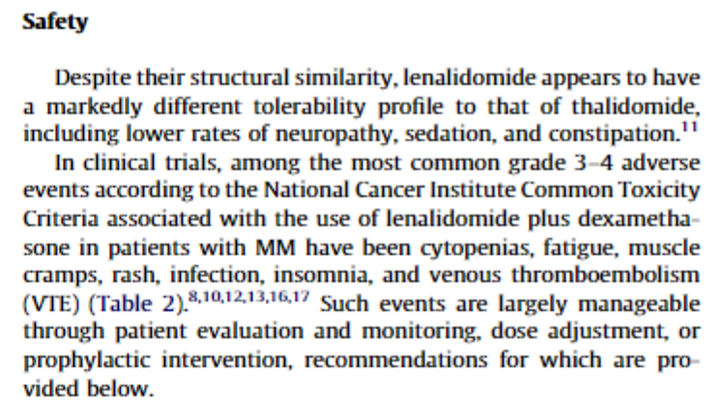
Lenalidomide and Pomalidomide TEAEs
 | Pomalidomide plus low-dose dexamethasone (n=300)
 | Total | Grade 3 | Grade 4 | Grades
Infections and infestations | 203 (68%) | 72 (24%) | 19 (6%) | 11 (4%)
Anaemia | 157 (52%) | 93 (31%) | 6 (2%) | **
Neutropenia | 152 (51%) | 77 (26%) | 66 (22%) | **
Fatigue | 103 (34%) | 16 (5%) | ** | **
Thrombocytopenia | 90 (30%) | 27 (9%) | 40 (13%) | **
Pyrexia | 80 (27%) | 8 (3%) | 1 (<1%) | **
Diarrhoea | 66 (22%) | 3 (1%) | ** | **
Constipation | 65 (22%) | 7 (2%) | ** | **
Cough | 61 (20%) | 1 (<1%) | 1 (<1%) | **
Back pain | 59 (20%) | 13 (4%) | 2 (1%) | **
Dyspnoea | 59 (20%) | 13 (4%) | 2 (1%) | **
Bone pain | 52 (17%) | 20 (7%) | 1 (<1%) | **
Peripheral oedema | 52 (17%) | 4 (1%) | ** | **
Upper respiratory tract infection | 48 (16%) | 5 (2%) | ** | **
Asthenia | 48 (16%) | 10 (3%) | 1 (<1%) | **
Muscle spasms | 47 (16%) | 1 (<1%) | ** | **
Pneumonia | 46 (15%) | 30 (10%) | 8 (3%) | 4 (1%)
Nausea | 45 (15%) | 2 (1%) | ** | **
Leukopenia | 38 (13%) | 20 (7%) | 6 (2%) | **
Dizziness | 37 (12%) | 4 (1%) | ** | **
Decreased appetite | 36 (12%) | 2 (1%) | ** | **
Insomnia | 31 (10%) | 3 (1%) | ** | **
Bronchitis | 30 (10%) | 3 (1%) | ** | **
Febrile neutropenia | 29 (10%) | 23 (8%) | 5 (2%) | **
Epistaxis | 28 (9%) | 2 (<1%) | 1 (<1%) | **
Hypercalcaemia | 21 (7%) | 6 (2%) | 7 (2%) | **
Muscle weakness | 11 (4%) | 3 (1%) | ** | **

Slide 4
CC-220-MM-001: Response Rates and Safety
ORRª 31.9%
ORRª 33.3%
ORRª 32.4%
Common (> 20% all grade) TEAEs and events of interest, n (%) | Cohort B (IBER + DEX) (N = 75)
 | All grade | Grade 3 | Grade 4
Anaemia | 32 (42.7) | 20 (26.7) | 1 (1.3)
Neutropenia | 30 (40.0) | 13 (17.3) | 12 (16.0)
Febrile neutropenia | 4 (5.3) | 4 (5.3) | 0
Thrombocytopenia | 13 (17.3) | 3 (4.0) | 5 (6.7)
Infection | 38 (50.7) | 16 (21.3) | 1 (1.3)
Fatigue | 26 (34.7) | 0 | 1 (1.3)
Insomnia | 23 (30.7) | 0 | 0
Back pain | 16 (21.3) | 6 (8.0) | 0
Muscle spasms | 15 (20.0) | 0 | 0
Diarrhoea | 15 (20.0) | 0 | 0
Constipation | 11 (14.7) | 1 (1.3) | 0
Peripheral sensory neuropathy | 4 (5.3) | 1 (1.3) | 0
Deep vein thrombosis | 1 (1.3) | 0 | 0
Pulmonary embolism | 1 (1.3) | 1 (1.3) | 0
100
3 (4.3)
3 (4.5)
2 (5.4)
VGPR
PR
MR
80
19 (27.5)
19 (28.8)
10 (27.0)
SD
PD
60
10 (14.5)
9 (13.6)
4 (10.8)
Response, n (%)
40
15 (40.5)
26 (37.7)
25 (37.9)
20
11 (15.9)
10 (15.2)
6 (16.2)
0
All evaluable (n = 69)
IMiD®-agent refractory^{b} (n = 66)
Quad-class refractory^{c} (n = 37)

Slide 5
TEAEs: Iberdomide in Combination with DEX and DARA, BORT, or CFZ (Cohorts E, F and G) in Patients With RRMM
TEAEs of interest, n (%) | Grade ≥ 3
TEAEs of interest, n (%) | IberDd (N = 39)ª | IberVd (N = 25) | IberKd (N = 9)
Haematological
Neutropenia | 26 (66.7) | 7 (28.0) | 3 (33.3)
Febrile neutropenia^{b} | 2 (5.1) | 0 | 0
Thrombocytopenia | 5 (12.8) | 6 (24.0) | 1 (11.1)
Anaemia | 8 (20.5) | 3 (12.0) | 0
Non-haematological
Fatigue | 1 (2.6) | 0 | 1 (11.1)
Diarrhoea | 1 (2.6) | 1 (4.0) | 0
Constipation | 0 | 0 | 0
Infusion-related reaction | 0 | - | -
Peripheral neuropathy^{c} | 0 | 0 | 0
Rash | 0 | 1 (4.0) | -
Thrombotic event^{d} | 0 | 0 | 0
Infections | 6 (15.4) | 5 (20.0) | 3 (33.3)
Upper respiratory tract infection | 0 | 2 (8.0) | 0

Slide 6
Take Home Point
CELMods® are safe and may have a favorable profile compared to IMIDs for certain toxicities such as neutropenia
Combination with other therapies increases grade 3 and 4 toxicity; however, this remains manageable
Hematological AEs and infections were the most common and were overall treatable

