Slide 1
How Effective is CC-92480 Monotherapy or in Combination in RRMM?
Krina Patel, MD, MSc
Associate Professor
UT MD Anderson Cancer Center
Houston, Texas

Slide 2
Disclaimer
The views and opinions expressed in this educational activity are those of the faculty and do not necessarily represent the views of TotalCME, Inc., the CME providers, or the companies providing educational grants. This presentation is not intended to define an exclusive course of patient management; the participant should use their clinical judgment, knowledge, experience, and diagnostic skills in applying or adopting for professional use any of the information provided herein. Any procedures, medications, or other courses of diagnosis or treatment discussed or suggested in this activity should not be used by clinicians without evaluation of their patient's conditions and possible contraindications or dangers in use, review of any applicable manufacturer’s product information, and comparison with recommendations of other authorities. Links to other sites may be provided as additional sources of information.

Slide 3
CC-92480-MM-001 Phase 1 Trial: Mezigdomide (CC-92480) + DEX Study Design
Part 1: Dose Escalation
Key Eligibility Criteria
RRMM
Resistant, intolerant to, or not otherwise candidates for currently available therapiesª
PD on or within 60 days of last anti-myeloma therapy
10/14 days × 2
Continuous
schedules
CC-92480^{b} QD + DEX^{c}
21/28 days
CC-92480^{b} QD + DEX^{c}
Part 2: Cohort Expansion
Study Endpoints
Primary:
Assess PK and safety, and define the MTD/RP2D
Secondary:
Assess preliminary efficacy
3/14 days × 2
Intensive
schedules
CC-92480^{b} QD + DEX^{c}
7/14 days × 2
CC-92480^{b} BID/QD + DEX^{c}

Slide 4
CC-92480-MM-001: Prior Therapies
Characteristics | Safety population (N = 76)ª
Prior lines of therapies, median (range), n | 6 (2–13)
ASCT, n (%) | 58 (76.3)
PI, n (%) | 76 (100)
LEN, n (%) | 74 (97.4)
POM, n (%) | 70 (92.1)
Anti-CD38 mAb, n (%) | 57 (75.0)
LEN refractory, n (%) | 56 (73.7)
POM refractory, n (%) | 60 (78.9)
IMiD®-agent refractory,^{b} n (%) | 68 (89.5)
PI refractory, n (%) | 56 (73.7)
Anti-CD38-mAb refractory, n (%) | 53 (69.7)
Triple-class refractory,^{c} n (%) | 38 (50.0)

Slide 5
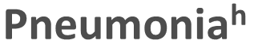
CC-92480-MM-001: Efficacy and Safety in Patients With Heavily Pretreated RRMM
ORRª 21.1%
ORRª 40.0%
ORRª 54.5%
Common (> 20% all grade) TEAEs and events of interest, n (%) | All doses (N = 76)
 | Grade 3 | Grade 4
Neutropenia | 23 (30.3) | 26 (34.2)
Febrile neutropenia | 4 (5.3) | 1 (1.3)
Anaemia | 24 (31.6) | –
Thrombocytopenia | 5 (6.6) | 7 (9.2)
Fatigue | 7 (9.2) | –
Pyrexia | 3 (3.9) | –
Peripheral sensory neuropathy | – | –
Diarrhoea | 1 (1.3) | –
Nausea | 1 (1.3) | –
Deep vein thrombosis | – | –
Infections | 25 (32.9) | 2 (2.6)
Pneumonia^{h} | 11 (14.5) | –
CBR^{e}
26.3%
CBR^{e}
50.0%
CBR^{e}
63.6%
DCR^{f}
75.0%
DCR^{f}
100%
DCR^{f}
100%
Prophylactic G-CSF was not permitted during C1
Neutropenia was managed with dose interruption/reduction and G-CSF
Dose reduction of CC-92480 occurred in 17 (22.4%) patients
No patients discontinued due to treatment-related AEs
MTD
RP2D

Slide 6
CC-92480-MM-001: Responders (PR or Better) by Dose Level
Majority of responders were dual IMiD®-agent refractoryª (10/16 [63%] patients)
Dosing schedule | Dose level | POM refractory | Anti-CD38-mAb refractory | C2 | C3 |  |  |  | C4 |  |  |  | C5 |  |  |  | C6 |  |  |  | C7 |  |  |  | C8 |  |  |  | C9 |  |  |  | C10 |  |  |  | C11 |  |  |  | C12 |  |  |  | C13
10/14 days × 2 | 0.6 mg QD | No | No | MR |  |  |  |  |  |  |  |  |  |  |  |  |  |  |  |  |  |  |  |  |  |  |  |  | PR
 | 1.0 mg QD | No | No | VGPR |  |  |  |  |  |  |  |  | PD
 |  | No | Yes | MR | PR |  |  |  |  |  |  |  |  |  |  |  |  | VGPR
 |  | Yes | Yes | SD |  |  |  |  |  |  |  |  | PR
 |  | Yes | No | SD |  |  |  |  | PR
21/28 days | 0.8 mg QD | Yes | Yes | PR
 |  | Yes | Yes | PR
 | 1.0 mg QD | Yes | Yes | PR |  |  |  |  |  | PD
 |  | No | Yes | SD |  | PR |  |  |  |  | VGPR
 |  | Yes | No | VGPR
 |  | Yes | Yes | PR |  | VGPR |  |  |  |  |  |  |  |  |  | CR
 |  | Yes | No | PR
 |  | Yes | Yes | PR
7/14 days × 2^{d} | 0.8 mg BID | No | No | VGPR |  |  |  | PD
 |  | Yes | Yes | VGPR
 | 1.6 mg QD | Yes | Yes | SD | MR |  |  |  |  |  |  |  |  |  |  |  |  |  |  |  | PR
CR
VGPR^{b}
PR^{c}
MR
SD
PD
On treatment at time of
data cut-off

Slide 7
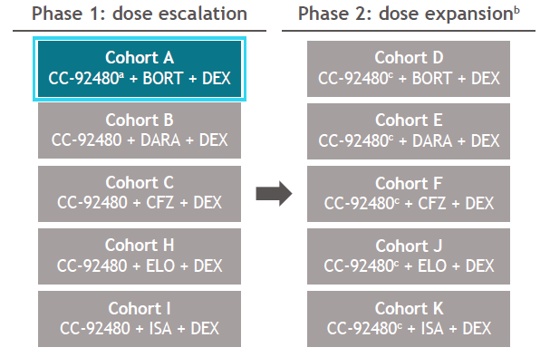
CC-92480-MM-002¹ Phase 1/2 trial: Mezigdomide (CC-92480) + BORT + DEX Study Design
Treatment Schedule for the Mezigdomide + BORT + DEX cohort
Key Eligibility Criteria
RRMM
2-4 prior regimens
Prior treatment with LEN
PD during or after the last anti-myeloma therapy
Oral CC-92480 at specified cohort dose on D1–14, followed by a seven-day resting period
1.0 mg
n = 10
0.6 mg
n = 6
0.3 mg
n = 3
Study Endpoints
Primary:
Determine MTD/RP2D, evaluate preliminary safety and efficacy of CC-02480 + BORT + DEX
Secondary:
Evaluate additional efficacy measures
21-day cycles
s.c. BORT at a starting dose of 1.3 mg/m² on D1, 4, 8, and 11 (C1–8) and on D1 and 8 (C ≥ 9)
Oral DEX at 20 mg/day (10 mg/day if > 75 years of age) on D1, 2, 4, 5, 8, 9, 11, and 12 (C1–8) and on D1, 2, 8, and 9 (C ≥ 9)

Slide 8
CC-92480-MM-002: Prior Therapies and Refractory Status Mezigdomide (CC-92480) + BORT + DEX
Characteristics | All patients (N = 19)
Prior therapies, median (range), n | 3 (2–4)
Stem cell transplant, n (%) | 11 (57.9)
PI, n (%) | 18 (94.7)
IMiD® agent, n (%) | 19 (100)
POM, n (%) | 9 (47.4)
CD38 mAb, n (%) | 7 (36.8)
IMiD®-agent refractory, n (%) | 15 (78.9)
LEN refractory | 15 (78.9)
POM refractory | 8 (42.1)
PI refractory, n (%) | 8 (42.1)
IXA refractory | 5 (26.3)
BORT refractory | 3 (15.8)
CFZ refractory | 2 (10.5)
CD38 mAb refractory, n (%) | 7 (36.8)
Triple-class refractory,ª n (%) | 4 (21.1)

Slide 9
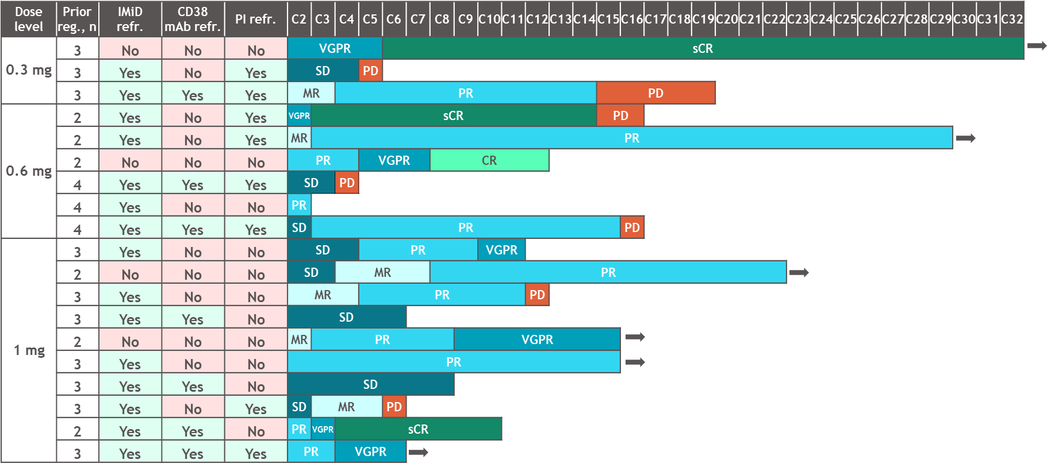
CC-92480-MM-002: Response Mezigdomide (CC-92480) + BORT + DEX
ORRª 73.7%
CBR
78.9%
sCR
CR
VGPR
PR
MR
SD
PD
On treatment at time of
data cut-off
Median time to response was 1.17 (range, 0.7–4.9) months and median DOR was 10.4 (95% CI, 9.5–NR) months
CC-92480-MM-002
Phase 1/2: 480/DEX in combination with either BORT, CFZ, DARA, ISA, ELO

Slide 10
Take Home Point
Mezigdomide in doublet and triplet combinations is safe and has efficacy even in IMID refractory patients

