Slide 1
Supportive Care Only for RSV in 2023– Can We Do Better?
Priya Soni, MD, FAAP
Assistant Professor
Pediatric Infectious Diseases
Cedars-Sinai Medical Center
Assistant Clinical Professor Step II, Pediatric Infectious Diseases
David Geffen School of Medicine (UCLA)
Los Angeles, CA

Slide 2
Disclaimer
The views and opinions expressed in this educational activity are those of the faculty and do not necessarily represent the views of TotalCME, Inc., the CME providers, or the companies providing educational grants. This presentation is not intended to define an exclusive course of patient management; the participant should use their clinical judgment, knowledge, experience, and diagnostic skills in applying or adopting for professional use any of the information provided herein. Any procedures, medications, or other courses of diagnosis or treatment discussed or suggested in this activity should not be used by clinicians without evaluation of their patient's conditions and possible contraindications or dangers in use, review of any applicable manufacturer’s product information, and comparison with recommendations of other authorities. Links to other sites may be provided as additional sources of information.

Slide 3
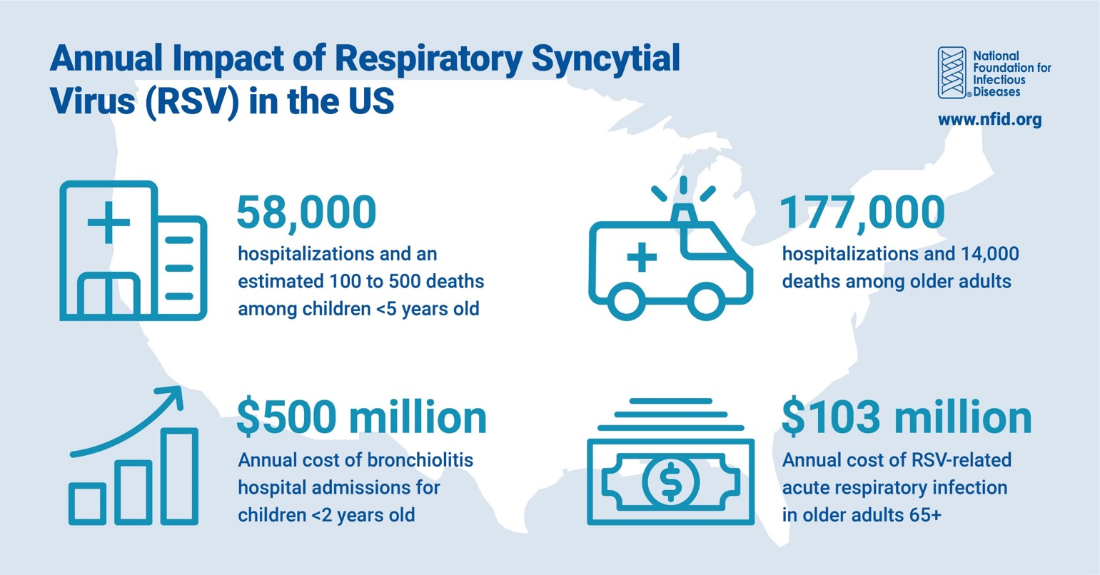
Burden of Infection Across Age Groups
RSV, respiratory syncytial virus.
National Foundation for Infectious Diseases. www.nfid.org. Accessed Mar 2023.

Slide 4
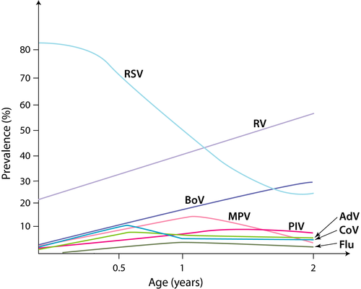
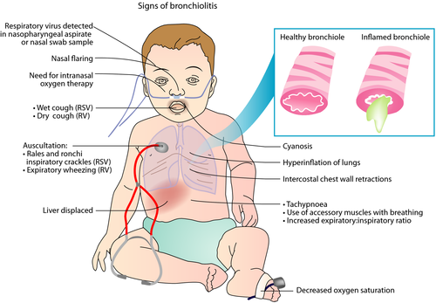
Main Cause of Bronchiolitis in Infants: RSV
AdV: adenovirus; BoV: human bocavirus 1; CoV: coronavirus MPV: metapneumovirus; PIV: parainfluenza virus; RV: rhinovirus.
Jartti T, et al. Allergy. 2019;74:40-52.

Slide 5
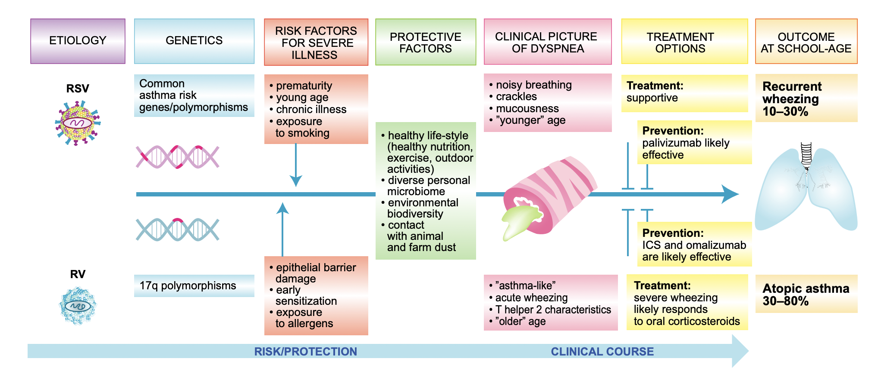
Treatment for RSV is Mainly Supportive
Jartti T, et al. Allergy. 2019;74:40-52.

Slide 6
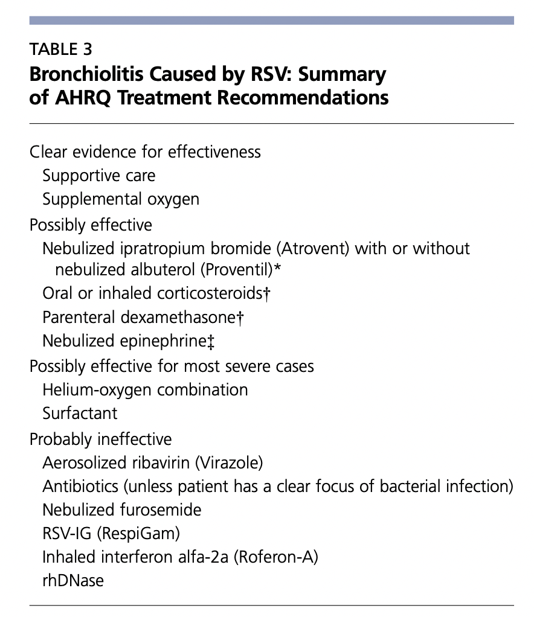
Clinical Management: Assessing Efficacy for Treatment and Agents for Bronchiolitis Management via Agency for Healthcare Research and Quality (AHRQ)
Key Takeaways:
Strategies have focused on prevention and prophylaxis with monoclonal antibody administration of Palivizumab (for high-risk infants during RSV season)
Nebulized epinephrine therapy has not been known to decrease length of stay
Chest physiotherapy or inhaled bronchodilators not recommended
Antibiotics not recommended
*Evidence of modest short-term improvement only.
†Not recommended by the American Academy of Pediatrics; patients with atopy may benefit most.
**A randomized clinical trial12 published after the AHRQ’s evidence report found no benefit with nebulized epinephrine.
Adapted from Agency for Healthcare Research and Quality. Management of bronchiolitis in infants and children. Evidence report/technology assessment: number 69. Rockville, Md.: Agency for Healthcare Research and Quality, 2003.
AHRQ, Agency for Healthcare Research and Quality; rhDNase, recombinant human deoxyribonuclease; RSV-IG, intravenous respiratory syncytial virus immune globulin.
Smith DK, et al. Am Fam Physician. 2017;95(2):94-9; Steiner RWP. Am Fam Physician. 2004;69(2):325-30.

Slide 7
Supportive Measures Provided with In-patient Management of RSV:
Respiratory Support
Nasal Suctioning
Fluid Management

Slide 8
Respiratory Support
Supplemental oxygen support to maintain O2 saturation >90-92% on RA
Modalities:
  Heated HFNC (High-flow nasal cannula) – also known as high-flow warm humidified oxygen
  CPAP
Goals:
  Reduce the work of breathing, improve gas exchange exchange, and avoid endotracheal intubation in infants with bronchiolitis at risk for progression to respiratory failure
CPAP, continuous positive airway pressure; HFNC, high-flow nasal cannula; RA, right atrium.

Slide 9
Respiratory Failure → Endotracheal Intubation
Worsening respiratory distress despite HFNC and/or CPAP; those who have hypoxemia despite O2 supplementation
Signs of impending respiratory failure:
  Marked retractions
  Decreased or absent breath sounds
  Fatigue
  Poor response to stimulation (ie, – weak or no cry)
  Arterial or venous blood gas in infants often show hypercapnia (CO2 >55 mmHg [arterial sample], or >60 mmHg [venous sample])

Slide 10
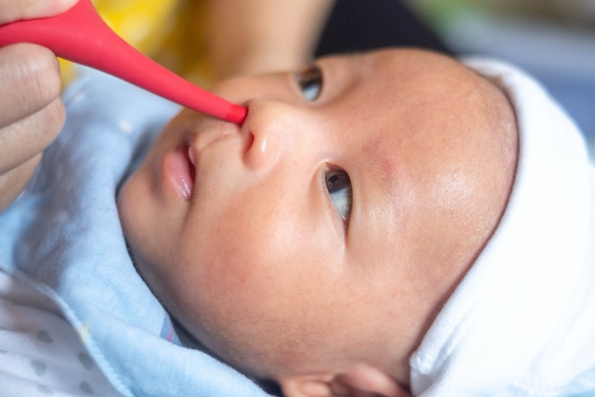
Nasal Suctioning
Nasal suctioning before each feeding and inhalation therapy
are helpful
Normal saline nasal drops may
be used before suctioning
Before discharge, parents and other caregivers should be taught proper suctioning techniques for at-home care
Mussman GM, et al. JAMA Pediatr. 2013;167(5):414-21.

Slide 11
Fluid Management
Increased fluid requirements related to fever and tachypnea and decreased intake (related to tachypnea and respiratory distress) in young infants with RSV
Maintenance of fluids is KEY
Exclusive IV fluid administration –
  Ensures adequate hydration
  Avoids the risk of aspiration in infants with RSV bronchiolitis who are on oxygen and may not tolerate OG tube feeding
Monitoring intake/output is crucial – fluid overload should be avoided as it will lead to pulmonary congestion and worse outcomes
OG, orogastric.

Slide 12
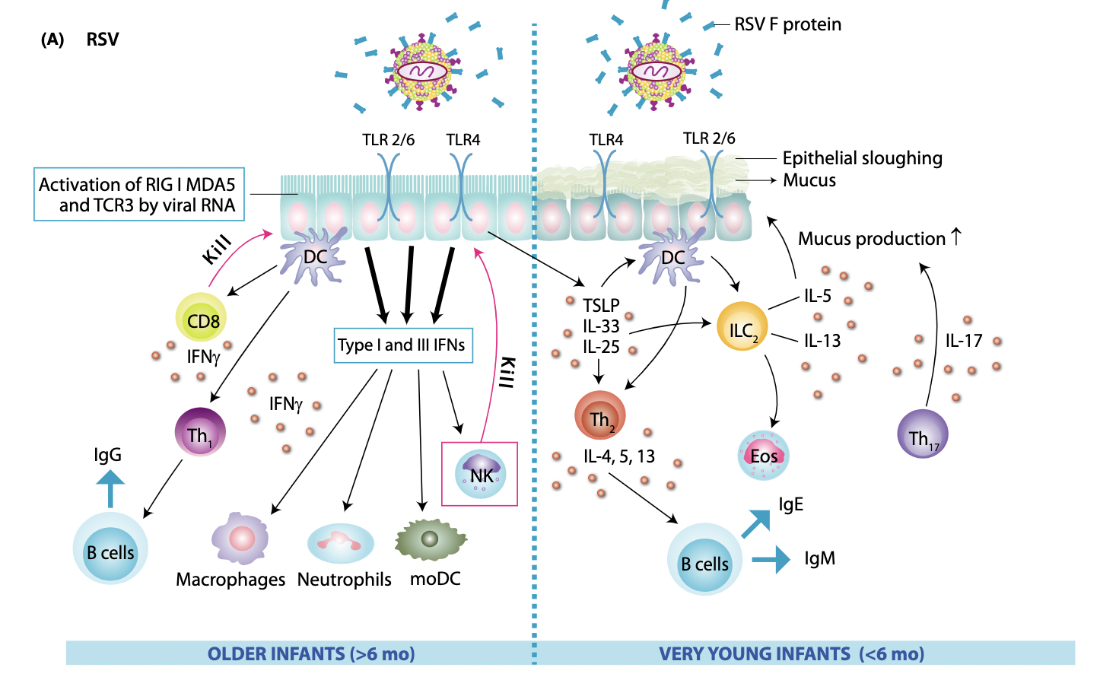
RSV in Infants
< 6 Months of Age:
DC, dendritic cell; Eos, eosinophil; IFN, interferon; Ig, immunoglobulin; IL, interleukin; ILC, innate lymphoid cell; moDC, monocyte-derived dendritic cell; NK, natural killer; TH1, type I helper T cell; TH2, type II helper T cell; TLR, toll-like receptor; TSLP, thymic stromal lymphopoietin.
Jartti T, et al. Allergy. 2019;74:40-52.

Slide 13
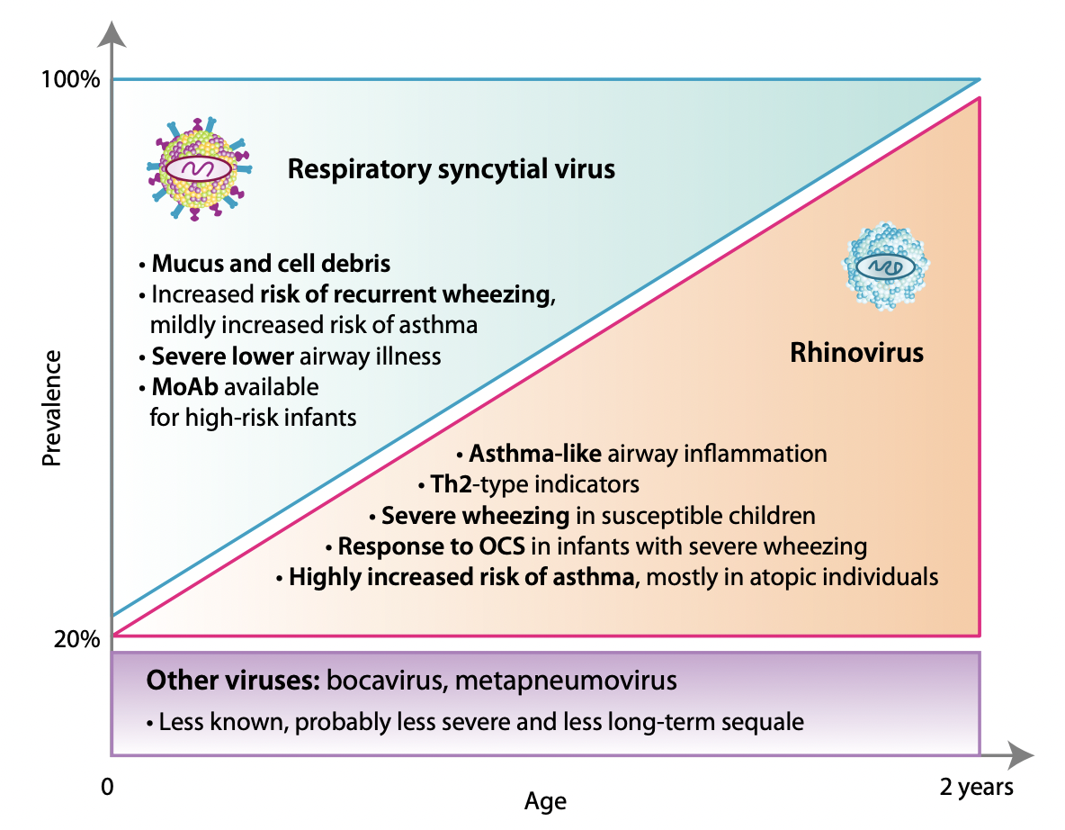
Long-Term Implications of Early RSV Disease
MoAb, monocolonal antibody; OCS, oral corticosteroid; Th, T helper cell.
Jartti T, et al. Allergy. 2019;74:40-52.

Slide 14
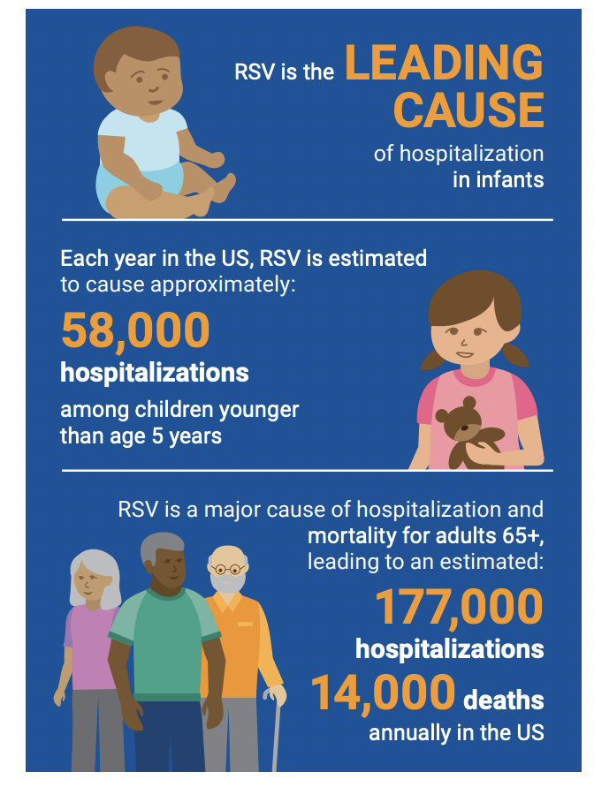
Supportive Care Alone Is Insufficient
Key Strategic Priorities
Substantial gaps and controversies exist in the management of RSV bronchiolitis in infants
Majority of clinical trials have not been based on virus-specific data; further research is required in order to direct focus on more personalized management plans for RSV
National Foundation for Infectious Disease. 2022. www.nfid.org/wp-content/uploads/2022/04/NFID-RSV-Call-to-Action.pdf. Accessed Mar 2023.

