Slide 1
Addressing PH Subtypes: Raising Awareness of Understudied Populations
Richard Krasuski, MD
Professor of Medicine and Pediatrics
Director, Adult Congenital Heart Disease Center
Director, Hemodynamic Research
Director, Interventional CTEPH Program
Duke University Medical Center
Durham, NC

Slide 2
Disclaimer
The views and opinions expressed in this educational activity are those of the faculty and do not necessarily represent the views of TotalCME, Inc., the CME providers, or the companies providing educational grants. This presentation is not intended to define an exclusive course of patient management; the participant should use their clinical judgment, knowledge, experience, and diagnostic skills in applying or adopting for professional use any of the information provided herein. Any procedures, medications, or other courses of diagnosis or treatment discussed or suggested in this activity should not be used by clinicians without evaluation of their patient's conditions and possible contraindications or dangers in use, review of any applicable manufacturer’s product information, and comparison with recommendations of other authorities. Links to other sites may be provided as additional sources of information.

Slide 3
Learning Objectives
Review characteristics of PH patient groups that fall outside of the idiopathic category
Discuss the screening, diagnosis and expedient referral of non-idiopathic patients to PH specialty centers from community generalists and specialty healthcare providers
Focus on understudied PH groups that require special diagnostic attention by all healthcare providers
Review treatment and management approaches to these understudied PH patients

Slide 4
The Importance of Referring the
PAH-ACHD Patient to an
Accredited Specialty Center

Slide 5
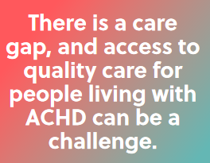

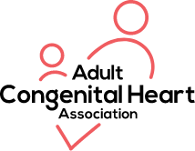
Why Accreditation of ACHD Programs is Important
Ensures a minimum standard of care for a very complicated patient population – fluid process with continuous feedback
Helps identify various specialists in institutions and ensures their participation in care provision
Helps identify gaps in programs and opportunities to improve provision of care
Helps empower patients to select, participate in and influence their own care
47 ACHA ACHD Accredited Centers
in 28 different states in a combination
of both Adult and Pediatric Hospitals
(https://www.achaheart.org/)

Slide 6
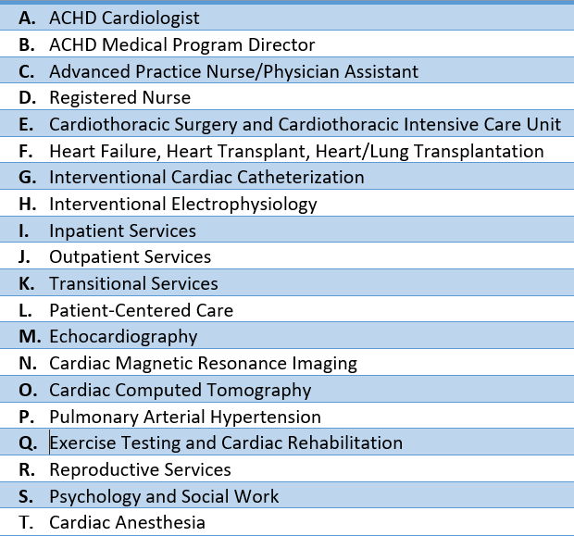
ACHA Accreditation Criteria
20 different categories of criteria
Patients with CHD have unique characteristics that need to be met, not only with regard to their heart issues
Plethora of innovative ways that programs meet patient needs and serve the community
ACHA ACHD Accreditation Steering Committee meets regularly to update criteria
Providers at centers who may not be able to become accredited can use criteria to elevate the level of care at their individual institutions

