Slide 1
Addressing PH Subtypes: Raising Awareness of Understudied Populations
Richard Krasuski, MD
Professor of Medicine and Pediatrics
Director, Adult Congenital Heart Disease Center
Director, Hemodynamic Research
Director, Interventional CTEPH Program
Duke University Medical Center
Durham, NC

Slide 2
Disclaimer
The views and opinions expressed in this educational activity are those of the faculty and do not necessarily represent the views of TotalCME, Inc., the CME providers, or the companies providing educational grants. This presentation is not intended to define an exclusive course of patient management; the participant should use their clinical judgment, knowledge, experience, and diagnostic skills in applying or adopting for professional use any of the information provided herein. Any procedures, medications, or other courses of diagnosis or treatment discussed or suggested in this activity should not be used by clinicians without evaluation of their patient's conditions and possible contraindications or dangers in use, review of any applicable manufacturer’s product information, and comparison with recommendations of other authorities. Links to other sites may be provided as additional sources of information.

Slide 3
Learning Objectives
Review characteristics of PH patient groups that fall outside of the idiopathic category
Discuss the screening, diagnosis and expedient referral of non-idiopathic patients to PH specialty centers from community generalists and specialty healthcare providers
Focus on understudied PH groups that require special diagnostic attention by all healthcare providers
Review treatment and management approaches to these understudied PH patients

Slide 4
Imaging in ACHD-PAH – What the PH/CHD Specialty Center Offers

Slide 5
Imaging of Congenital Heart Disease
Goals of Imaging ACHD patient with PAH
Determine original and current (post-op) anatomical relationships
Assess for residual lesions
Shunts (ASD, VSD, PDA, collaterals)
Valve stenosis or regurgitation
Vascular obstructions (pulmonary arteries and veins, right and left ventricular outflow tracts)
Measure differential pulmonary blood flow
Evaluation of ventricular size, thickness and function
Appraisal for myocardial injury

Slide 6
Imaging of Congenital Heart Disease: Pros and Cons
 | ✓ Pro | ✖ Con
Echocardiography | Noninvasive, No radiation, Readily available, No sedation, Visualization of intracardiac anatomy, Excellent temporal resolution | Poor acoustic windows Poor visualization of extracardiac anatomy
Nuclear Perfusion | Noninvasive, Can quantify pulmonary blood flow | Limited information, Radiation
CT | Noninvasive, Excellent spatial resolution | Radiation, Limited intracardiac anatomy and hemodynamic data
CMR | Noninvasive, No radiation, Can assess intra and extracardiac anatomy, ventricular function and myocardial viability, hemodynamic data, lung perfusion | Not readily available Time consuming Metallic artifact and some devices still contraindicated
Angiography | Visualization of extracardiac anatomy, Hemodynamics, Facilitates interventions | Invasive, Need for sedation, Radiation, Poor visualization of intracardiac anatomy

Slide 7
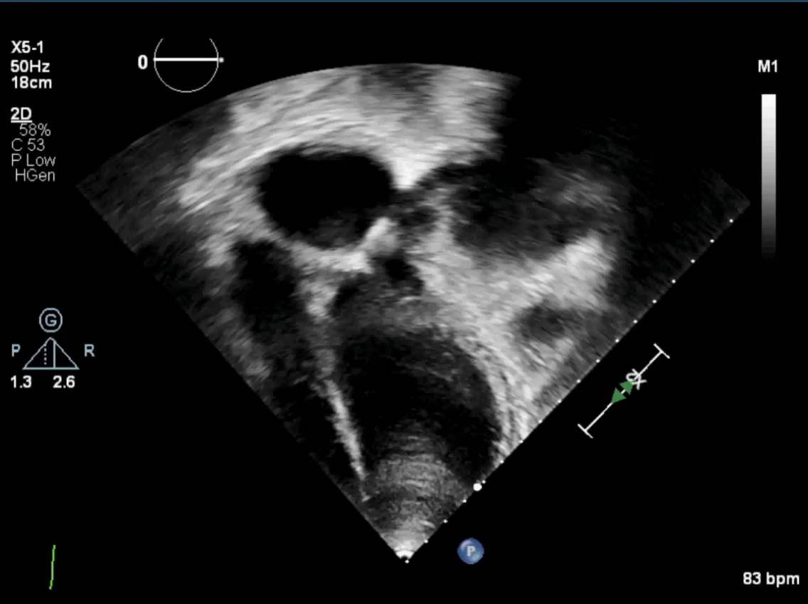
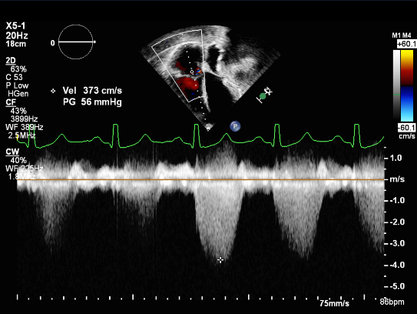
Non-Invasive Imaging: Echocardiography

Slide 8
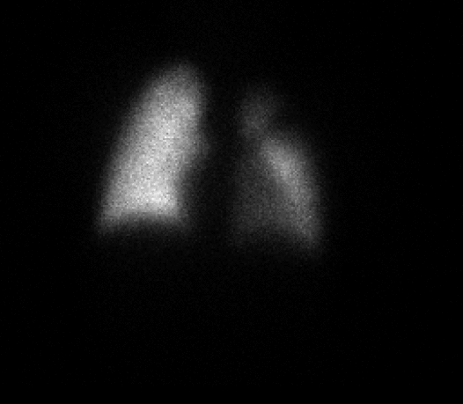
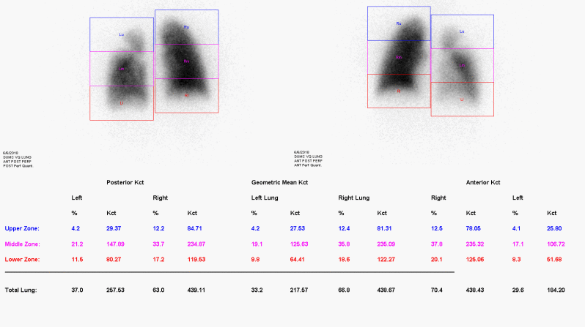
Non-Invasive Imaging: Nuclear Perfusion Scan

Slide 9
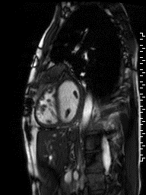
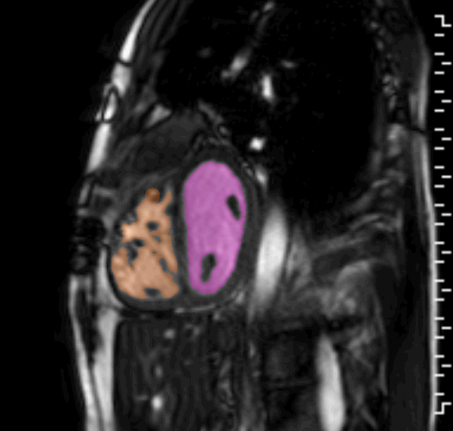
Non-Invasive Imaging: CMRI/CT

Slide 10
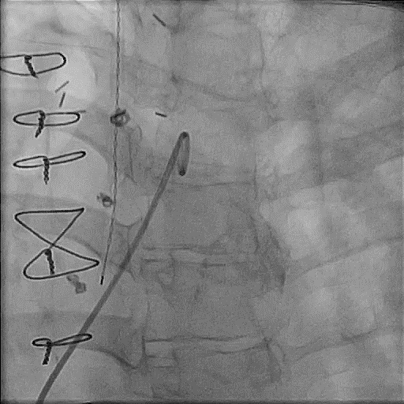
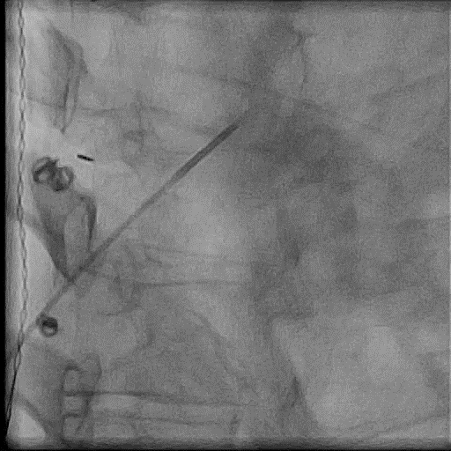
Selective Pulmonary Angiography

