Slide 1
Addressing PH Subtypes: Raising Awareness of Understudied Populations
Richard Krasuski, MD
Professor of Medicine and Pediatrics
Director, Adult Congenital Heart Disease Center
Director, Hemodynamic Research
Director, Interventional CTEPH Program
Duke University Medical Center
Durham, NC

Slide 2
Disclaimer
The views and opinions expressed in this educational activity are those of the faculty and do not necessarily represent the views of TotalCME, Inc., the CME providers, or the companies providing educational grants. This presentation is not intended to define an exclusive course of patient management; the participant should use their clinical judgment, knowledge, experience, and diagnostic skills in applying or adopting for professional use any of the information provided herein. Any procedures, medications, or other courses of diagnosis or treatment discussed or suggested in this activity should not be used by clinicians without evaluation of their patient's conditions and possible contraindications or dangers in use, review of any applicable manufacturer’s product information, and comparison with recommendations of other authorities. Links to other sites may be provided as additional sources of information.

Slide 3
Learning Objectives
Review characteristics of PH patient groups that fall outside of the idiopathic category
Discuss the screening, diagnosis and expedient referral of non-idiopathic patients to PH specialty centers from community generalists and specialty healthcare providers
Focus on understudied PH groups that require special diagnostic attention by all healthcare providers
Review treatment and management approaches to these understudied PH patients

Slide 4
ACHD: Basic Lesion Types

Slide 5
Many Different Lesions Result in PH, BUT Very Few Have Been Included in Prospective Studies
Complex
Mitral Atresia
d-TGA
CCTGA
DORV
Heterotaxy
Single ventricle
Conduits
Truncus
Cyanotic
Eisenmenger
15%
47%
Studies have mainly focused on Eisenmenger Syndrome patients and repaired shunts
Many lesions exist for which the effects of advanced medical therapy for PAH are poorly understood
38%
Simple
TOF
SV defect
APV drainage
AVC
Primum ASD
Sub PS
AoCo
Ebstein
VPS
PR
Complex PDA or VSD
Large defects (ASD > 2 cm, VSD > 1 cm, PDA > 0.6 cm
Simple ASD
Simple Aortic Disease
Simple Mitral Disease
Simple PDA
Mild Valvular PS
Moderate

Slide 6
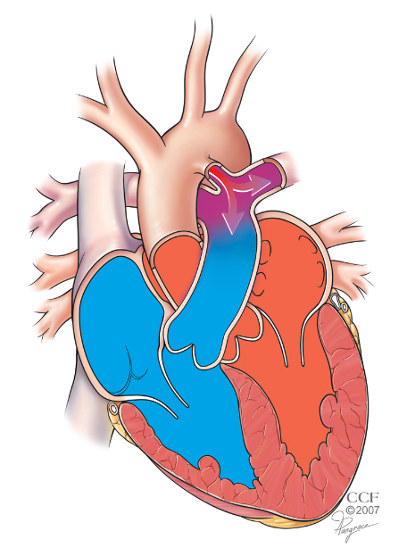
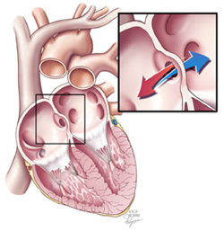
Shunt Lesions ARE Most Common Cause OF PAH
Patients with repaired and unrepaired defects can develop PAH (~2-10%)
Increasing dyspnea, declining exercise capacity, and progressive increase in PVR are clinical hallmarks
25%-50% of CHD-PAH patients unabated can progress to Eisenmenger syndrome
PDA
ASD
VSD

Slide 7
PAH-CHD Clinical Subgroups and Characteristics
SUBGROUP | 1 Eisenmenger syndrome (ES) | 2 PAH associated with persistent systemic-to-pulmonary shunts | 3 PAH with small/coincidental shunts | 4 PAH after defect correction
CHARACTERISTICS | Large intra- and extra-cardiac defects systemic-to-pulmonary shunts Cyanosis Secondary erythrocytosis Multisystem involvement | Correctable with surgery or intravascular percutaneous procedure Non-correctable Moderate to large defects PVR mildly to moderately increased Systemic-to-pulmonary shunting still prevalent No cyanosis at rest | PVR elevation with small cardiac defects (which do not account for elevated PVR) Clinical picture similar to iPAH Defect closure contraindicated | Congenital heart disease repaired PAH immediately after or recurs/develops months/years after correction, in absence of significant postoperative haemodynamic lesions

Slide 8
Morbidity and Mortality Are Higher in PAH-CHD
38,430 adults with CHD in the province of Quebec
2,212 had diagnosis of PH
Prevalence:
1 out of every 17 CHD patients
All Cause Mortality
2X Higher
Morbidity
3X Higher
Hospitalization Days
3X Higher

