Slide 1
Addressing PH Subtypes: Raising Awareness of Understudied Populations
Richard Krasuski, MD
Professor of Medicine and Pediatrics
Director, Adult Congenital Heart Disease Center
Director, Hemodynamic Research
Director, Interventional CTEPH Program
Duke University Medical Center
Durham, NC

Slide 2
Disclaimer
The views and opinions expressed in this educational activity are those of the faculty and do not necessarily represent the views of TotalCME, Inc., the CME providers, or the companies providing educational grants. This presentation is not intended to define an exclusive course of patient management; the participant should use their clinical judgment, knowledge, experience, and diagnostic skills in applying or adopting for professional use any of the information provided herein. Any procedures, medications, or other courses of diagnosis or treatment discussed or suggested in this activity should not be used by clinicians without evaluation of their patient's conditions and possible contraindications or dangers in use, review of any applicable manufacturer’s product information, and comparison with recommendations of other authorities. Links to other sites may be provided as additional sources of information.

Slide 3
Learning Objectives
Review characteristics of PH patient groups that fall outside of the idiopathic category
Discuss the screening, diagnosis and expedient referral of non-idiopathic patients to PH specialty centers from community generalists and specialty healthcare providers
Focus on understudied PH groups that require special diagnostic attention by all healthcare providers
Review treatment and management approaches to these understudied PH patients

Slide 4
A Short Tour of Congenital Heart Disease Associated PAH (CHD-PAH)

Slide 5
Specifics of PAH in Adult Congenital Heart Disease (ACHD)
CHD affects 0.8% of live births in the U.S. (excluding bicuspid AV and MVP)
PH is a common complication of CHD (5-10%), particularly if significant and unrepaired¹
With newer and improved diagnostic techniques and evolving medical, catheter-based and surgical interventions, there are now >1,400,000 adults with congenital heart disease (adults>children)
Unfortunately, most physicians get minimal exposure to CHD patients during training
All ACHD patients should be seen by an ACHD specialist at least once – complex patients need follow-up every 6-12 months at an accredited ACHD center¹
Specific Aspects of PH in ACHD²
Higher flow and more downstream shunt lesions are more likely to cause PAH
Like any PH, ACHD-PH can be pulmonary venous or pulmonary arterial
Same hemodynamic criteria used for diagnosis as other Group 1 disease
Differentiation of etiology can dramatically impact management
Diagnostic catheterization is essential for proper diagnosis and should be performed by a board certified ACHD physician

Slide 6
Advances In CHD Management Have Led to Growing Adult Population with New Problems and Concerns
1960
2010
1960s
2010
>1,400,000 adults with CHD (adults>children)
Most patients only palliated
Lesions can recur
Palliative methods can cause problems
Simple lesions can result in PH, arrhythmias, and heart failure, even after successful repair
Epidemiologic studies limited
Complexity varied
No centralized database
5%
15%
10%
15%
35%
35%
50%
50%
85%
85%
Surviving to Adulthood
Died in First Year
Died within 18 Years
Notes:
9

Slide 7
Categorizing Congenital Heart Disease and PH
In CHD, PAH can be classified into 4 distinct subgroups of patients:
Eisenmenger syndrome
Persistent systemic-to-pulmonary shunts
Small, coincidental defects
Patients who have undergone defect correction
Patients with shunts, repaired and unrepaired, need to be screened at an ACHD center for the development of PAH
2018 WSPH Recommendations
Post-operative PAH screening in subgroup 4 without PAH should include clinical, echocardiographic and ECG screening during follow-up visits 3–6 months after correction and then throughout their planned long-term cardiovascular follow-up

Slide 8
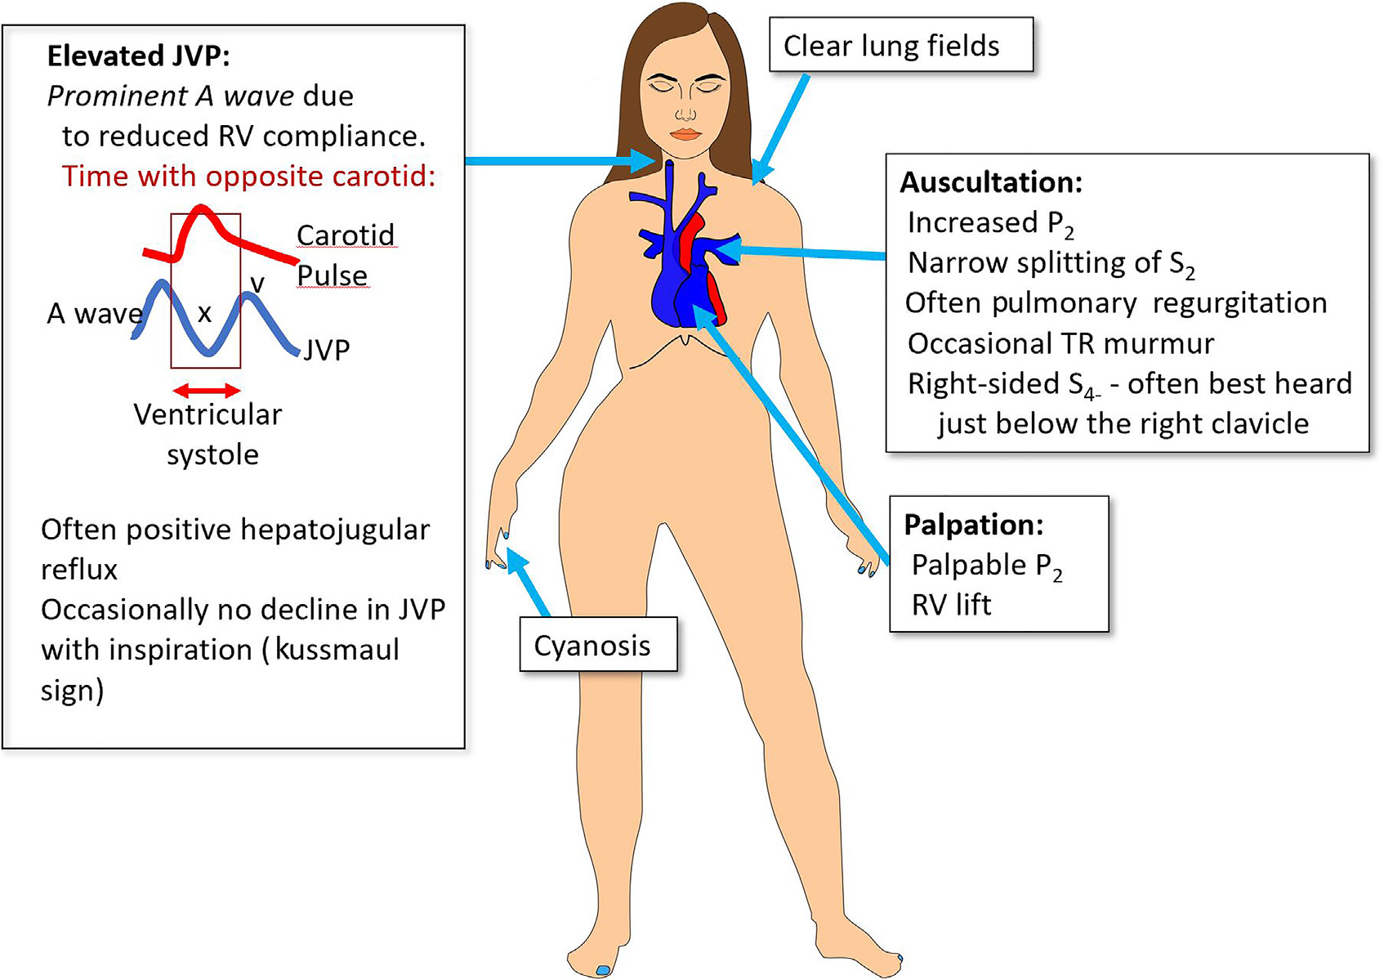
Physical Manifestations and Common Examination Findings in a Patient With PAH-CHD

Slide 9
Progression of PAH-CHD to Eisenmenger Syndrome
Systemic-to-pulmonary (left-to-right) shunt
Increased pulmonary blood flow and pressure
Pulmonary vascular remodeling
Increase in pulmonary vascular resistance
Reversed (right-to-left) shunt: pulmonary-to-systemic
Cyanosis (Eisenmenger Syndrome)
Notes:
9

Slide 10
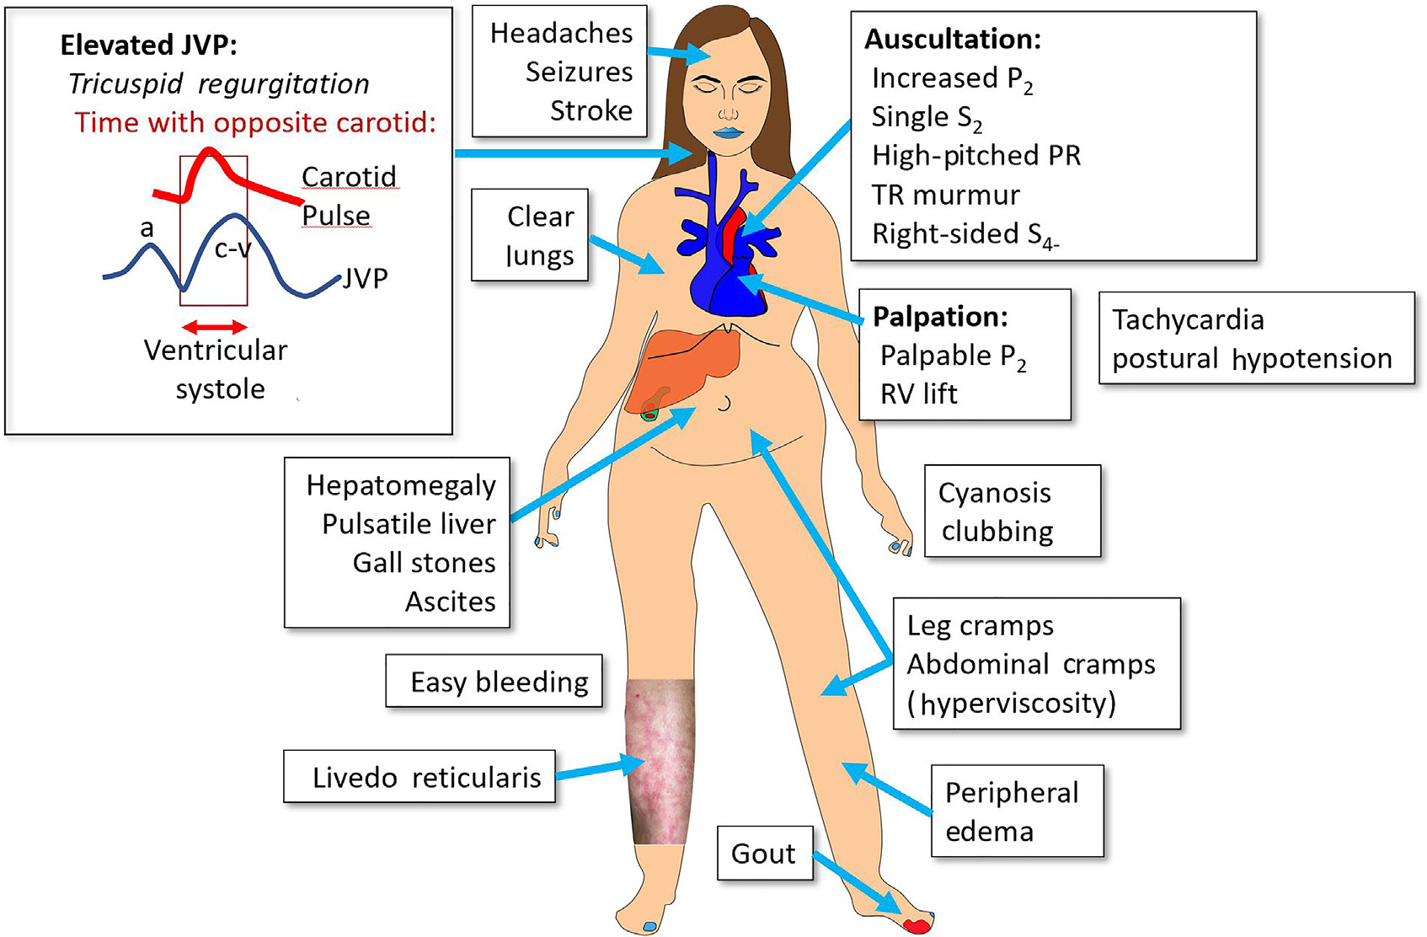
Eisenmengers Syndrome: Physical Manifestations and Common Examination Findings

Slide 11
Unique Considerations In The CHD-PAH Patient
Is there too much or too little pulmonary blood flow?
If a defect is present, is it correctable?
If a defect is correctable, what is the best manner in which to correct it?
Have advanced medical therapies been adequately tested and do they work in CHD patients?

