Slide 1
Addressing PH Subtypes: Raising Awareness of Understudied Populations
Richard Krasuski, MD
Professor of Medicine and Pediatrics
Director, Adult Congenital Heart Disease Center
Director, Hemodynamic Research
Director, Interventional CTEPH Program
Duke University Medical Center
Durham, NC

Slide 2
Disclaimer
The views and opinions expressed in this educational activity are those of the faculty and do not necessarily represent the views of TotalCME, Inc., the CME providers, or the companies providing educational grants. This presentation is not intended to define an exclusive course of patient management; the participant should use their clinical judgment, knowledge, experience, and diagnostic skills in applying or adopting for professional use any of the information provided herein. Any procedures, medications, or other courses of diagnosis or treatment discussed or suggested in this activity should not be used by clinicians without evaluation of their patient's conditions and possible contraindications or dangers in use, review of any applicable manufacturer’s product information, and comparison with recommendations of other authorities. Links to other sites may be provided as additional sources of information.

Slide 3
Learning Objectives
Review characteristics of PH patient groups that fall outside of the idiopathic category
Discuss the screening, diagnosis and expedient referral of non-idiopathic patients to PH specialty centers from community generalists and specialty healthcare providers
Focus on understudied PH groups that require special diagnostic attention by all healthcare providers
Review treatment and management approaches to these understudied PH patients

Slide 4
The Echocardiogram Is of Central Importance to CTD-PAH (and All Types of PH) Diagnosis and Referral

Slide 5
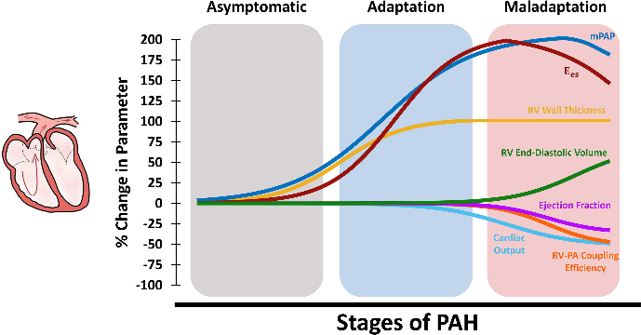
Importance of Structural Changes in the RV in PAH
Right ventricular (RV) function is the single most important prognostic determinant of survival in various forms of pulmonary hypertension (PH)¹
PAH has been shown to result in RV remodeling at different scales (organ-level hemodynamics to tissue stiffening, fiber reorientation, and altered myocyte contractility and mitochondrial energetics)²
The RV initially responds to increased pressures in PAH by undergoing concentric hypertrophy, which helps reducing RV wall stress and results in increased organ-level contractility
Increased wall thickness results in maintained cardiac output and ejection fraction during the early stages of RV remodeling with further progression of PAH, RV hypertrophy reaches a plateau³ while PA pressures continue to rise⁴
RV Wall Thickness

Slide 6
Using Echo To Uncover Ph Related Changes in Heart Structure: You Absolutely Need Good Images of the Right Heart!
The most common opportunity to spot a new PAH patient is either in the echo review or in the echo report
Emphasis of echocardiogram should not be on pressures, but on structural changes associated with the heart
Pressures obtained are useful but are estimates only
Tricuspid regurgitant velocity
Right ventricular size (right ventricle/left ventricle basal diameter ratio >1.0)
RA size (RA area [end-systole] >18 cm²)
RA function
Interventricular septal function
IVC diameter fluctuations with respiratory cycles (IVC diameter >21 mm with decreasing inspiratory collapse)
Pattern of systolic flow velocity
Early diastolic pulmonary regurgitant velocity
Diameter of the pulmonary artery (>25 mm)
Key Structural Features of the Heart in PAH
Right heart pressures are more accurately assessed with RHC

Slide 7
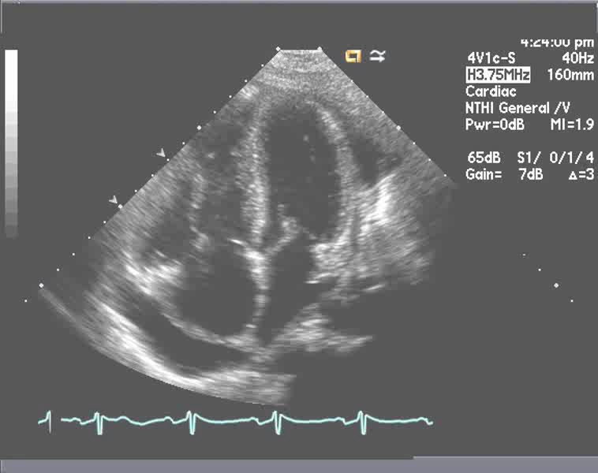
ECHO: It’s Not All About Pressures –Structural Images Essential
RV Dilation and
Dysfunction
Normal Right
Sided Chambers
LVH
RV
LV
LV
Precapillary PH
RV
Postcapillary PH
RA
LA
RA
LA
Group 1
Group 2
Pericardial Effusion
Small LA w/
Shifted Septum
LA Enlargement
LA=left atrium/atrial
LV=left ventricle/ventricular
RA=right atrium/atrial
RV=right ventricle/ventricular

