Slide 1

Aficamten in Patients With Symptomatic Non-Obstructive Hypertrophic Cardiomyopathy (REDWOOD-HCM Cohort 4)
Ahmad Masri, MD, MS
Director, Cardiac Amyloidosis Program
Director, Hypertrophic Cardiomyopathy Center
Assistant Professor of Medicine
Oregon Health & Science University
Portland, OR

Slide 2

Background
Patients with non-obstructive hypertrophic cardiomyopathy (nHCM) represent a significant subset of HCM patients (~30%), and when symptomatic, have few therapeutic options.
Other than cardiac transplantation, there are no proven medical therapies that improve functional capacity, symptoms, or outcomes.
Aficamten is a small molecule, allosteric inhibitor of cardiac myosin designed to reduce the hypercontractility that underlies the pathophysiology of HCM.
REDWOOD-HCM is a phase 2 dose-finding study, and Cohort 4 is designed to evaluate the safety of aficamten in patients with symptomatic nHCM.

Slide 3
Methods
Eligible participants with nHCM were enrolled in an open-label fashion according to these key eligibility criteria:
  NYHA II/III with LVEF ≥60%
  Absence of rest or provoked LVOT gradient (<30 mmHg)
  NT-proBNP ≥300 pg/mL
  No history of LVEF <45%.
Safety, NYHA class, LVEF, cardiac biomarkers (NT-proBNP and hs-cTnI) were assessed.
  Data are presented for 40 patients up to Week 10 and 35 patients at Week 12 (at data cutoff 5 patients had completed treatment and 1 died).

Slide 4
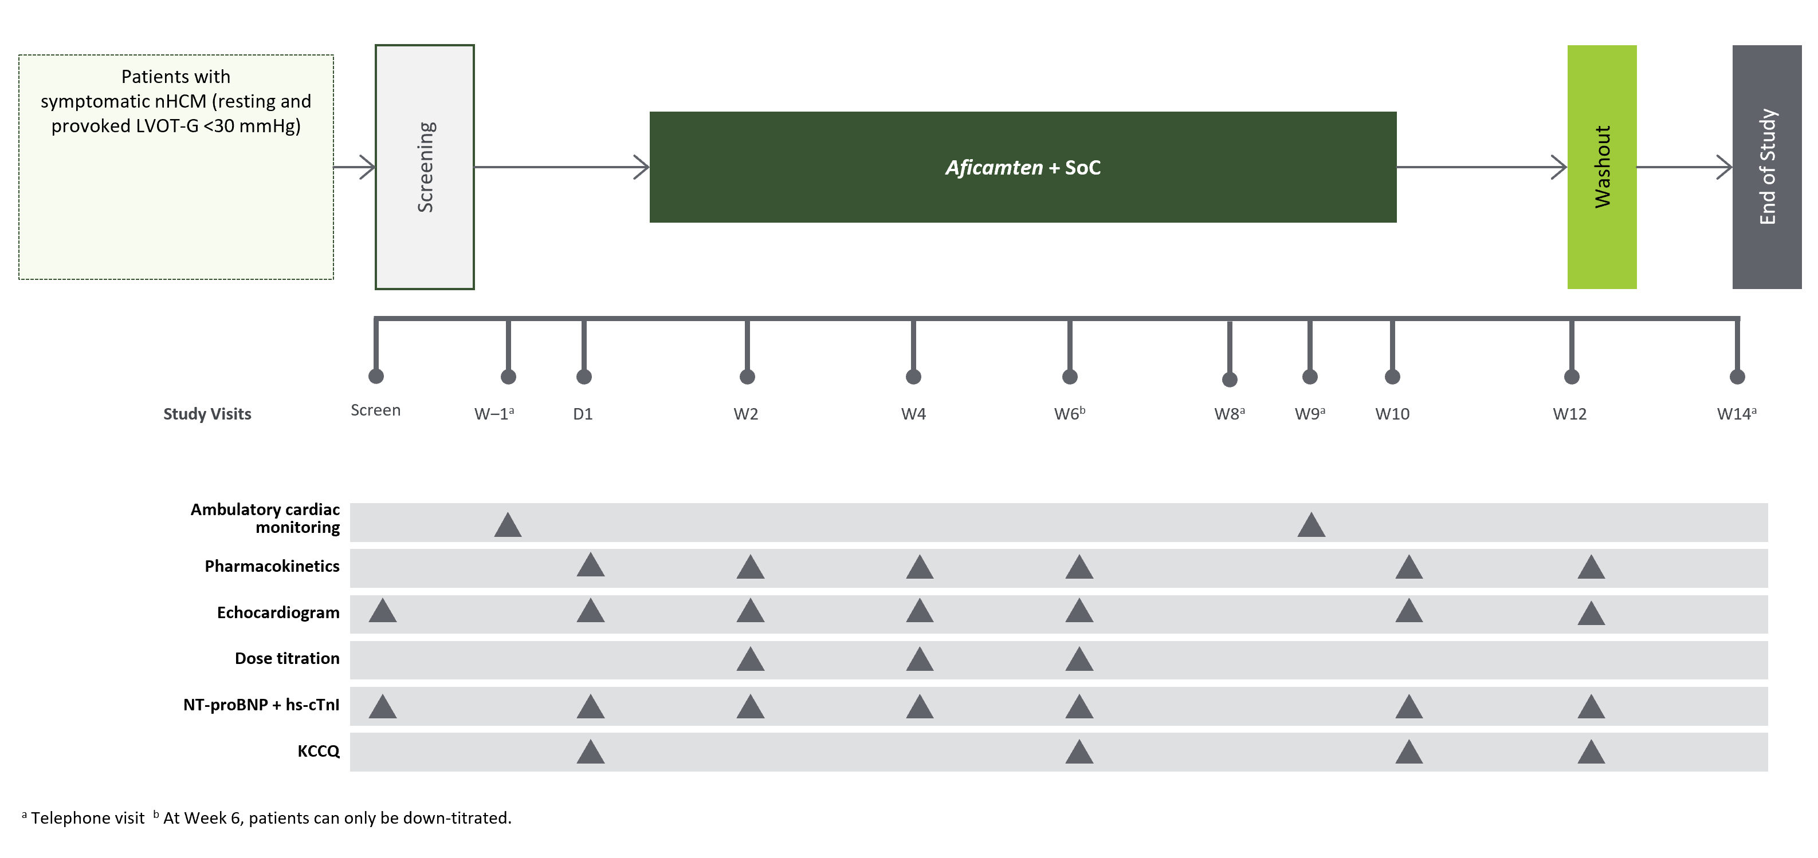
Study Schema and Titration Schedule
Up-Titration if:
LVEF ≥55%
Maintain if:
LVEF 50–54%
Down-Titration if:
LVEF <50%
Discontinue if:
LVEF <40%

Slide 5
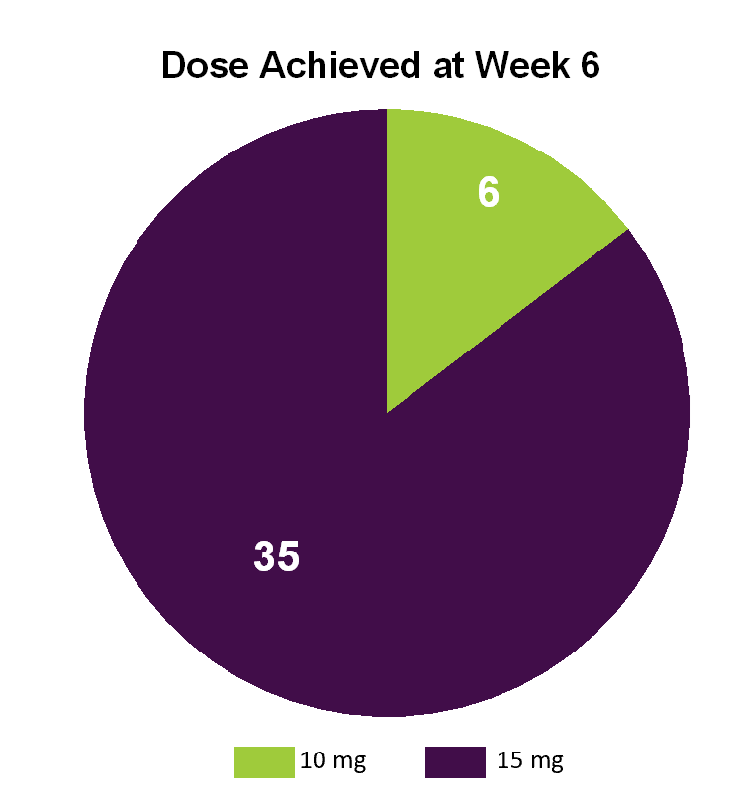
Baseline Characteristics and Dose Achieved
Baseline characteristic | N=41
Age, mean ± SD, y | 55.9 ± 15.8
Sex, female, n (%) | 24 (58.5)
Race, n (%)
White | 28 (68.3)
Black or African American | 8 (19.5)
Asian | 2 (4.9)
Other | 3 (7.3)
BMI, mean ± SD, kg/m² | 30.0 ± 7.1
NYHA class, n (%)
Class II | 21 (51.2)
Class III | 20 (48.8)
LVEF, mean ± SD, % Site-read | 68.1 ± 5.5
NT-proBNP, GeoMean (%CV), pg/mL | 1254 (80.1)
hs-cTroponin I, GeoMean (%CV), ng/mL | 28.7 (317.6)
35 patients (85%) achieved daily aficamten dose of 15 mg; 6 patients (15%) achieved 10 mg; 1 patient on 10 mg did not complete the titration period because aficamten was discontinued due to personal reasons.

Slide 6
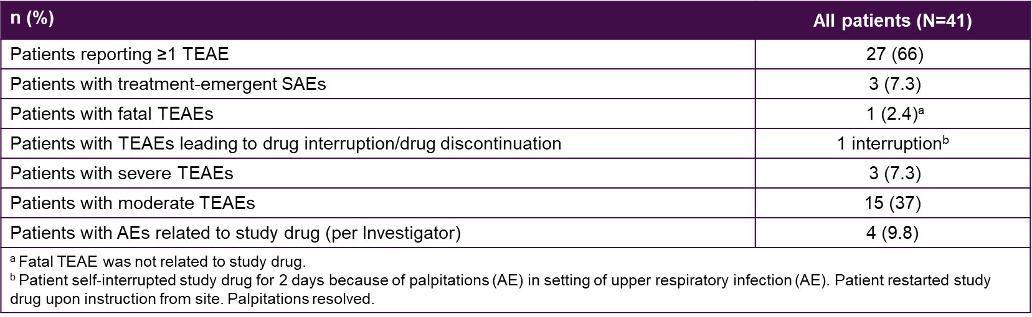
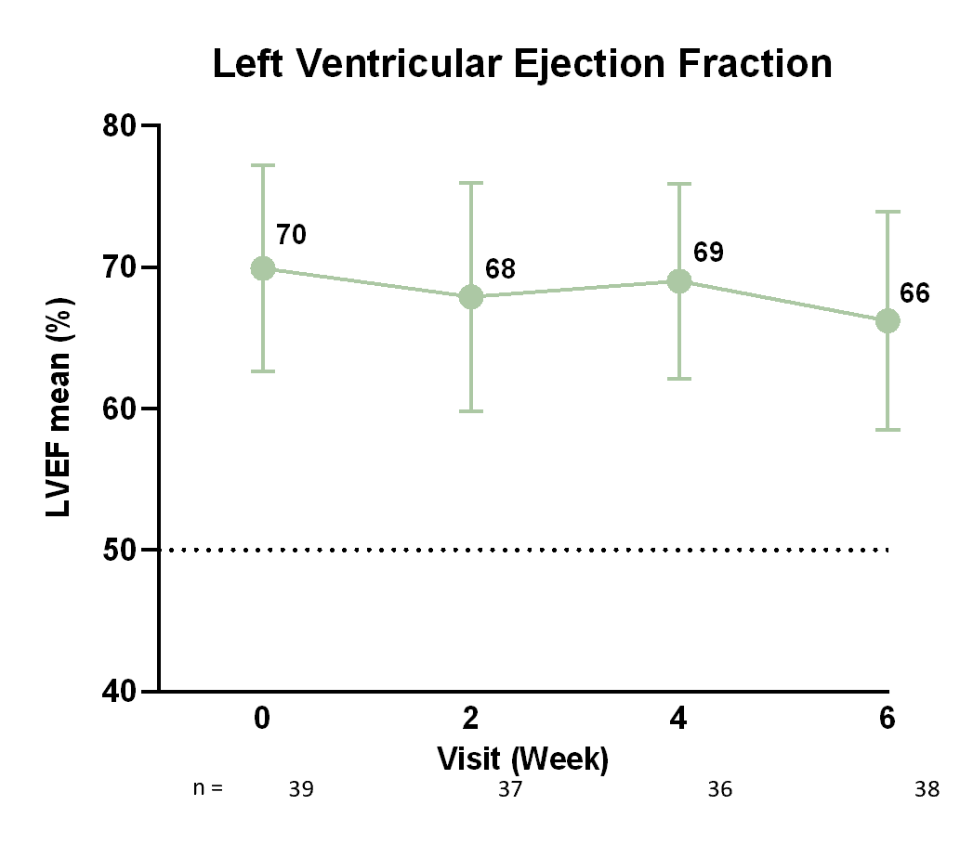
Aficamten was Well-Tolerated
There were no drug discontinuations due to AEs:
  1 patient had a dose reduction to 10 mg for AE of fatigue at Week 9;
  1 had a dose interruption for 2 days due to AE of palpitation.
3 patients had SAEs: bronchitis, new onset atrial fibrillation, cardiac arrest.
None were deemed related to aficamten by the Investigator.
3 patients (7.3%) had LVEF <50% at Week 10 (EOT):
  2 in patients with permanent atrial fibrillation, 1 of whom reported palpitations that required adjustment of rate-control medications.
  No AEs of heart failure were reported.
  All 3 patients returned to baseline LVEF by Week 12.

Slide 7
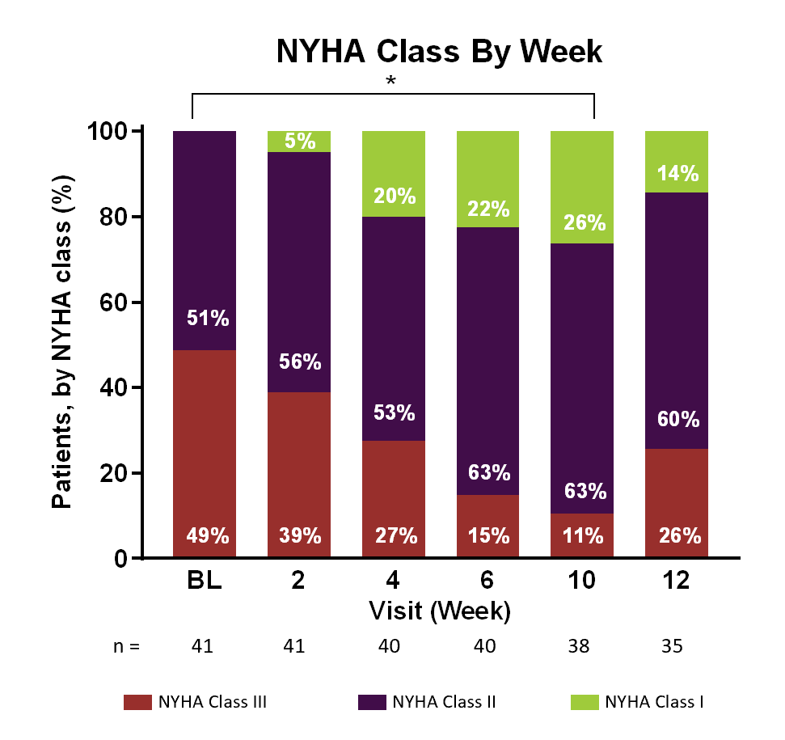
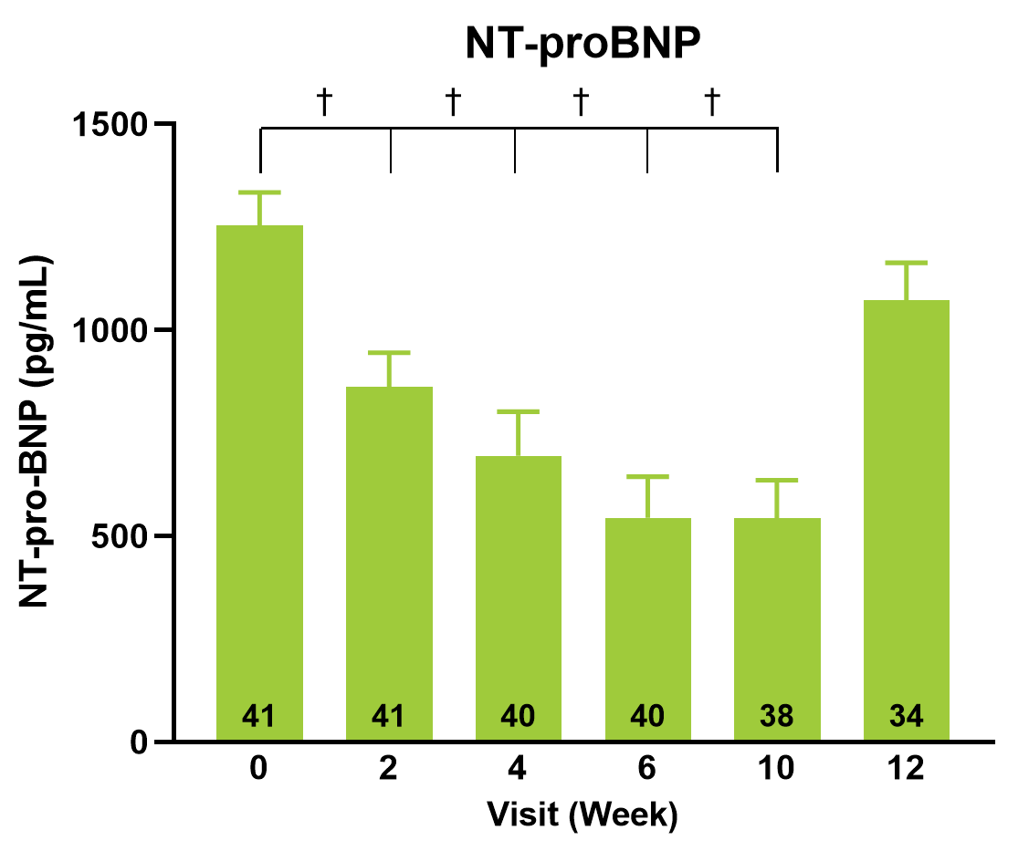
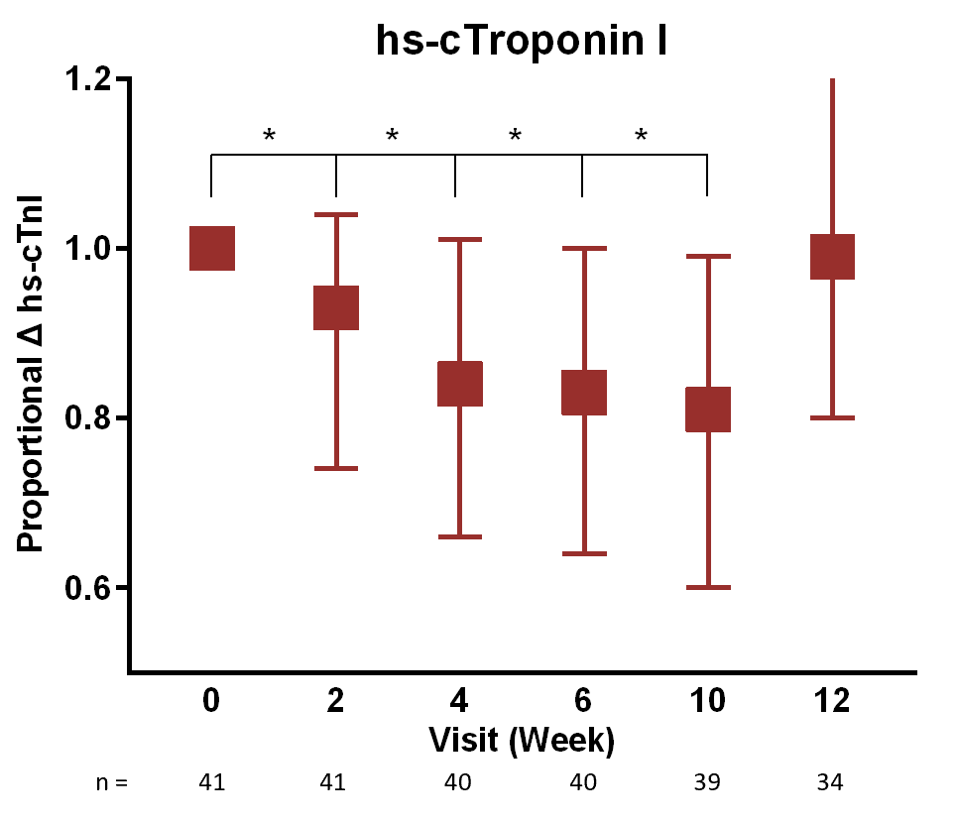
Change in NYHA Class, NT-proBNP and hs-cTnI
NYHA class improved during treatment (* P<0.05): 22 of 41 (54%) patients experienced a change of ≥1 NYHA class, including 12 patients who improved from class III to II; 2 patients improved from class III to I; and 8 from class II to I.
Geometric mean NT-proBNP (%CV) decreased at each scheduled visit with the proportional change from baseline being highly statistically significant († P<0.0001).
hs-cTnI decreased significantly at each study visit compared to baseline (* P<0.05).
After the 2-week washout, cardiac biomarkers returned to baseline.

Slide 8
Conclusions
REDWOOD-HCM Cohort 4 is the first study exploring dosing and tolerability of aficamten in patients with non-obstructive HCM.
Aficamten was well tolerated overall, with modest on-target reductions in LVEF in response to aficamten over 10 weeks.
There was significant improvement in heart failure burden in most patients with nHCM accompanied by improvement in cardiac biomarkers during open-label therapy.
These results support further study of aficamten in a larger, longer-term trial of patients with symptomatic nHCM.

