Slide 1

Applicability of the GALACTIC-HF Trial and Omecamtiv Mecarbil to Patients Hospitalized for Heart Failure in the US: The GWTG-HF Registry
Stephen J. Greene, MD, FACC, FHFSA
Assistant Professor, Division of Cardiology
Advanced Heart Failure & Transplantation
Duke University Medical Center
Duke Clinical Research Institute
Durham, NC
Funding: Cytokinetics (South San Francisco, CA)
Disclosures: Amgen, AstraZeneca, Bayer AG, Boehringer Ingelheim/ Lilly, Bristol Myers Squibb, Corteria Pharmaceuticals, CSL Vifor, Cytokinetics, Merck, Novartis, PharmaIN, Pfizer,
Roche Diagnostics, Sanofi, scPharmaceuticals, Tricog Health, and Urovant

Slide 2
Disclaimer
The views and opinions expressed in this educational activity are those of the faculty and do not necessarily represent the views of TotalCME, Inc., the CME providers, or the companies providing educational grants. This presentation is not intended to define an exclusive course of patient management; the participant should use their clinical judgment, knowledge, experience, and diagnostic skills in applying or adopting for professional use any of the information provided herein. Any procedures, medications, or other courses of diagnosis or treatment discussed or suggested in this activity should not be used by clinicians without evaluation of their patient's conditions and possible contraindications or dangers in use, review of any applicable manufacturer’s product information, and comparison with recommendations of other authorities. Links to other sites may be provided as additional sources of information.

Slide 3
Background
In the GALACTIC-HF trial, omecamtiv mecarbil reduced the risk of cardiovascular death or worsening heart failure (HF) among patients with HF and EF ≤35%, with larger treatment effect at lower ejection fractions.
The applicability of the GALACTIC-HF trial and the proportion of US patients who may be candidates for omecamtiv mecarbil has not been characterized.

Slide 4
Objectives
To examine the proportion of patients hospitalized with HF with reduced ejection fraction (HFrEF) in the US who met eligibility criteria for GALACTIC-HF, including among the subset of patients with severely reduced EF ≤30%.

Slide 5
Methods
Data Source: 423 sites in American Heart Association’s Get With the Guidelines-HF Registry
Study Population: Patients hospitalized for worsening chronic HF with EF ≤40% without severe kidney disease (defined as eGFR <20 mL/min/1.73m² or dialysis) or history of heart transplantation or durable mechanical support
Patients were examined according to key GALACTIC-HF inclusion and exclusion criteria, and grouped by EF subgroup (≤30% vs 31-40%).

Slide 6
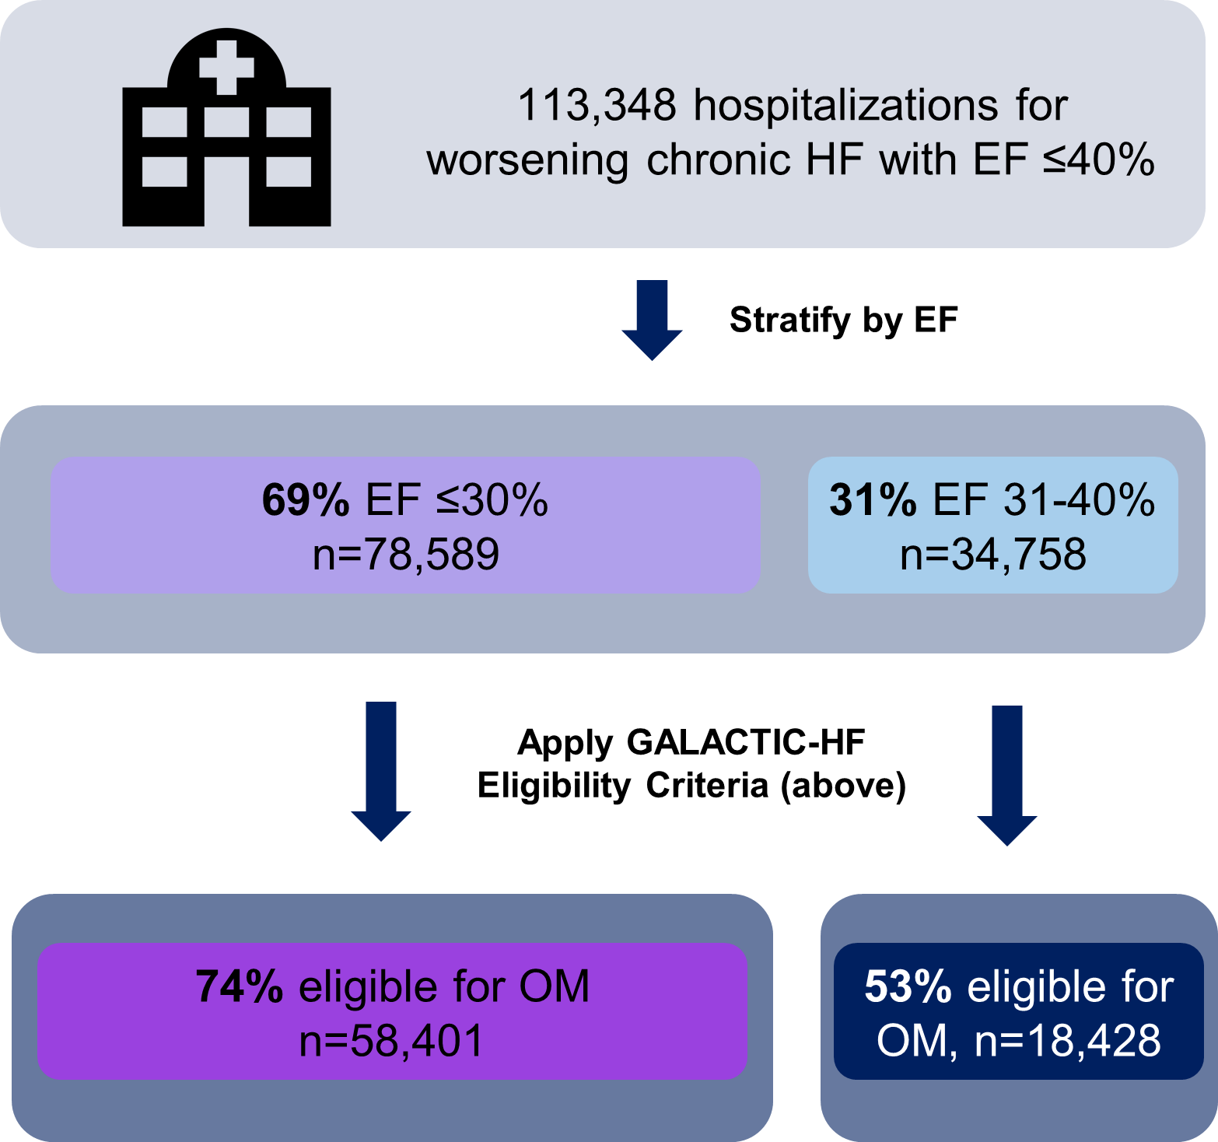
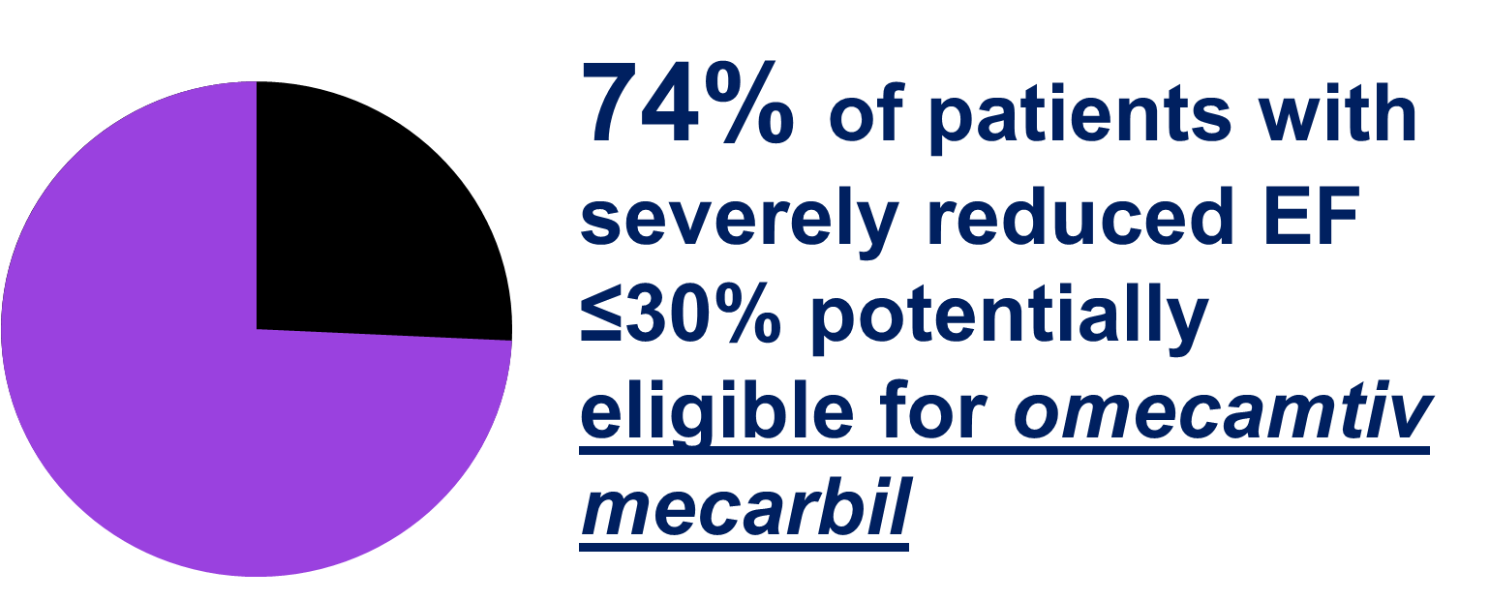
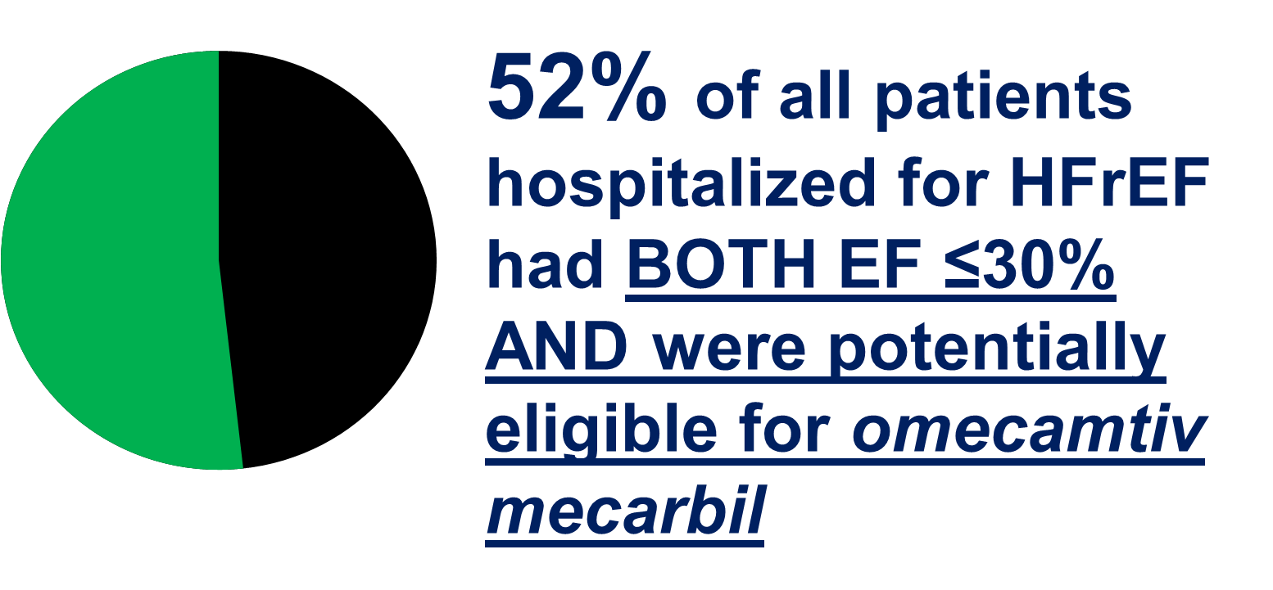
Results – Proportion Meeting GALACTIC-HF Eligibility Criteria

Slide 7
Limitations
Participation in GWTG-HF is voluntary and may not be representative of patients with HF across all US hospitals.
In determining potential eligibility for OM, we did not apply a requirement that patients were already receiving quadruple medical therapy for HFrEF.

Slide 8
Conclusions
Among hospitalizations for worsening chronic HFrEF, more than two-thirds were potentially eligible for omecamtiv mecarbil
69% of patients with worsening chronic HFrEF have severely reduced EF ≤30%
  Among this large subset, approximately 3 out of 4 patients were potentially eligible for omecamtiv mecarbil.

