Slide 1

NT-proBNP During Screening in the Study of Vericiguat in Participants With Heart Failure With Reduced Ejection Fraction (VICTORIA) Trial: Insights Into Outcomes and Vericiguat
Cynthia M. Westerhout, Y Zheng, LH Lund, J Butler, RW Troughton, M Emdin, CSP Lam, P Ponikowski, RO Blaustein, C O’Connor, L Roessig, AA Voors, JA Ezekowitz, PW Armstrong, for the VICTORIA Study Group.
ACC CME March 9, 2023

Slide 2

Disclosures
CM Westerhout: Bayer Canada (consulting fees)

Slide 3
Disclaimer
The views and opinions expressed in this educational activity are those of the faculty and do not necessarily represent the views of TotalCME, Inc., the CME providers, or the companies providing educational grants. This presentation is not intended to define an exclusive course of patient management; the participant should use their clinical judgment, knowledge, experience, and diagnostic skills in applying or adopting for professional use any of the information provided herein. Any procedures, medications, or other courses of diagnosis or treatment discussed or suggested in this activity should not be used by clinicians without evaluation of their patient's conditions and possible contraindications or dangers in use, review of any applicable manufacturer’s product information, and comparison with recommendations of other authorities. Links to other sites may be provided as additional sources of information.

Slide 4
Today’s Aims
In this session, you will learn about the:
frequency and direction of NT-proBNP changes during the 30-day screening period;
associations of these changes with the primary composite endpoint of CV death and HF hospitalization (HFH); and
vericiguat’s clinical benefit relative to these changes.

Slide 5
HFrEF Patients in VICTORIA
VICTORIA enrolled 5050 patients with heart failure and reduced ejection fraction (HFrEF) <45%, randomized to vericiguat or placebo. Entering with:
  NT-proBNP ≥1000 pg/mL or BNP ≥300 pg/mL (sinus rhythm) or
  NT-proBNP ≥1600 pg/mL or BNP ≥500 pg/mL (atrial fibrillation) during the 30-day screening period.
Mean age 67 years; 24% female
Index event:
  67% HF-related hospitalization (HFH) <3 months
  17% 3-6 months
  16% IV diuretic for HF <30months
Armstrong PW, Pieske B, Anstrom KJ, et al. NEJM 2022;382:1883-93.

Slide 6
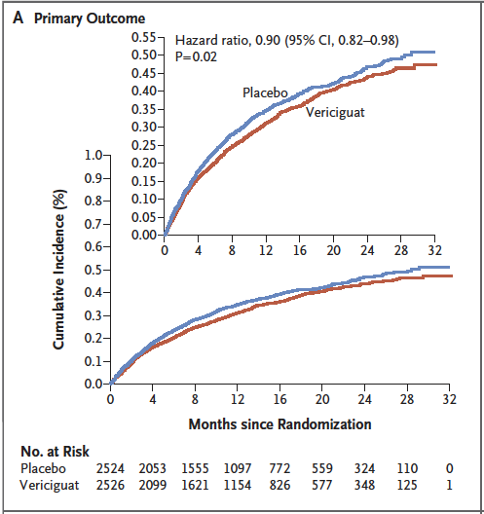
Primary Results of VICTORIA
Armstrong PW, Pieske B, Anstrom KJ, et al. NEJM 2022;382:1883-93.

Slide 7
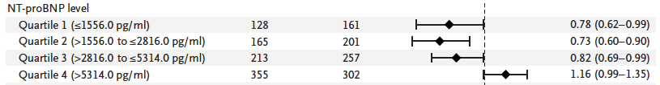
Primary Results of VICTORIA
Does what happens before randomization
NT-proBNP provide insights into these results?
Armstrong PW, Pieske B, Anstrom KJ, et al. NEJM 2022;382:1883-93.

Slide 8
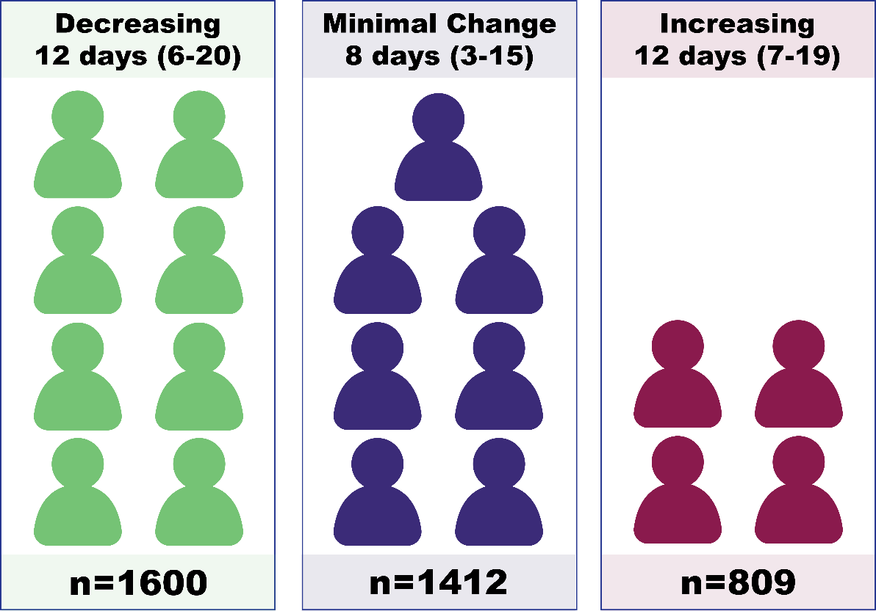
Methods
3821 of 5050 patients randomized had NT-proBNP at screening and randomization.
Relative change: Decreased (>20%), Minimal change (≤20%), and Increased (>20%), similar to Armstrong et al.
Given the observed interaction of vericiguat with pre-specified quartiles of NT-proBNP at randomization, its trajectory during screening and associations with vericiguat’s treatment effect were examined.
Armstrong PW, Zheng Y, Troughton RW, et al. Sequential evaluation of NT-proBNP in heart failure: Insights into clinical outcomes and efficacy of vericiguat. JACC HF 2022;10:677-88.

Slide 9
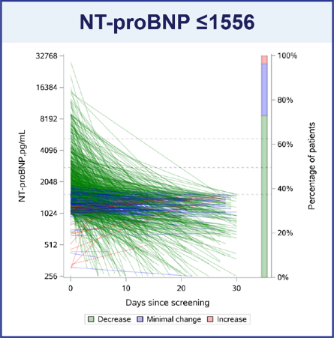
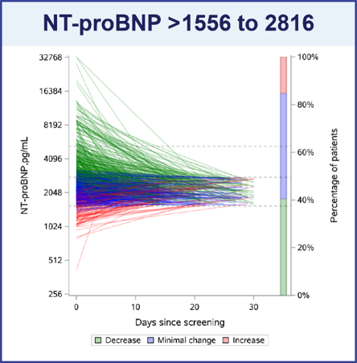
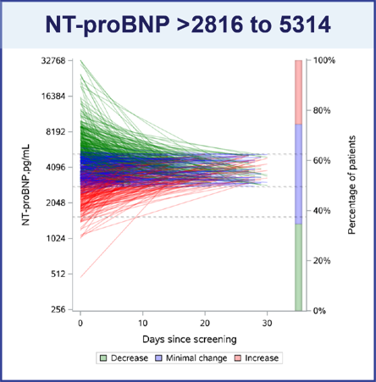
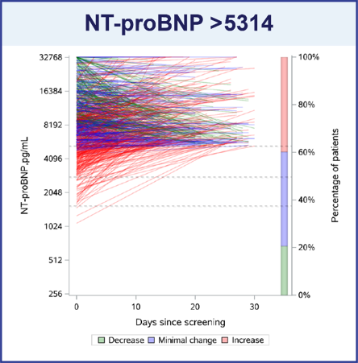
Trajectory of NT-proBNP: Screening to Randomization
According to NT-proBNP (pg/mL) at Randomization

Slide 10
Association with Clinical Outcomes

Slide 11
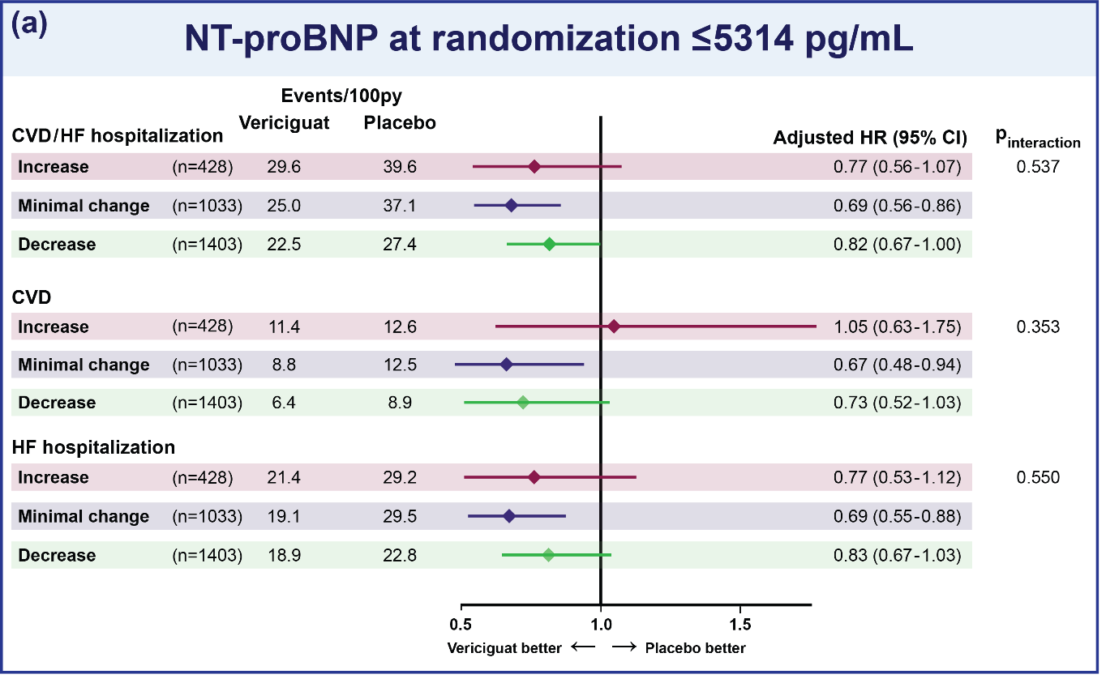
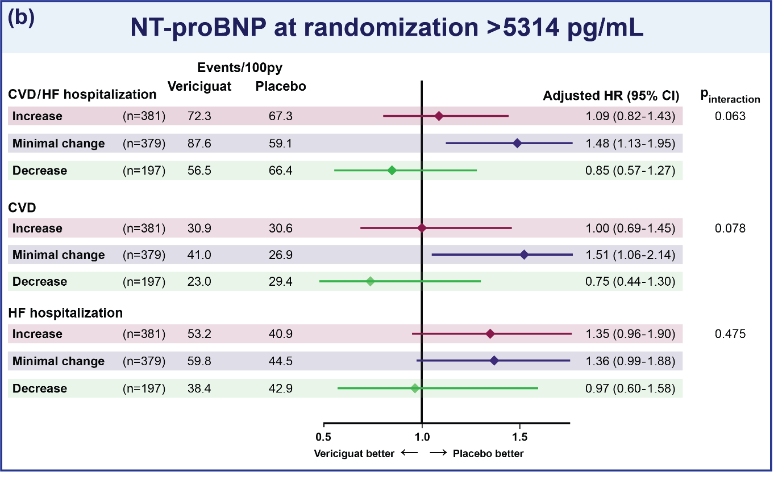
Vericiguat’s Treatment Effect by Change in Screening NT-proBNP
According to NT-proBNP (pg/mL) at Randomization

Slide 12
Conclusions and Implications
Changes in NT-proBNP were common during the screening period:
        Decrease or minimal change > increase
Minimal change or especially an increase in NT-proBNP levels during screening interval had a greater risk of CV death and HFH.
      In the upper quartile of NT-proBNP at randomization, a signal of benefit for vericiguat was observed when NT-proBNP decreased.
These finding in high-risk HF patients underscores that changes in NT-proBNP add important information beyond a single NT-proBNP measurement, particularly for future trial design.

