Slide 1

Consistent Benefit of Rivaroxaban Early and Late After Lower Extremity Revascularization Marc P. Bonaca MD MPH, Eike Sebastian Debus MD, PhD, Manesh R. Patel, MD, Mark R. Nehler, MD, Sonia S. Anand, MD, Connie N. Hess, MD, MHS, Judith Hsia MD, Michael Szarek, Jerrod Nelms, Eva Muehlhofer, MD, Lloyd P. Haskell, MD, MBA, Scott D. Berkowitz, MD, Rupert M. Bauersachs, MD American College of Cardiology Scientific Sessions – March 2023

Slide 2
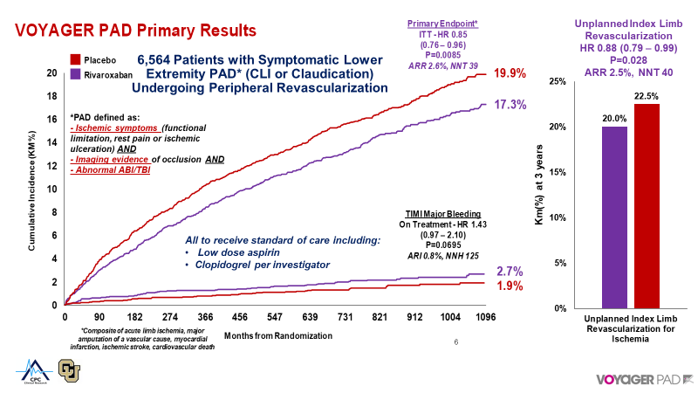
Questions in Implementation
How early to start?
Transition after DAPT at 30 or 90 days?
How long to continue?
Is the benefit consistent early and late after LER?
Objective
To evaluate whether the benefit and risk of rivaroxaban is consistent early and late after lower extremity revascularization

Slide 3
Primary Endpoint & TIMI major Bleeding
First 90 Days
P vs. constant HR 0.47
From day 91 through 3 Years
Placebo
3.8%
Placebo
16.1%
HR 0.78
(0.60 – 1.02)
HR 0.87
(0.76 – 1.00)
Rivaroxaban
3.0%
ARR 0.8%
Rivaroxaban
14.3%
KM (%)
KM (%)
ARR 1.8%
HR 2.01
(0.90 – 4.47)
ARI 0.3%
ARI 0.5%
Rivaroxaban0.58%
HR 1.28
(0.82 – 1.99)
Rivaroxaban 2.07%
Placebo
0.29%
Placebo
1.58%
Days from Randomization
Days from Randomization

Slide 4
Net Clinical Benefit*
P vs. Constant HR 0.52
Overall HR 0.80
(0.70 – 0.92, p=0.0012)
First 90 Days
From day 91 through 3 Years
Placebo
3.9%
Placebo
14.5%
HR 0.74
(0.56 – 0.97)
HR 0.82
(0.70 – 0.96)
Rivaroxaban
12.5%
KM (%)
KM (%)
Rivaroxaban
2.9%
Days from Randomization
Days from Randomization
*MI, ischemic stroke, ALI, major vascular amputation, CV death, TIMI major bleeding

Slide 5
MALE – Acute Limb Ischemia or Major Vascular Ampuation
First 90 Days
P vs. constant HR 0.06
From day 91 through 3 Years
Placebo
7.3%
Placebo
2.5%
HR 0.55
(0.38 – 0.79)
HR 0.81
(0.66 – 0.99)
Rivaroxaban
1.4%
Rivaroxaban
6.0%
KM (%)
KM (%)
Days from Randomization
Days from Randomization

Slide 6
Acute Limb Ischemia
First 90 Days
P vs. constant HR 0.059
From day 91 through 3 Years
Placebo
5.7%
Placebo
2.1%
HR 0.48
(0.31 – 0.73)
HR 0.75
(0.60 – 0.95)
Rivaroxaban
4.3%
KM (%)
Rivaroxaban
1.0%
KM (%)
Days from Randomization
Days from Randomization

Slide 7
Is DAPT Alone Enough for Early Limb Events?
Placebo
With Clopidogrel
N=3313
Rivaroxaban
DAPT Only
18.3%
DAPT + Rivaroxaban
Bleeding Risk based on Duration of DAPT
Primary Efficacy Endpoint
16.0%
ARR 2.3%
ARI 0.4%
6:1 Benefit Risk Ratio for Adding Rivaroxaban on top of DAPT
Cumulative Incidence (KM%)
Principal Safety Outcome
2.7%
2.3%
Days from Randomization
Hiatt WR et al. Circulation 2020

Slide 8
MALE and ALI in those Receiving DAPT – First 90 Days
Acute Limb Ischemia
First 90 Days
Acute Limb Ischemia or Major Amputation of a Vascular Etiology
First 90 Days
DAPT
2.0%
DAPT
1.7%
MALE – KM (%)
ALI – KM (%)
Days from Randomization
Days from Randomization

Slide 9
MALE and ALI in those Receiving DAPT – First 90 Days
Acute Limb Ischemia at 90 Days
Acute Limb Ischemia or Major Amputation of a Vascular Etiology
First 90 Days
DAPT
DAPT
HR 0.45
(0.25 – 0.83)
HR 0.43
(0.22 – 0.84)
Rivaroxaban +
DAPT
Rivaroxaban +
DAPT
ALI – KM (%)
MALE – KM (%)

Slide 10
Primary Outcome* and Acute Limb Ischemia Early and Late
Primary Outcome* Overall
0.85 (0.76 – 0.96)
≤30 Days
P vs. constant HR 0.94
0.87 (0.56 – 1.33)
>30 Days
0.85 (0.75 – 0.96)
≤90 Days
P vs. constant HR 0.47
0.78 (0.60 – 1.02)
>90 Days
0.87 (0.76 – 1.00)
Acute Limb Ischemia Overall
0.67 (0.55 – 0.82)
≤30 Days
0.45 (0.24 – 0.85)
On top of DAPT
0.45 (0.14 – 1.46)
On top of Aspirin
0.48 (0.22 – 1.01)
P-interaction 0.93
>30 Days
P vs. constant HR 0.18
0.71 (0.57 – 0.88)
≤90 Days
0.48 (0.31 – 0.73)
>90 Days
P vs. constant HR 0.059
0.75 (0.60 – 0.95)
0.25
1.0
1.5
Rivaroxaban Better
Placebo
Better
*acute limb ischemia, major amputation of a vascular etiology, myocardial infarction, ischemic stroke, or CV death

Slide 11
Summary
After LER, rivaroxaban 2.5 mg twice daily added to antiplatelet therapy
Reduces MACE and MALE and increases bleeding but with an overall favorable benefit-risk profile
This favorable benefit-risk profile is present both early and late after LER
Rates of acute limb ischemia and major amputation of vascular etiology are high early LER despite DAPT (2%)
Rivaroxaban reduced this risk when started within 10 days of LER (~50% within 5 days in trial) after LER by ~50%

Slide 12
Conclusions
VOYAGER PAD and other contemporary datasets (e.g. BEST CLI) demonstrate high rates of morbid limb complications after lower extremity revascularization for symptomatic PAD
Rates of acute limb ischemia and amputation are high after LER despite the use of DAPT
Rivaroxaban 2.5 mg twice daily reduces irreversible harm events of the heart limb and brain:
Early after LER
When added to aspirin alone or to DAPT
In chronic PAD (including mortality & amputation benefit – COMPASS)
In eligible patients, rivaroxaban 2.5 mg twice daily should be started early after LER and continued long-term regardless of DAPT

