Slide 1

VOYAGER-PAD Angiographic Core Lab:
Design and Initial Results
Kevin Rogers, MD, MSc
Associate Professor
Vascular Medicine and Intervention
CPC Clinical Research
University of Colorado
Aurora, CO

Slide 2
Disclaimer
The views and opinions expressed in this educational activity are those of the faculty and do not necessarily represent the views of TotalCME, Inc., the CME providers, or the companies providing educational grants. This presentation is not intended to define an exclusive course of patient management; the participant should use their clinical judgment, knowledge, experience, and diagnostic skills in applying or adopting for professional use any of the information provided herein. Any procedures, medications, or other courses of diagnosis or treatment discussed or suggested in this activity should not be used by clinicians without evaluation of their patient's conditions and possible contraindications or dangers in use, review of any applicable manufacturer’s product information, and comparison with recommendations of other authorities. Links to other sites may be provided as additional sources of information.

Slide 3

Background
PAD affects 230 million people worldwide and 10% suffer adverse cardiovascular events
PAD patients are heterogeneous
Sparse data exists regarding PAD and outcomes

Slide 4
Background
PAD affects 230 million people worldwide and 10% suffer adverse cardiovascular events
PAD patients are heterogeneous
Sparse data exists regarding PAD and outcomes
Sparse data exists regarding PAD anatomy
and clinical outcomes

Slide 5
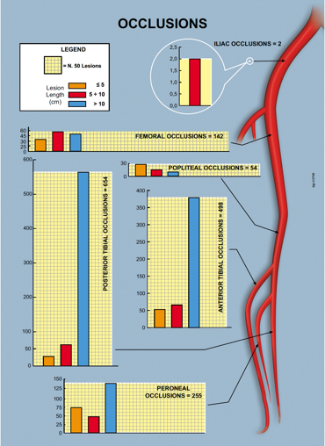
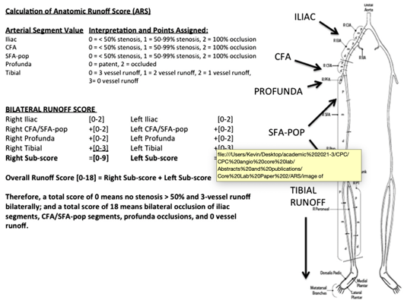
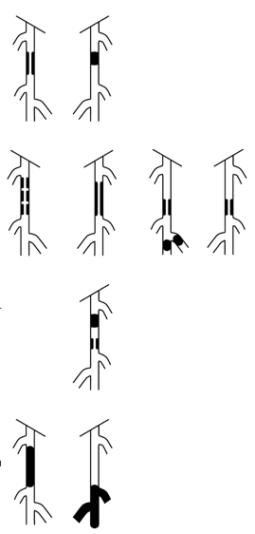
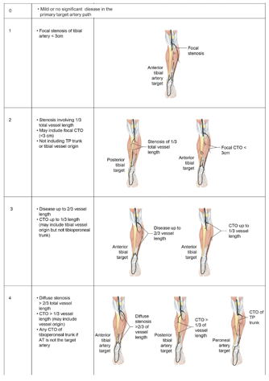
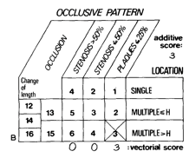
PAD Anatomic Classification Systems
BOLLINGER
GRAZIANI
ANATOMIC RUNOFF SCORE
TASC
GLASS
Angiographic anatomy of 417
CLTI patients with diabetes
was characterized
Angiogram reports of 908 patients
were reviewed
Association with traditional CV outcomes
Created by expert consensus and
systematic literature review
to predict endovascular outcomes
based on anatomy
Earliest, 1981
Case-based
Expert consensus to guide
revascularization strategies
for all PAD

Slide 6
PAD Anatomic Classification Systems
BOLLINGER
GRAZIANI
ANATOMIC RUNOFF SCORE
TASC
GLASS
Current anatomic scores are based on expert opinion or are from datasets without associations with limb-specific outcomes
Angiographic anatomy of 417
CLTI patients with diabetes
was characterized
Angiogram reports of 908 patients
were reviewed
Association with traditional CV outcomes
Created by expert consensus and
systematic literature review
to predict endovascular outcomes
based on anatomy
Earliest, 1981
Case-based
Expert consensus to guide
revascularization strategies
for all PAD

Slide 7
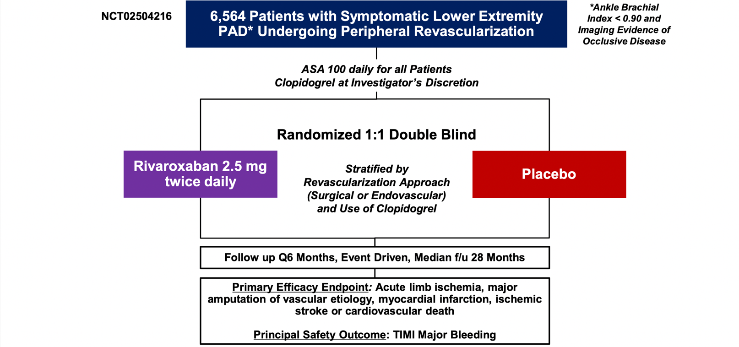
VOYAGER-PAD Trial Design

Slide 8
VOYAGER-PAD Trial Design
Angiographic studies
obtained for a core lab

Slide 9
VOYAGER-PAD Trial Design
Independent adjudication of limb-specific events available for analysis
Angiographic studies
obtained for a core lab

Slide 10

VOYAGER-PAD Angiographic Core Lab
Anatomic and Flow Characteristics Across 16 Anatomic Segments from 2646 Angiograms in Core Lab Database
Adjudicated MACE and MALE outcomes and PROs
(association with anatomy)
1. Infra-renal abdominal aorta
2. Common iliac
3. External iliac
4. Common femoral
28-month median follow-up
Profunda femoral
Superficial femoral
Severity of stenosis
Length of Disease
Calcification
Prior stenting or bypass
Thrombus
Aneurysm
Revascularization
Cross-sectional Analyses
Popliteal 1
Popliteal 2
Popliteal 3
PAD characteristics (Rutherford
Category, ABI, CLTI) associations
with anatomic features
Anterior tibial
Tibioperoneal trunk
Peroneal
Posterior tibial
Lateral plantar
Dorsalis pedis
Pedal arch
Clinical characteristics (age, sex,
diabetes, smoking, CKD) association with anatomic features

Slide 11
Generation of Stenosis-Length Severity Score
Stenosis severity of segment | Stenosis-severity Score
<50% | 0
50-69% | 1
70-99% | 2
100% | 3
For Index Limb:
Stenosis-Length score products
per segment are summed
For each segment:
Stenosis-severity score
x
Length-severity score
Length severity of segment | Length-severity Score
<1/3 | 1
1/3-2/3 | 2
>2/3 | 3
Stenosis-Length
Severity Score

Slide 12
Baseline Characteristics by Stenosis-Length Severity Score Terciles
Variable | Low Tertile n=519 | Mid Tertile n=496 | High Tertile n=522 | P value tertile 1 vs. 2 | P value tertile 2 vs. 3 | P value tertile 1 vs. 3
Age, years (mean, SD) | 66.6 (8.3) | 67 (8.3) | 68 (8.5) | 0.49 | 0.05 | 0.01
Sex, female (n, %) | 154 (29.7%) | 148 (29.8%) | 129 (24.7%) | 0.95 | 0.07 | 0.07
Black (n, %) | 17 ( 3.3%) | 21 ( 4.2%) | 24 ( 4.6%) | 0.28 | 0.07 | 0.02
BMI (mean, Kg/m2) | 27.6 | 26.8 | 26.3 | <0.01 | 0.07 | <0.01
CKD, yes (n, %) | 62 (11.9%) | 56 (11.3%) | 60 (11.5%) | 0.74 | 0.92 | 0.82
Diabetes, yes (n, %) | 208 (40.1%) | 197 (39.7%) | 248 (47.5%) | 0.91 | 0.01 | 0.02
Smoking, never (n, %) | 67 (12.9%) | 83 (16.7%) | 115 (22.0%) | 0.14 | 0.09 | <0.01
Index leg ABI at screen (mean, SD) | 0.6 (0.16) | 0.6 (0.18) | 0.5 (0.20) | <0.01 | <0.01 | <0.01

Slide 13
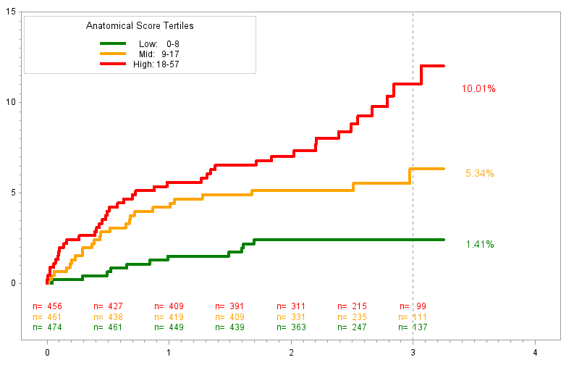
Survival Plot of MALE* by Stenosis-Length Severity Score Terciles
10.01%
10.01%
P=0.04
5.34%
P<0.01
5.34%
Percent with MALE*
1.41%
1.41%
Years
*MALE=ALI, vascular amputation

Slide 14
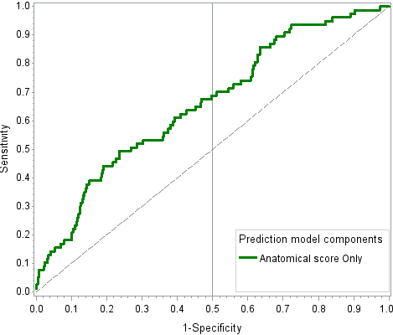
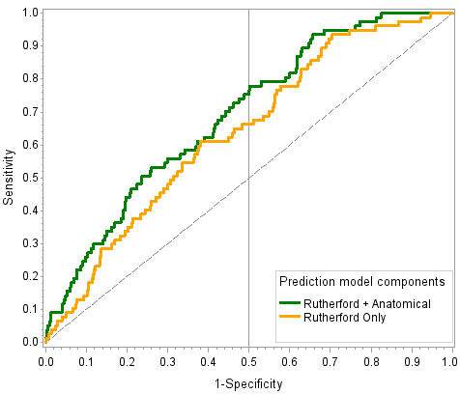
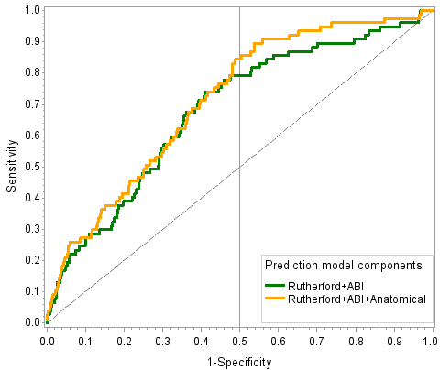
ROC Analysis for SLS Severity Score, ABI, and Rutherford for MALE*
ROC Curve for
SLS Score alone
ROC for SLS Score+Rutherford &
Rutherford Alone
ROC for SLS+ABI+Rutherford &
ABI+Rutherford
AUC=0.668
AUC=0.702
AUC=0.719
0.684
0.632
P<0.001
P<0.001
P<0.001
SLS Score
SLS Score + Rutherford
Rutherford alone
SLS+ABI+Rutherford
ABI+Rutherford
*MALE=ALI, vascular amputation

Slide 15
Conclusions
PAD is prevalent and confers increased risk of limb events
Understanding how PAD anatomy contributes to risk may improve outcomes (as in CAD)
VOYAGER-PAD Angiographic Core lab offers an opportunity to better understand the relationships with anatomy, outcomes, and PAD subgroups
The stenosis-length severity score seems to add incremental predictive value for major adverse limb events to ABI and Rutherford category

