Slide 1

CLEAR Outcomes Trial and Cardiovascular Outcome
Steven Nissen, MD, MACC
Chief Academic Officer
Heart and Vascular Institute
Lewis and Patricia Dickey Chair in Cardiovascular Medicine
Professor of Medicine
Cleveland Clinic Lerner School of Medicine
Case Western Reserve University
Cleveland, OH

Slide 2
Disclaimer
The views and opinions expressed in this educational activity are those of the faculty and do not necessarily represent the views of TotalCME, Inc., the CME providers, or the companies providing educational grants. This presentation is not intended to define an exclusive course of patient management; the participant should use their clinical judgment, knowledge, experience, and diagnostic skills in applying or adopting for professional use any of the information provided herein. Any procedures, medications, or other courses of diagnosis or treatment discussed or suggested in this activity should not be used by clinicians without evaluation of their patient's conditions and possible contraindications or dangers in use, review of any applicable manufacturer’s product information, and comparison with recommendations of other authorities. Links to other sites may be provided as additional sources of information.

Slide 3
CLEAR Outcomes Trial Design
Statin intolerance: An adverse effect that started or increased during statin therapy and resolved or improved after therapy discontinued.
Intolerance to 2 or more statins or 1 statin if unwilling to attempt a second statin or advised by physician to not attempt second statin. Very low dose statin therapy permitted (< lowest approved dose).
≥1,620 primary 4-component MACE
≥810 key secondary 3-component MACE
≥24 months follow up
Bempedoic Acid 180 mg/day
Primary or secondary prevention patients with LDL-C ≥ 100 mg/dL
3
Matching Placebo

Slide 4
Primary and Key Secondary Endpoints
Primary endpoint 4-component MACE: nonfatal MI, nonfatal stroke, coronary revascularization or cardiovascular death
Hierarchical testing of key secondary endpoints:
3-component MACE (MI, stroke or CV death)
Fatal and nonfatal MI
Coronary revascularization
Fatal and nonfatal stroke
Cardiovascular death
All cause mortality
Sequential
Testing

Slide 5
Selected Baseline Characteristics
Characteristic | Bempedoic Acid N=6992 | Placebo N=6978
Mean Age (years) | 65.5 | 65.5
Female sex | 48.1% | 48.4%
White | 91.5% | 90.8%
LDL cholesterol (mg/dL) | 139.0 | 139.0
HDL cholesterol (mg/dL) | 49.6 | 49.4
hsCRP (mg/L) | 2.3 | 2.3
High Risk Primary Prevention | 30.0% | 30.2%
Secondary Prevention | 70.0% | 69.8%
Diabetes | 45.0% | 46.3%
Baseline statin use | 22.9% | 22.5%

Slide 6
Effect of Trial Regimens on LDL-C and hsCRP
3

Slide 7
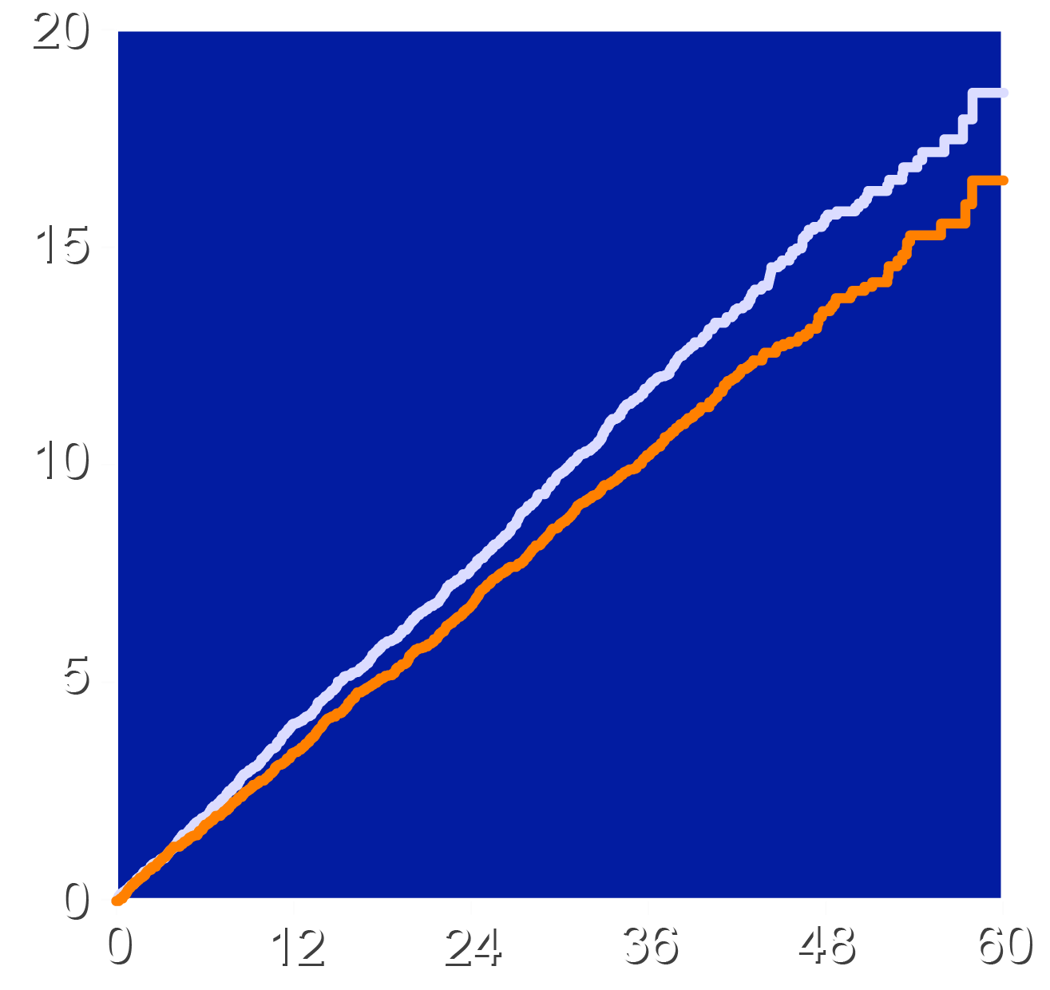
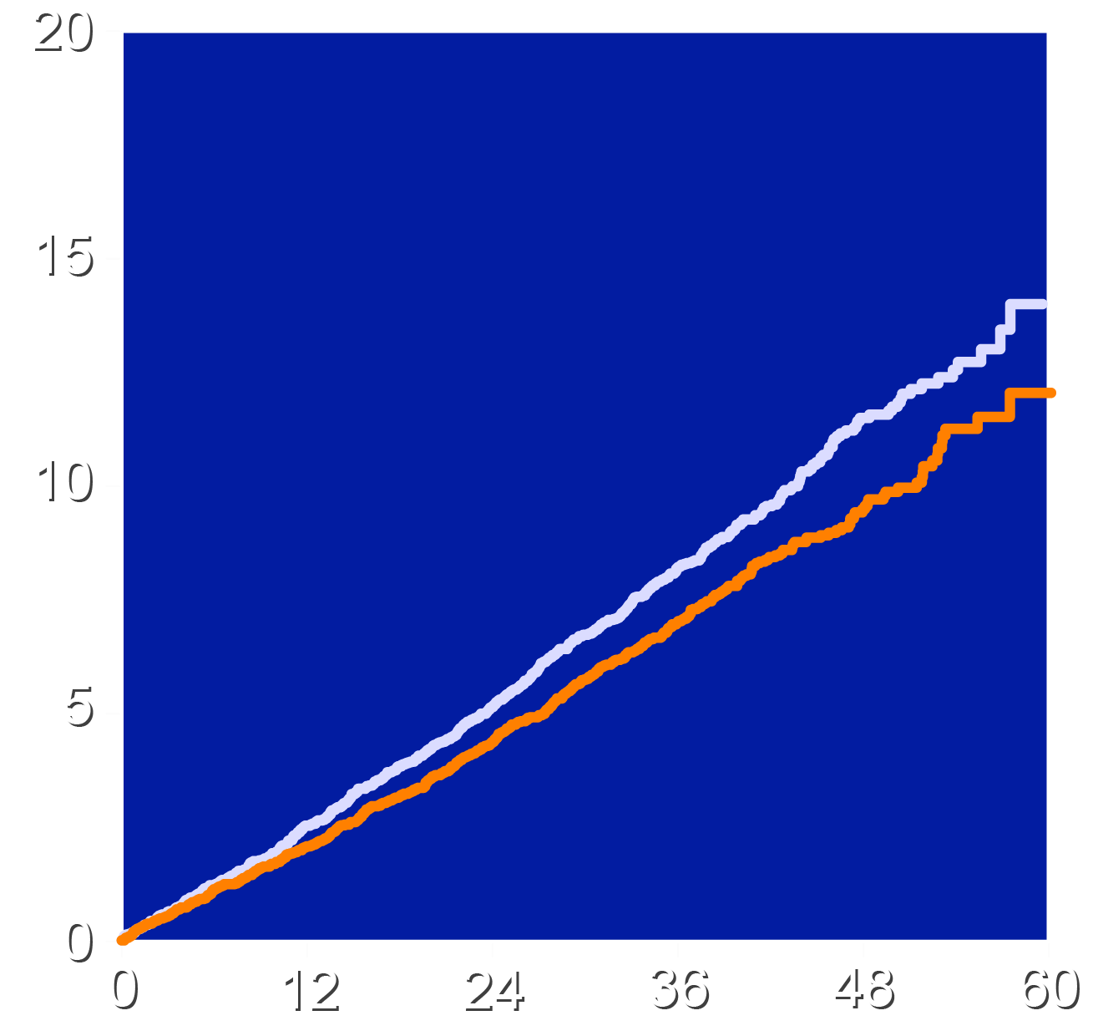
Primary and First Key Secondary Cardiovascular End Points
4-component MACE
3-component MACE
HR 0.87 (95% CI 0.79-0.96)
P=0.004
Absolute risk reduction 1.6%
NNT=63
HR 0.85 (95% CI 0.76-0.96)
P=0.006
Absolute risk reduction 1.3%
Patients with an Event (%)
Patients with an Event (%)
Placebo
Bempedoic Acid
Placebo
Bempedoic Acid
Months Since Randomization
Months Since Randomization

Slide 8
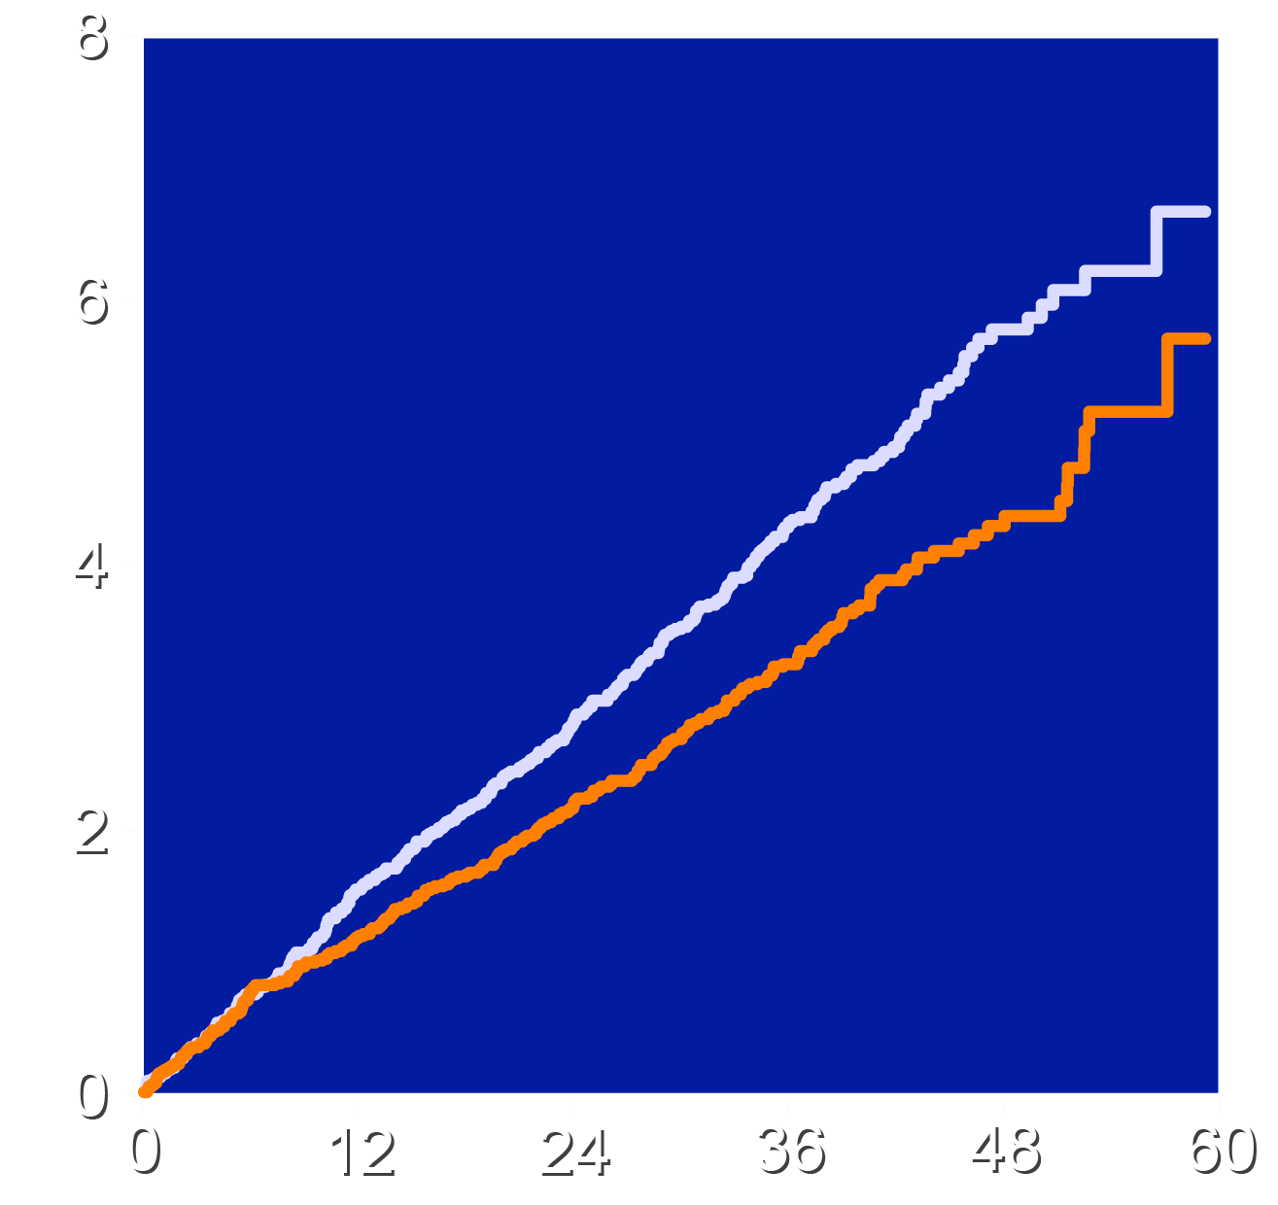
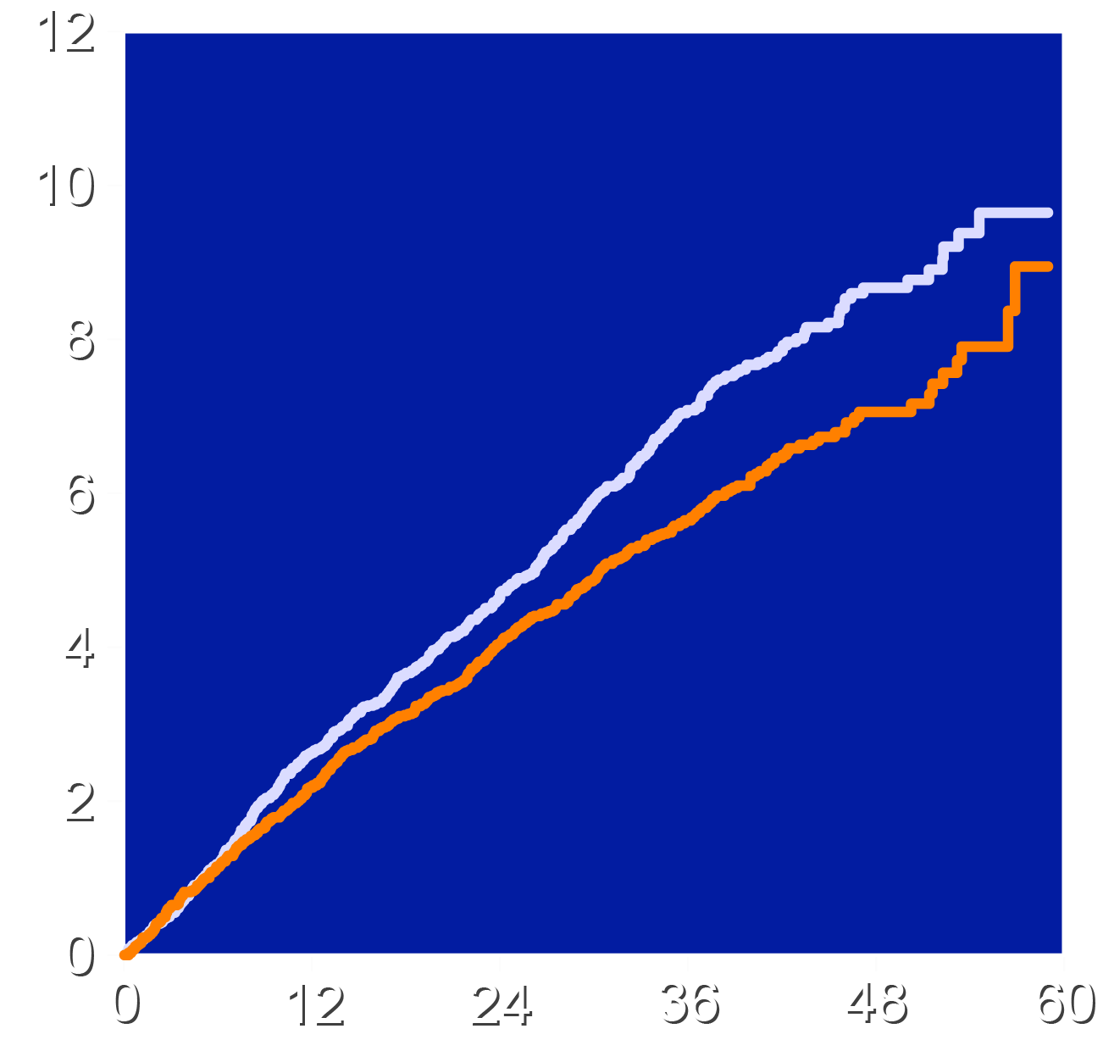
Key Secondary End Point: MI and Coronary Revascularization
Fatal and Nonfatal MI
Coronary Revascularization
HR 0.77 (95% CI 0.66-0.91)
P=0.002
Absolute risk reduction 1.1%
HR 0.81 (95% CI 0.72-0.92)
P=0.001
Absolute risk reduction 1.4%
Patients with an Event (%)
Patients with an Event (%)
Placebo
Bempedoic Acid
Placebo
Bempedoic Acid
Months Since Randomization
Months Since Randomization

Slide 9
Investigator-Reported Adverse Effects
Characteristic | Bempedoic Acid N=7001 | Placebo N=6964
Serious Treatment Emergent Adverse event | 25.2% | 24.9%
Adverse event leading to drug discontinuation | 10.8% | 10.4%
Any muscle disorder | 15.0% | 15.4%
New onset diabetes | 16.1% | 17.1%
Elevated hepatic enzymes | 4.5% | 3.0%
Prespecified renal events | 11.5% | 8.6%
Gout | 3.1% | 2.1%
Cholelithiasis | 2.2% | 1.2%
Adjudicated tendon rupture | 1.2% | 0.9%

Slide 10
Conclusions
Bempedoic acid was well-tolerated in a mixed population of primary and secondary prevention patients unable or unwilling to take statins
Bempedoic acid lowered LDL-C by 21.7% and hsCRP by 22.2% with small increases in the incidence of gout and cholelithiasis
The primary end point, 4-component MACE was reduced 13%, 3-component MACE 15%, myocardial infarction 23% and coronary revascularization 19%
These findings establish bempedoic acid as an effective approach to reduce major cardiovascular events in statin intolerant patients

