Slide 1

The STELLAR Phase 3 Trial:
A Study of Sotatercept in Combination with Background Therapy for the Treatment of Pulmonary Arterial Hypertension
Marius M. Hoeper, MD
Deputy Director, Department of Respiratory Medicine
Clinic for Respiratory Medicine
Hannover Medical School
Hannover, Germany
Marius M. Hoeper, David B. Badesch, H. Ardeschir Ghofrani, J. Simon R. Gibbs, Mardi Gomberg-Maitland, Vallerie V. McLaughlin, Ioana R. Preston, Rogerio Souza, Aaron B. Waxman, Ekkehard Grünig, Grzegorz Kopeć, Gisela Meyer,
Karen M. Olsson, Stephan Rosenkranz, Yayun Xu, Barry Miller, Marcie Fowler,
John Butler, Janethe de Oliveira Pena, Marc Humbert, for the STELLAR
Trial Investigators

Slide 2
Disclaimer
The views and opinions expressed in this educational activity are those of the faculty and do not necessarily represent the views of TotalCME, Inc., the CME providers, or the companies providing educational grants. This presentation is not intended to define an exclusive course of patient management; the participant should use their clinical judgment, knowledge, experience, and diagnostic skills in applying or adopting for professional use any of the information provided herein. Any procedures, medications, or other courses of diagnosis or treatment discussed or suggested in this activity should not be used by clinicians without evaluation of their patient's conditions and possible contraindications or dangers in use, review of any applicable manufacturer’s product information, and comparison with recommendations of other authorities. Links to other sites may be provided as additional sources of information.

Slide 3
Disclosures
Marius M. Hoeper is consultant for Acceleron Pharma Inc., a
wholly-owned subsidiary of Merck & Co., Inc., Rahway, NJ, USA.
This study was funded by Acceleron Pharma Inc., a wholly-owned subsidiary of Merck & Co., Inc., Rahway, NJ, USA.

Slide 4
Sotatercept is Proposed as a Reverse-Remodeling Agent
PAH is a progressive disease driven by pulmonary vascular remodeling due in part to an imbalance in
anti-proliferative (BMPR-II-mediated) and pro-proliferative (ActRIIA-mediated) signaling pathways, resulting in hyperproliferation of vessel wall cells.^{1,2}
Sotatercept, an activin signaling inhibitor, is proposed to act as a reverse-remodeling agent through rebalancing of anti-proliferative and pro-proliferative signaling pathways.^{3,4}
BMPs
Sotatercept
BMPs
Activin
Activin
Modified Extracellular
Domain of ActRIIA
Human IgG1Fc
Domain
Increased Vascular
Proliferation
Rebalanced toward
Vascular Homeostasis

Slide 5
STELLAR: Study Design
A Phase 3, randomized, double-blind, placebo-controlled, multicenter, parallel-group study (NCT04576988) to evaluate sotatercept on top of background PAH therapy* in adult participants with PAH with WHO FC II or III
Efficacy/safety data through treatment week 24; cumulative safety and time to death or clinical worsening as of Aug 26, 2022 are reported
Primary Endpoint: Change from baseline at week 24 in 6MWD
Double-blind primary treatment period (24 weeks)
Double-blind
extension
Secondary Endpoints (Tested hierarchically to control type 1 error)
Change from baseline at week 24 in
Multicomponent clinical improvement
  Increase ≥30 meters in 6MWD
  NT-proBNP ≥30%↓ or maintenance/ achievement of NT-proBNP <300 pg/mL
  Improvement in WHO FC or maintenance of WHO FC II
PVR, NT-proBNP, WHO FC
Time to death or first clinical worsening event though study completion (Aug 26, 2022)
French Risk Score
3 domains of PAH-SYMPACT®
Inclusion Criteria:
WHO Group 1 PAH
WHO FC II or III
Adult ≥18 years
Baseline PVR ≥400 dynes·sec·cm⁻⁵ and PCWP or LVEDP ≤15 mmHg
6MWD 150 - 500 meters
Stable treatment with background PAH therapy*
Randomization 1:1
Stratified by baseline WHO FC and background PAH therapy
Placebo every 3 weeks (N=160)
Sotatercept 0.3 mg/kg starting dose to 0.7 mg/kg every three weeks (N=163)
Total randomized: 323
*Background PAH therapy included monotherapy, double therapy or triple therapy with one or more of the following:
An endothelin receptor antagonist, a phosphodiesterase-5 inhibitor, a soluble guanylate cyclase stimulator, and/or a prostacyclin (including intravenous).

Slide 6
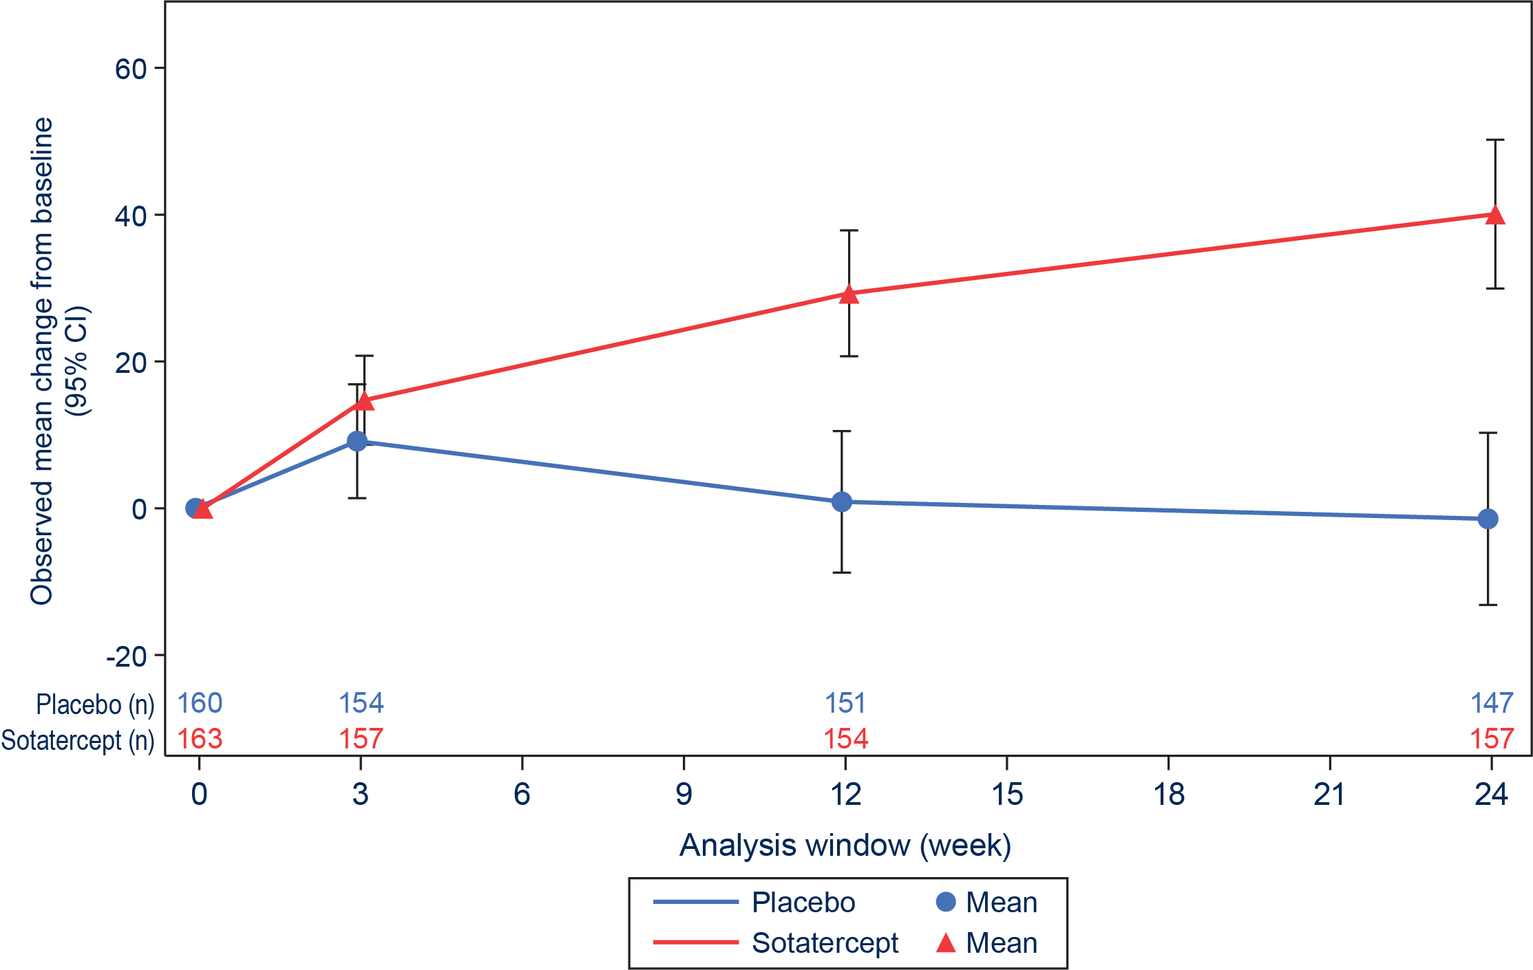
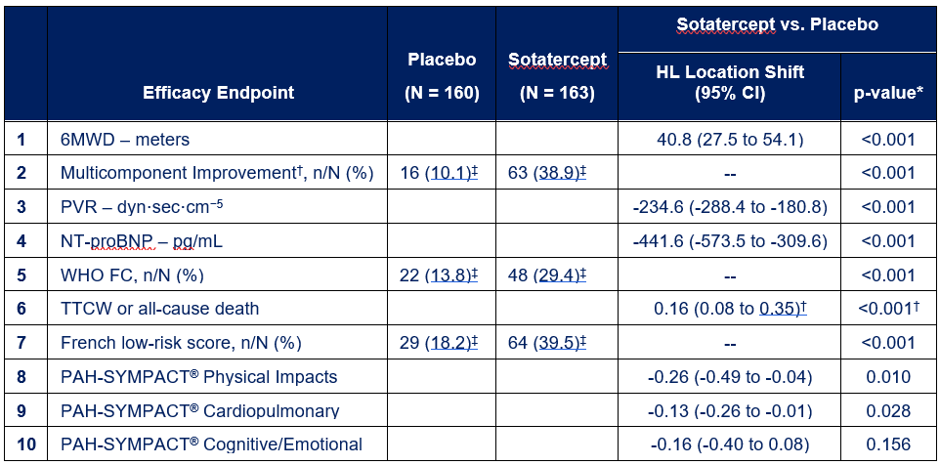
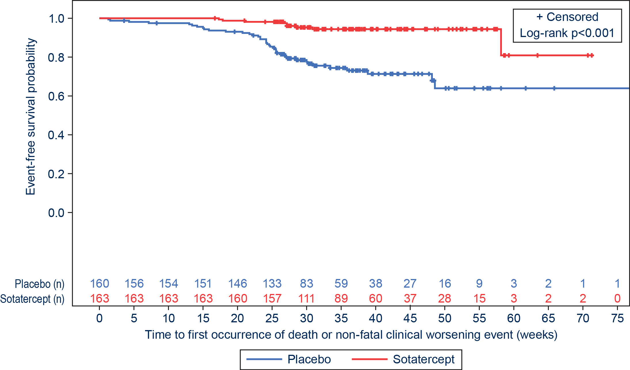
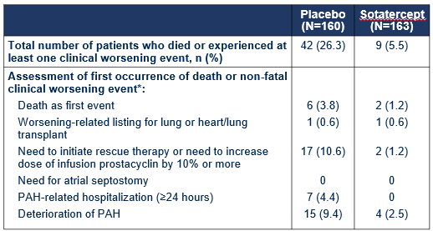
Efficacy Results:
Change from Baseline in 6MWD
+40.8 m (95% CI, 27.5 to 54.1), p<0.001
TTCW Event Analysis
HR 0.16 (95% CI, 0.08 to 0.35)
*Based on aligned rank stratified Wilcoxon test for continuous parameters or Cochran-Mantel-Haenszel method for dichotomous variables, both stratified by randomization factors.
† Defined as meeting all 3 of the following criteria at week 24: improvement in 6MWD [increase of ≥30 meters]; improvement in NT-proBNP level [decrease of ≥30%] or maintenance/achievement of NT-proBNP level <300 pg/mL; and improvement in WHO FC [shift from class III to II or I, or class II to I] or maintenance of class II.
‡For multicomponent improvement and French risk score, N= 159 (placebo) and N= 162 (sotatercept) due to one patient in each treatment group with missing data due to COVID-19 and excluded from analysis. For WHO FC, N= 159 (placebo) and N= 163 (sotatercept) due to a placebo-treated patient with missing data due to COVID-19 and excluded from analysis.
†Expressed as hazard ratio (95% CI) and log-rank test p-value.
The between-group reduction from baseline in least-squares mean pulmonary artery pressure (exploratory endpoint) at week 24 was -13.9 mmHg (95% CI: -16.0 to -11.8)

Slide 7
Overall Summary of Safety
Cumulative results through data cut-off date*
Number of patients with any | Placebo (N=160) n (%) | Sotatercept (N=163) n (%)
Treatment-Emergent adverse events (TEAEs) | 147 (91.9) | 148 (90.8)
TEAEs related to treatment | 43 (26.9) | 77 (47.2)
TEAEs leading to death | 7 (4.4) | 2 (1.2)
Severe TEAEs | 29 (18.1) | 21 (12.9)
Serious TEAEs | 44 (27.5) | 36 (22.1)
Serious TEAEs related to treatment | 2 (1.3) | 3 (1.8)
TEAEs of interest† | 72 (45.0) | 97 (59.5)
Bleeding events | 25 (15.6) | 52 (31.9)
Telangiectasia | 6 (3.8) | 23 (14.1)
Increased hemoglobin (increased hematocrit, increased RBC count) | 0 | 10 (6.1)
Thrombocytopenia | 5 (3.1) | 14 (8.6)
Increased blood pressure | 1 (0.6) | 7 (4.3)
TEAEs with incidence ≥10% in one or more treatment groups
Epistaxis | 3 (1.9) | 33 (20.2)
Telangiectasia | 6 (3.8) | 23 (14.1)
Dizziness | 7 (4.4) | 24 (14.7)
*Data cut-off date August 26, 2022.
†TEAE of interest (bleeding events, cardiac events, embryo-fetal toxicity, hepatic toxicity, immunogenicity, increased blood pressure, increased hemoglobin, leukopenia, neutropenia, renal toxicity, suppression of follicle stimulating hormone, thrombocytopenia, thromboembolic events) and special interest (telangiectasia) were predefined parameters that were monitored to assess the overall safety profile of sotatercept. Only those TEAEs in which the point estimate(s) for the between-group differences excluded zero are shown in this table.
A TEAE has a start date on or after the first dose of treatment and up to 56 days after the last dose of treatment.

Slide 8
Summary and Conclusions
STELLAR is the first Phase 3 trial of sotatercept, an activin signaling inhibitor, in adults with PAH and WHO FC II-III.
Sotatercept improved 6MWD (+40.8 m, 95% CI, 27.5 to 54.1; p<0.001) and delivered broad clinical benefit across multiple domains including hemodynamics, WHO functional class, disease biomarkers, risk scores and patient-reported outcomes.
Sotatercept reduced the risk of death and non-fatal clinical worsening events by 84% vs placebo (HR: 0.16 [95% CI: 0.08 to 0.35]).
Sotatercept was generally well tolerated.
  Adverse events more frequent with sotatercept vs placebo: minor bleeding events, telangiectasia, dizziness, increased hemoglobin levels, thrombocytopenia and increased blood pressure.
These results establish the clinical utility of sotatercept, administered in combination with approved PAH therapies, as a new treatment for PAH.

