Slide 1
2022 ESC/ERS Guidelines for the Diagnosis and Treatment of Pulmonary Hypertension: Updates on Diagnosis
Jean Elwing, MD
Professor of Medicine
Director, Pulmonary Hypertension Program
Division of Pulmonary, Critical Care and Sleep Medicine
University of Cincinnati
Cincinnati, OH
MarcHumbert (France),Gabor Kovacs (Austria), Marius M. Hoeper (Germany), Roberto Badagliacca (Italy), Rolf M.F. Berger (Netherlands), Margarita Brida (Croatia), Jørn Carlsen (Denmark), Andrew J.S. Coats (United Kingdom), Pilar Escribano-Subias (Spain), Pisana Ferrari (Italy), Diogenes S. Ferreira (Brazil), Hossein Ardeschir Ghofrani (Germany), George Giannakoulas (Greece), David G. Kiely (United Kingdom), Eckhard Mayer (Germany), Gergely Meszaros (Hungary), Blin Nagavci (Germany), Karen M. Olsson (Germany), Joanna Pepke-Zaba (United Kingdom), Jennifer K. Quint (United Kingdom), Göran Rådegran (Sweden), Gerald Simonneau (France), Olivier Sitbon (France), Thomy Tonia (Switzerland), Mark Toshner (United Kingdom), Jean-Luc Vachiery (Belgium), Anton Vonk Noordegraaf (Netherlands), Marion Delcroix *† (ERS Chairperson) (Belgium), Stephan Rosenkranz *† (ESC Chairperson) (Germany), and ESC/ERS Scientific Document Group
Eur Heart J. 2022;43(38):3618-3731. doi:10.1093/eurheartj/ehac237

Slide 2
2022 ERS/ESC Pulmonary Hypertension Guidelines: The Fundamentals
What’s new?
New definition of pulmonary hypertension
  Revised PVR cutoff
  Definition of exercise PH
Classification of PH has been updated
Diagnostic algorithm has been updated
  Change to vasoreactive iPAH
  Screening protocols for early PH detection
Risk stratification
  Includes new echocardiographic and cMRI prognostic indicators and changes to the risk table
  4-strata risk-assessment tool based on new cutoff levels
Revised risk table
Treatment algorithm revised to incorporate cardiopulmonary comorbidities, risk assessment, and combination therapy
  Specific recommendations on initial therapy in Group 1, use of PDE5is in Group 2 (PICO II) and Group 3 (PICO III)
Group 4: Chronic thromboembolic pulmonary disease (CTEPD) with or without PH
New standards for PH centers

Slide 3
In This Installment, Let’s Focus on These Changes…
What’s new?
New definition of pulmonary hypertension
  Revised PVR cutoff
  Definition of exercise PH
Classification of PH has been updated
Diagnostic algorithm has been updated
  Change to vasoreactive iPAH
  Screening protocols for early PH detection
Risk stratification
  Includes new echocardiographic and cMRI prognostic indicators and changes to the risk table
  4-strata risk-assessment tool based on new cutoff levels
Revised risk table
Treatment algorithm revised to incorporate cardiopulmonary comorbidities, risk assessment, and combination therapy
  Specific recommendations on initial therapy in Group 1, use of PDE5is in Group 2 (PICO II) and Group 3 (PICO III)
Group 4: Chronic thromboembolic pulmonary disease (CTEPD) with or without PH
New standards for PH centers
A new diagnostic algorithm has been developed aiming at earlier detection of PH in the community

Slide 4
ERS/ESC 2022: Diagnosis Essential Aspects
The diagnostic approach to PH is focused mainly on two tasks:
Raise early suspicion of PH and ensure fast-track referral to PH centers for patients with a high likelihood of PAH, CTEPH, or other forms of severe PH
Identify underlying diseases, especially LHD (group 2 PH) and lung disease (group 3 PH), as well as comorbidities, to ensure proper classification, risk assessment, and treatment
Diagnostic and disease monitoring procedures have been updated into the 3-strata risk table previously used in the 2019 guidelines
Important to note that the 2022 ERS/ESC guidelines for PAH have recommended a 4-strata risk-assessment algorithm for routine postdiagnosis assessment of patient risk
  Based on refined cutoff levels for WHO-FC, 6MWD, and NT-proBNP, categorizing patients as low, intermediate-low, intermediate-high, or high risk

Slide 5
Initial Comprehensive Risk Assessment in PAH (3-Strata Model): What’s Been Added or Changed?
Determinants of prognosis (estimated 1-year mortality) | Low risk (<5%) | Intermediate risk (5-20%) | High risk (>20%)
Clinical signs of right heart failure | Absent | Absent | Present
Progression of symptoms | No | Slow | Rapid
Syncope | No | Occasional syncope | Repeated syncope
WHO functional class | I, II | III | IV
6MWD | >440 m | 165-440 m | <165 m
Cardiopulmonary exercise testing | Peak VO₂ >15 ml/min/kg (>65% predicted) VE/VCO₂ slope <36 | Peak VO₂ 11-15 ml/min/kg (35-65% predicted) VE/VCO₂ slope 36-44 | Peak VO₂ <11 ml/min/kg (<35% predicted) VE/VCO₂ slope >44
NT-proBNP levels | BNP <50 ng/L NT-pro BNP <300 ng/L | BNP 50-800 ng/L NT-pro BNP 300-1100 ng/L | BNP >800 ng/L NT-pro BNP >1100 ng/L
Echocardiography | RA area, 18 cm² TAPSE/sPAP >0.32 mm/mmHg No pericardial effusion | RA area 18-26 cm² TAPSE/sPAP 0.19-0.32 mm/ mmHg Minimal pericardial effusion | RA area >26 cm² TAPSE/sPAP <0.19 mm/mmHg Moderate or large pericardial effusion
cMRI | RVEF .54% SVI .40 mL/m² RVESVI <42 mL/m² | RVEF 37-54% SVI 26-40 mL/m² RVESVI 42-54 mL/m² | RVEF ,37% SVI <26 mL/m² RVESVI >54 mL/m²
Hemodynamics | RAP <8 mmHg CI ≥2.5 L/min/m² SVI >38 mL/m² SvO₂ >65% | RAP 8-14 mmHg CI 2.0-2.4 L/min/m² SVI 31-38 mL/m² SvO₂ 60-65% | RAP >14 mmHg CI <2.0 L/min/m² SVI <31 mL/m² SvO₂ <60%

Slide 6
Diagnosis: New Additions to Diagnostic Steps
Echocardiography: Cutoff values for TAPSE/sPAP >0.32 mm/mmHg to <0.19 mm/mmHg to determine low-risk and high-risk status, respectively
cMRI imaging: Cutoff limits for RVEF >54%, SVI >40 mL/m², RVESVI <42 mL/m² to RVEF <37%, SVI <26 mL/m², RVESVI >54 mL/m² to determine low-risk and high-risk status, respectively
SVI criteria are now added with the cutoff values of >38 mL/m² and <31 mL/m² to determine low-risk and high-risk status, respectively

Slide 7
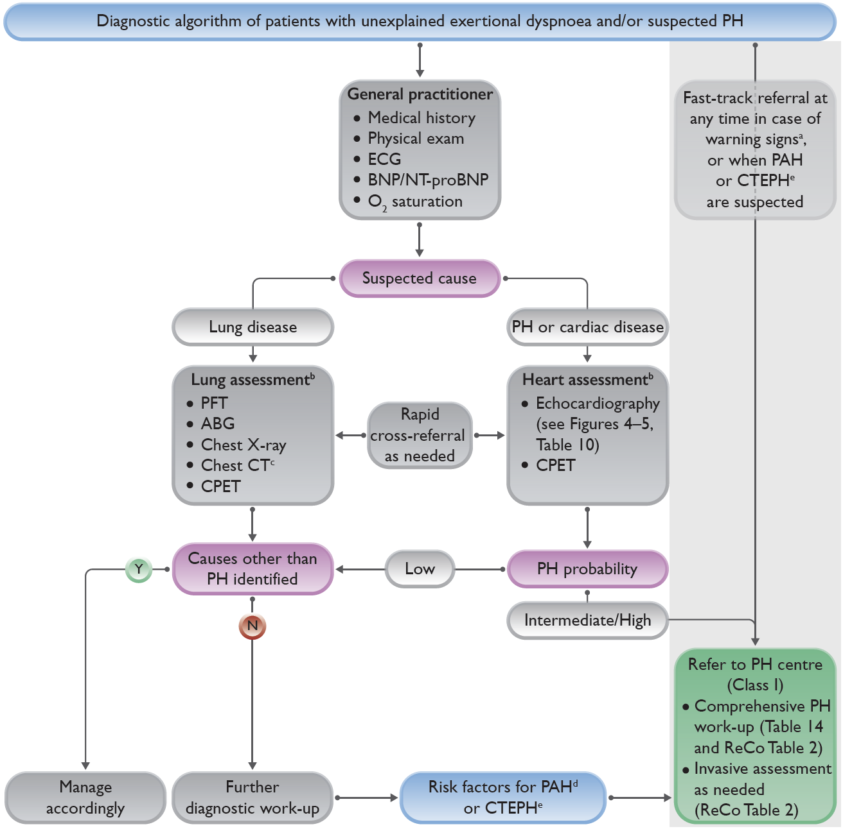
2022 Diagnostic Algorithm of Patients with Unexplained Dyspnea and/or Suspected Pulmonary Hypertension
a.
e.
Warning signs include rapid progression of symptoms, severely reduced exercise capacity, pre-syncope or syncope on mild exertion, signs of right heart failure
Lung and heart assessment by specialist as per local practice
As indicated; CT pulmonary angiography recommended if PH suspected
Includes connective tissue disease (especially systemic sclerosis), portal hypertension, HIV infection, and family history of PAH
History of PE, permanent intravascular devices, inflammatory bowel diseases, essential thrombocythemia, splenectomy, high-dose thyroid hormone replacement, and malignancy
b.
b.
c.
d.
e.

Slide 8
2022 ERS/ESC Recommendations for Diagnosis
Echocardiography is recommended as the first-line, noninvasive, diagnostic investigation in suspected PH
It is recommended to assign an echocardiographic probability of PH, based on an abnormal TRV and the presence of other echocardiographic signs suggestive of PH
It is recommended to maintain the current threshold for TRV (>2.8 m/s) for echocardiographic probability of PH according to the updated hemodynamic definition

Slide 9
2022 ERS/ESC Recommendations for Diagnosis
Ventilation/perfusion or perfusion lung scan is recommended in patients with unexplained PH to assess for CTEPH
CT pulmonary angiography is recommended in the work-up of patients with suspected CTEPH
Routine biochemistry, hematology, immunology, HIV testing, and thyroid function tests are recommended in all patients with PAH to identify associated conditions
Abdominal ultrasound is recommended for the screening of portal hypertension
Pulmonary function tests with DLCO are recommended in the initial evaluation of patients with PH
Open or thoracoscopic lung biopsy is not recommended in patients with PAH

Slide 10
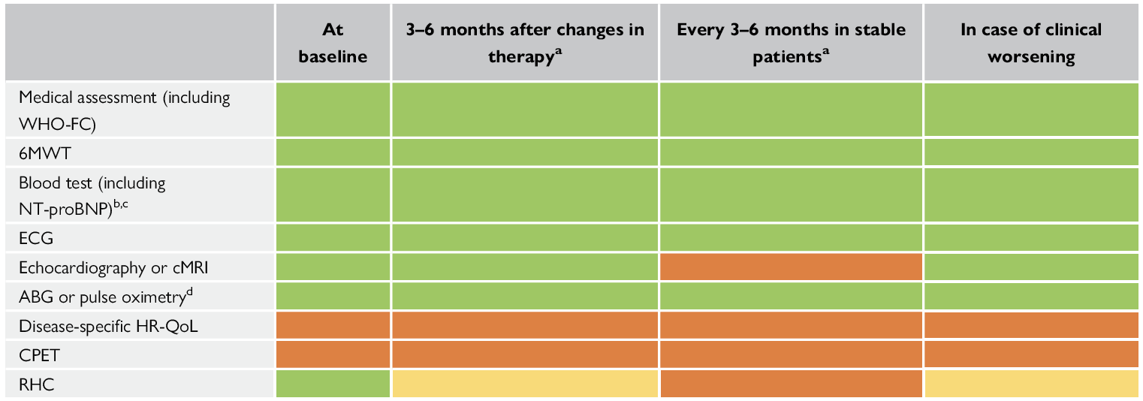
Frequency of Follow-Up Testing in Your PAH Patients
6MWT, 6-minute walking test; ABG, arterial blood gas analysis; ALAT, alanine aminotransferase; ASAT, aspartate aminotransferase; BNP, brain natriuretic peptide; cMRI, cardiac magnetic resonance imaging; CPET, cardiopulmonary exercise testing; ECG, electrocardiogram; HR-QoL, health-related quality of life; INR, international normalized ratio; NT-proBNP, N-terminal pro-brain natriuretic peptide; PAH, pulmonary arterial hypertension; RHC, right heart catheterization; TSH, thyroid-stimulating hormone; WHO-FC, World Health Organization functional class
Green: is indicated; Yellow: should be considered; Orange: may be considered
a: Intervals to be adjusted according to patient needs, PAH etiology, risk category, demographics, and comorbidities
b: Basic laboratory tests include blood count, INR (in patients receiving vitamin K antagonists), serum creatinine, sodium, potassium, ASAT/ALAT, bilirubin, and BNP/NT-proBNP
c: Extended laboratory tests (e.g. TSH, troponin, uric acid, iron status, etc.) according to clinical circumstances.
d: ABG should be performed at baseline but may be replaced by pulse oximetry in stable patients at follow-up

Slide 11
To Summarize:
The main diagnostic algorithm for PH has been simplified following a three-step approach, from suspicion by first-line physicians, detection by echocardiography, and confirmation with RHC in PH centers. Warning signs associated with worse outcomes have been identified, which justify immediate referral and management in PH centers
The 3-strata risk-stratification assessment in PAH has been refined after being validated in multiple registries. The MRI and echocardiographic criteria have been added to the ESC/ERS table, refining noninvasive evaluation at diagnosis
A 4-strata risk stratification, dividing the large, intermediate-risk group into intermediate–low and intermediate–high risk, is proposed at follow-up
It is recommended to evaluate disease severity in patients with PAH with a panel of data derived from clinical assessment, exercise tests, biochemical markers, echocardiography, and hemodynamic evaluations

