Slide 1
2022 ESC/ERS Guidelines for the Diagnosis and Treatment of Pulmonary Hypertension: A Look at Group I Treatment Guideline Updates
Marc Humbert (France),Gabor Kovacs (Austria), Marius M. Hoeper (Germany), Roberto Badagliacca (Italy), Rolf M.F. Berger (Netherlands), Margarita Brida (Croatia), Jørn Carlsen (Denmark), Andrew J.S. Coats (United Kingdom), Pilar Escribano-Subias (Spain), Pisana Ferrari (Italy), Diogenes S. Ferreira (Brazil), Hossein Ardeschir Ghofrani (Germany), George Giannakoulas (Greece), David G. Kiely (United Kingdom), Eckhard Mayer (Germany), Gergely Meszaros (Hungary), Blin Nagavci (Germany), Karen M. Olsson (Germany), Joanna Pepke-Zaba (United Kingdom), Jennifer K. Quint (United Kingdom), Göran Rådegran (Sweden), Gerald Simonneau (France), Olivier Sitbon (France), Thomy Tonia (Switzerland), Mark Toshner (United Kingdom), Jean-Luc Vachiery (Belgium), Anton Vonk Noordegraaf (Netherlands), Marion Delcroix *† (ERS Chairperson) (Belgium), Stephan Rosenkranz *† (ESC Chairperson) (Germany), and ESC/ERS Scientific Document Group
Eur Heart J. 2022;43(38):3618-3731. doi:10.1093/eurheartj/ehac237
Jean Elwing, MD Professor of Medicine Director, Pulmonary Hypertension Program Division of Pulmonary, Critical Care and Sleep Medicine University of Cincinnati Cincinnati, OH

Slide 2
2022 ERS/ESC Pulmonary Hypertension Guidelines: The Fundamentals
What’s new?
New definition of pulmonary hypertension (PH)
Revised PVR cutoff
Definition of exercise PH
Classification of PH has been updated
Diagnostic algorithm has been updated
Change to vasoreactive iPAH
Screening protocols for early PH detection
Risk stratification
Includes new echocardiographic and cMRI prognostic indicators and changes to the risk table
4-strata risk assessment tool based on new cutoff levels
Revised risk table
Treatment algorithm revised to incorporate cardiopulmonary comorbidities, risk assessment, and combination therapy
Specific recommendations on initial therapy in Group 1, use of PDE5is in Group 2 (PICO II) and Group 3 (PICO III)
Group 4: Chronic thromboembolic pulmonary disease (CTEPD) with or without PH
New standards for PH centers

Slide 3
In This Installment, Let’s Focus on These Changes…
What’s new?
New definition of pulmonary hypertension (PH)
Revised PVR cutoff
Definition of exercise PH
Classification of PH has been updated
Diagnostic algorithm has been updated
Change to vasoreactive iPAH
Screening protocols for early PH detection
Risk stratification
Includes new echocardiographic and cMRI prognostic indicators and changes to the risk table
4-strata risk assessment tool based on new cutoff levels
Revised risk table
Treatment algorithm revised to incorporate cardiopulmonary comorbidities, risk assessment, and combination therapy
Specific recommendations on initial therapy in Group 1, use of PDE5is in Group 2 (PICO II) and Group 3 (PICO III)
Group 4: Chronic thromboembolic pulmonary disease (CTEPD) with or without PH
New standards for PH centers

Slide 4
There Is a Spectrum of Management Options for PAH Based on Risk
What should be the initial treatment strategy for PAH?
Intermediate-risk patients can be treated with an initial treatment strategy of either maximal medical therapy with triple combination therapy, including a parenteral prostacyclin, or aggressive titration with dual oral therapy
Selection of a treatment strategy requires shared decision-making
The risks, uncertainties, and potential benefits of maximal medical therapy with upfront triple combination therapy, including a parenteral prostacyclin, should be discussed at the time of diagnosis
There should be a plan for a rapid reassessment of response at 3 months if an aggressive titration strategy is chosen

Slide 5
What Is New in Treatment of PH?
Initial treatment strategy for group 1 PH (Population, Intervention, Control, Outcome) (PICO I)
Use of oral phosphodiesterase 5 inhibitors (PDE5is) for the treatment of group 2 PH (PICO II)
Use of oral PDE5is for the treatment of group 3 PH (PICO III)
Use of PH drugs prior to BPA for the treatment of group 4 PH (PICO IV)
Therapeutic course is determined by vasoreactivity test results obtained during diagnosis

Slide 6
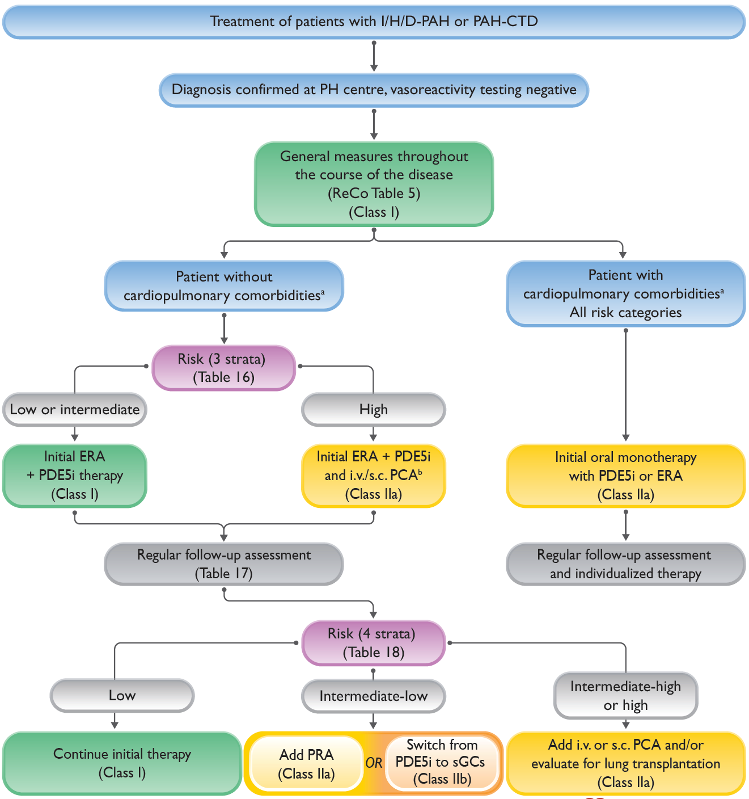
Treatment Algorithm for Idiopathic, Heritable, Drug-Associated, and CTD-Associated PAH
Key:
DLco: lung diffusion capacity for carbon monoxide
ERA: endothelin receptor antagonist
I/H/D-PAH: idiopathic, heritable, or drug-associated pulmonary arterial hypertension
i.v.: intravenous
PAH-CTD: PAH associated with connective tissue disease
PCA: prostacyclin analogue
PDE5i: phosphodiesterase 5 inhibitor
PRA: prostacyclin receptor agonist
ReCo: recommendation
s.c.: subcutaneous
sGCs: soluble guanylate cyclase stimulator
Cardiopulmonary comorbidities are conditions associated with an increased risk of left ventricular diastolic dysfunction, and include obesity, hypertension, diabetes mellitus, and coronary heart disease; pulmonary comorbidities may include signs of mild parenchymal lung disease and are often associated with a low DLco (<45% of the predicted value)
Intravenous epoprostenol or i.v./s.c. treprostinil

Slide 7
For the Vasoreactive Group I Patient…
Continuing high doses of CCBs is recommended in patients with IPAH, HPAH, or DPAH in WHO-FC I or II with marked hemodynamic improvement (mPAP <30 mmHg and PVR <4 WU)
In patients with a positive vasoreactivity test but insufficient long-term response to CCBs who require additional PAH therapy, continuation of CCB therapy should be considered

Slide 8
Treatment of Non-vasoreactive Patients With Idiopathic, Drug-Induced or Heritable PAH Presenting Without Cardiopulmonary Comorbidities
In patients with IPAH/HPAH/DPAH who present at high risk of death, initial combination therapy with a PDE5i, an ERA, and i.v./s.c. prostacyclin analogues should be considered
In patients presenting at intermediate-low risk of death while receiving ERA/ PDE5i therapy, the addition of selexipag should be considered
In patients presenting at intermediate-high or high risk of death while receiving ERA/PDE5i therapy, the addition of i.v./s.c. prostacyclin analogues and referral for lung transplantation evaluation should be considered

Slide 9
Initial Combination Therapy Recommendations: Group I Non-vasoreactive Patients
Initial oral drug combination therapy for patients with idiopathic, heritable, or drug-associated pulmonary arterial hypertension without cardiopulmonary comorbidities
Initial combination therapy with ambrisentan and tadalafil is recommended
Initial combination therapy with macitentan and tadalafil is recommended
Initial combination therapy with other ERAs and PDE5is should be considered
Initial combination therapy with macitentan, tadalafil, and selexipag is not recommended

Slide 10
Sequential Drug Combination Therapy for Group I PAH
It is recommended to base treatment escalations on risk assessment and general treatment strategies (see treatment algorithm)
The addition of macitentan to PDE5is or oral/inhaled prostacyclin analogues is recommended to reduce the risk of morbidity/mortality events
The addition of oral treprostinil to ERA or PDE5i/ riociguat monotherapy is recommended to reduce the risk of morbidity/mortality events
The addition of riociguat to bosentan should be considered to improve exercise capacity
The addition of bosentan to sildenafil is not recommended to reduce the risk of morbidity/mortality events

Slide 11
For the Non-vasoreactive Group I Patient With Cardiopulmonary Comorbidities…
In patients with IPAH/HPAH/DPAH and cardiopulmonary comorbidities, initial monotherapy with a PDE5i or an ERA should be considered
In patients with IPAH/HPAH/DPAH with cardiopulmonary comorbidities who present at intermediate or high risk of death while receiving PDE5i or ERA monotherapy, additional PAH medication may be considered on an individual basis

Slide 12
Key Take-Aways and Remaining Gaps in Knowledge: Group I PAH
The treatment algorithm for PAH has been simplified, with a clear focus on risk assessment, cardiopulmonary comorbidities, and treatment goals. Initial combination therapy and treatment escalation at follow-up when appropriate are current standards
A 4-strata risk stratification, dividing the large, intermediate-risk group into intermediate-low and intermediate-high risk, is proposed at follow-up
The efficacy and safety of PAH drugs in group 1 patients with an mPAP 21-24 mmHg, PVR 2-3 WU, and exercise PH has yet to be established
The role of PAH drugs in different PAH subgroups, including schistosomiasis-associated PAH, needs to be explored
Impact of PAH therapies and treatment strategies on survival needs to be further assessed

