Slide 1
2022 ESC/ERS Guidelines for the Diagnosis and Treatment of Pulmonary Hypertension
Vallerie V. McLaughlin, MD
Associate Chief Clinical Officer, Cardiovascular Services
Director, Pulmonary Hypertension Program
University of Michigan
Ann Arbor, MI
Marc Humbert (France),Gabor Kovacs (Austria), Marius M. Hoeper (Germany), Roberto Badagliacca (Italy), Rolf M.F. Berger (Netherlands), Margarita Brida (Croatia), Jørn Carlsen (Denmark), Andrew J.S. Coats (United Kingdom), Pilar Escribano-Subias (Spain), Pisana Ferrari (Italy), Diogenes S. Ferreira (Brazil), Hossein Ardeschir Ghofrani (Germany), George Giannakoulas (Greece), David G. Kiely (United Kingdom), Eckhard Mayer (Germany), Gergely Meszaros (Hungary), Blin Nagavci (Germany), Karen M. Olsson (Germany), Joanna Pepke-Zaba (United Kingdom), Jennifer K. Quint (United Kingdom), Göran Rådegran (Sweden), Gerald Simonneau (France), Olivier Sitbon (France), Thomy Tonia (Switzerland), Mark Toshner (United Kingdom), Jean-Luc Vachiery (Belgium), Anton Vonk Noordegraaf (Netherlands), Marion Delcroix *† (ERS Chairperson) (Belgium), Stephan Rosenkranz *† (ESC Chairperson) (Germany), and ESC/ERS Scientific Document Group
European Heart Journal. 2022;00:1–114. doi:1093/eurheartj/ehac237

Slide 2
2022 ERS/ESC Pulmonary Hypertension Guidelines: The Fundamentals
What’s new?
New definition of pulmonary hypertension (PH)
  Revised pulmonary vascular resistance (PVR) cutoff
  Definition of exercise PH
Classification of PH has been updated
Diagnostic algorithm has been updated
  Change to vasoreactive idiopathic pulmonary arterial hypertension (iPAH)
  Screening protocols for early PH detection
Risk stratification
  Includes new echocardiographic and angiography (cMRI) prognostic indicators and changes to the risk table
  Four-strata risk-assessment tool based on new cutoff levels
Revised risk table
Treatment algorithm revised to incorporate cardiopulmonary comorbidities, risk assessment, and combination therapy
  Specific recommendations on initial therapy in Group 1, use of phosphodiesterase 5 inhibitor (PDE5i) in Group 2 (PICO II) and Group 3 (PICO III)
Group 4: Chronic thromboembolic pulmonary disease (CTEPD) with or without PH
New standards for PH centers

Slide 3
In This First Installment, Let’s Focus On These Changes…
What’s new?
New definition of pulmonary hypertension (PH)
  Revised pulmonary vascular resistance (PVR) cutoff
  Definition of exercise PH
Classification of PH has been updated
Diagnostic algorithm has been updated
  Change to vasoreactive idiopathic pulmonary arterial hypertension (iPAH)
  Screening protocols for early PH detection
Risk stratification
  Includes new echocardiographic and angiography (cMRI) prognostic indicators and changes to the risk table
  Four-strata risk-assessment tool based on new cutoff levels
Revised risk table
Treatment algorithm revised to incorporate cardiopulmonary comorbidities, risk assessment, and combination therapy
  Specific recommendations on initial therapy in Group 1, use of phosphodiesterase 5 inhibitor (PDE5i) in Group 2 (PICO II) and Group 3 (PICO III)
Group 4: Chronic thromboembolic pulmonary disease (CTEPD) with or without PH
New standards for PH centers

Slide 4
The 2022 Definitions of Pulmonary Hypertension
Definition | Hemodynamic characteristics
Pulmonary hypertension | mPAP >20 mmHg
Precapillary pulmonary hypertension | mPAP >20 mmHg PAWP ≤15 mmHg PVR >2 WU
Isolated postcapillary pulmonary hypertension (IpcPH) | mPAP >20 mmHg PAWP >15 mmHg PVR ≤2 WU
Combined pre- and postcapillary pulmonary hypertension (CpcPH) | mPAP >20 mmHg PAWP >15 mmHg PVR >2 WU
Exercise pulmonary hypertension | mPAP/CO Slope between rests and exercise >3 mmHg/L/min
Some patients present with elevated mPAP (>20 mmHg) but low PVR (≤2 WU) and low PAWP (≤15 mmHg)
This hemodynamic condition may be described by the term “unclassified PH” (see text for further details)
mPAP: Mean pulmonary arterial pressure
WU : Wood Units
CO: Cardiac Output

Slide 5
ERS/ESC 2022: New Clinical Classifications of PH
Pulmonary arterial hypertension
1.1 Idiopathic PAH 1.1.1 Nonresponders at vasoreactivity testing 1.1.2 Acute responders at vasoreactivity testing
1.2 Heritable PAHª 1.3 Drugs and toxins inducedª
1.4 Associated with:
1.4.1 Connective tissue disease
1.4.2 HIV infection
1.4.3 Portal hypertension
1.4.4 Congenital heart disease
1.4.5 Schistosomiasis
1.5 PAH with features of venous/capillary (PVOD/PCH) involvement
1.6 Persistent PH of the newborn syndrome
3. PH due to lung diseases and/or hypoxia
3.1 Obstructive lung disease or emphysema
3.2 Restrictive lung disease
3.3 Lung disease with mixed restrictive/obstructive pattern
3.4 Hypoventilation syndrome
3.5 Hypoxia without lung disease
3.6 Developmental lung disorders (Table P3)
4. PH associated with pulmonary artery obstructions
4.1 Chronic thromboembolic PH
4.2 Other pulmonary artery obstructions^{c}
5. PH with unclear mechanisms
5.1 Hematologic disorders^{d}
5.2 Systemic disorders^{e}
5.3 Metabolic disorders^{f}
5.4 Chronic renal failure with or without hemodialysis
5.5 Pulmonary tumor thrombotic microangiopathy 5.6 Fibrosing mediastinitis
2. PH associated with left heart disease
2.1 Heart failure
2.1.1 PH due to heart failure with preserved ejection fraction EF 2.1.2 With reduced or mildly reduced ejection fraction^{b}
2.2 Valvular heart disease
2.3 Congenital/acquired cardiovascular conditions leading to postcapillary PH
HF: heart failure; HIV: human immunodeficiency virus; PAH: pulmonary arterial hypertension; PCH: pulmonary capillary hemangiomatosis; PH: pulmonary hypertension; PVOD: pulmonary veno-occlusive disease
Patients with heritable PAH or PAH associated with drugs and toxins might be acute responders
Left ventricular ejection fraction for HF with reduced ejection fraction: ≤40%; for HF with mildly reduced ejection fraction: 41-49%
Other causes of pulmonary artery obstructions include: sarcomas (high- or intermediate-grade or angiosarcoma), other malignant tumors (e.g., renal carcinoma, uterine carcinoma, germ-cell tumors of the testis), non-malignant tumors (e.g., uterine leiomyoma), arteritis without connective tissue disease, congenital pulmonary arterial stenoses, and hydatidosis
Including inherited and acquired chronic hemolytic anemia and chronic myeloproliferative disorders
Including sarcoidosis, pulmonary Langerhans’s cell histiocytosis, and neurofibromatosis type 1
Including glycogen storage diseases and Gaucher disease

Slide 6
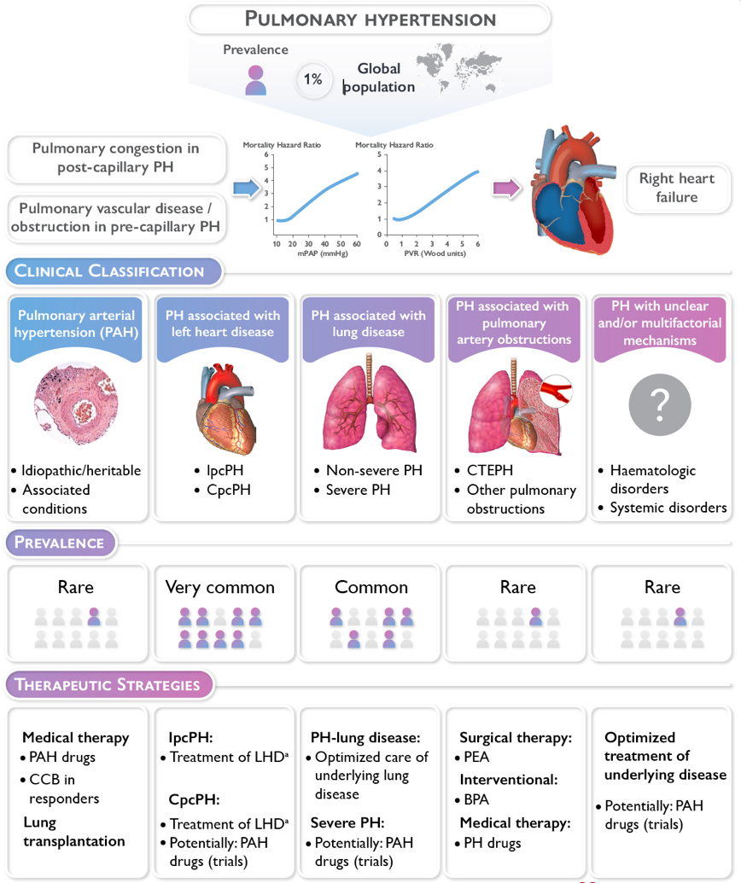
An Overall Look at the New
ERS/ESC Views on PH Classification
BPA: balloon pulmonary angioplasty
CCB: calcium channel blocker
CTEPH: chronic thrombo-embolic pulmonary hypertension
CpCPH: combined post- and pre-capillary pulmonary hypertension
IpcPH: isolated post-capillary pulmonary hypertension; LHD, left heart disease
PAH: pulmonary arterial hypertension
PEA: pulmonary endarterectomy
PH: pulmonary hypertension
Treatment of heart failure according to the ESC Guidelines for the diagnosis and treatment of acute and chronic heart failure
Treatment of left-sided valvular heart disease according to the 2021
ESC/EACTS Guidelines for the management of valvular heart disease

Slide 7
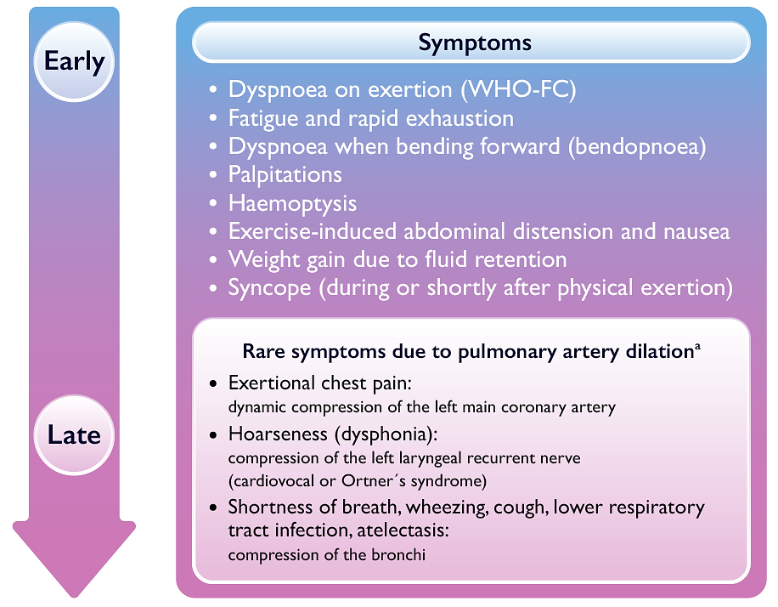
ERS/ESC 2022: Pulmonary Hypertension Clinical Signs and Symptoms

Slide 8
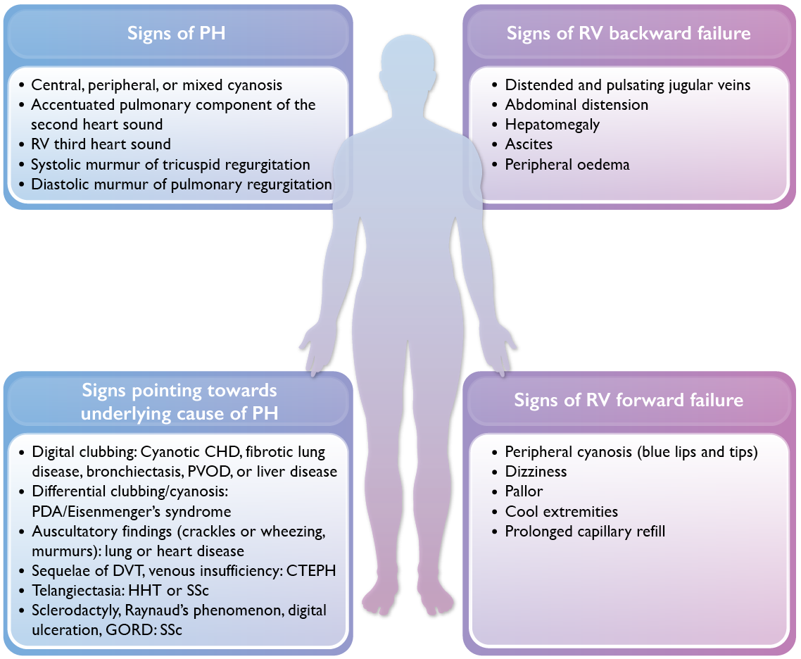
Pulmonary Hypertension: Clinical Signs and Symptoms (cont.)
CHD: congenital heart disease
CTEPH: chronic thrombo-embolic pulmonary hypertension
DVT: deep venous thrombosis
GORD: gastro-oesophageal reflux disease
HHT: hereditary hemorrhagic telangiectasia
PDA: patent ductus arteriosus
PH: pulmonary hypertension
PVOD: pulmonary veno-occlusive disease
RV: right ventricle
SSc: systemic sclerosis

Slide 9
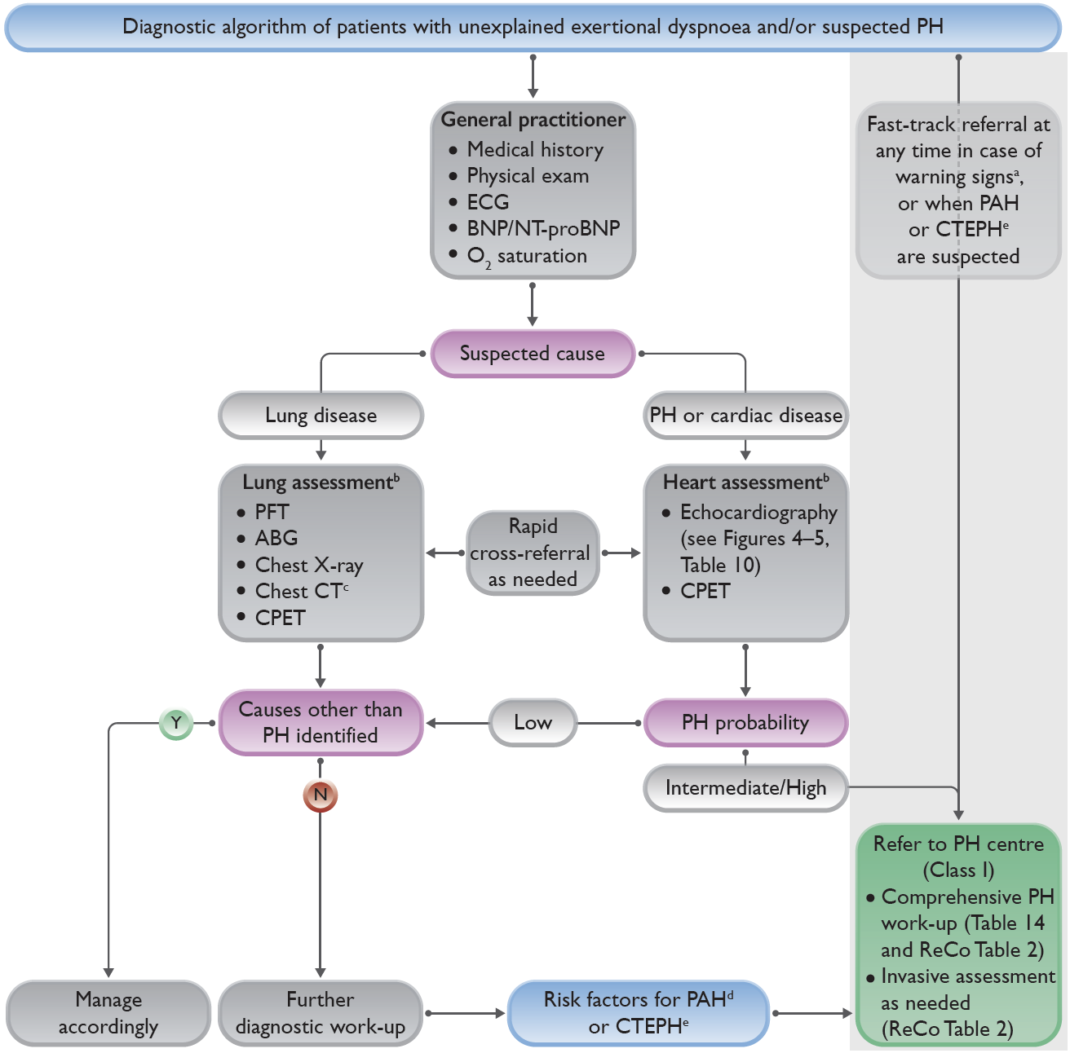
2022 Diagnostic Algorithm of Patients with Unexplained Dyspnea and/or Suspected Pulmonary Hypertension
Warning signs include rapid progression of symptoms, severely reduced exercise capacity, pre-syncope or syncope on mild exertion, signs of right heart failure
Lung and heart assessment by specialist as per local practice
As indicated; CT pulmonary angiography recommended if PH suspected
Includes connective tissue disease (especially systemic sclerosis), portal hypertension, HIV infection, and family history of PAH
History of PE, permanent intravascular devices, inflammatory bowel diseases, essential thrombocythemia, splenectomy, high-dose thyroid hormone replacement, and malignancy

Slide 10
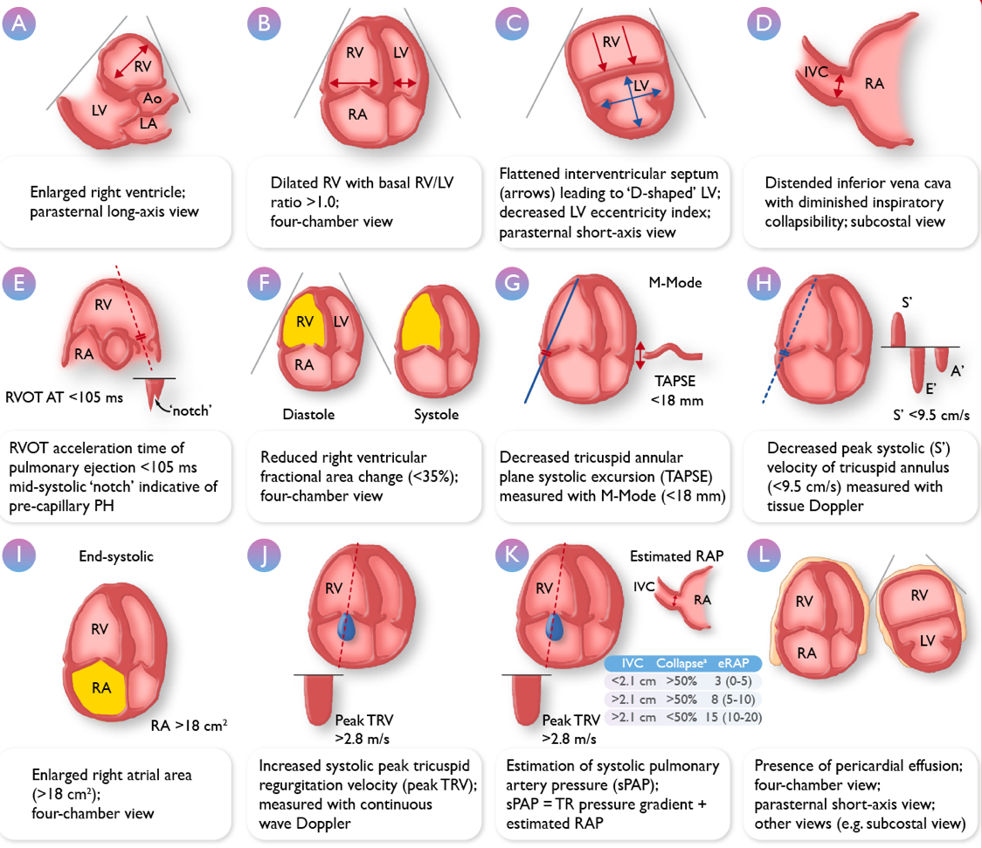
ERS/ESC 2022: Echo Parameters for Assessing PH
Transthoracic echocardiographic parameters in the assessment of pulmonary hypertension
Ao: aorta
IVC: inferior vena cava
LA: left atrium
LV: left ventricle
PH: pulmonary hypertension
RA: right atrium
RAP: right atrial pressure
RV: right ventricle
RVOT AT: right ventricular outflow tract acceleration time
sPAP: systolic pulmonary artery pressure
TAPSE: tricuspid annular plane systolic excursion
TR: tricuspid regurgitation
TRV: tricuspid regurgitation velocity

Slide 11
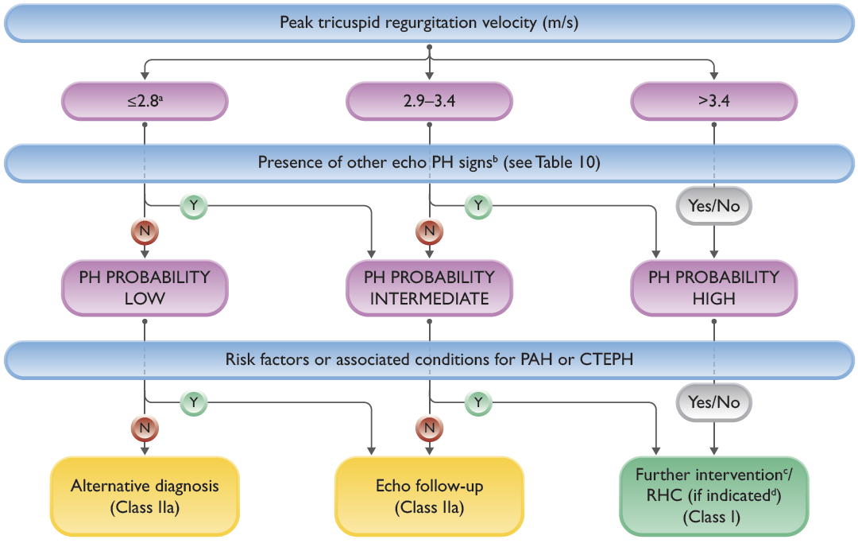
Echocardiographic Probability of Pulmonary Hypertension and Recommendations for Further Assessment
Or unmeasurable. The TRV threshold of 2.8 m/s was not changed according to the updated hemodynamic definition of PH
Signs from at least two categories in Table 10 (A/B/C) must be present to alter the level of echocardiographic probability of PH
Further testing may be necessary (e.g., imaging, cardiopulmonary exercise testing)
Right heart catheterization should be performed if useful information/a therapeutic consequence is anticipated (e.g., PAH or CTEPH), and may not be indicated in patients without risk factors or associated conditions for PAH or CTEPH (e.g., when mild PH and predominant LHD or lung disease are present)

Slide 12
Comprehensive Risk Assessment in PAH (Three-Strata Model)
Determinants of prognosis (estimated 1-year mortality) | Low risk (<5%) | Intermediate risk (5-20%) | High risk (>20%)
Clinical signs of right heart failure | Absent | Absent | Present
Progression of symptoms | No | Slow | Rapid
Syncope | No | Occasional syncope | Repeated syncope
WHO functional class | I, II | III | IV
6MWD | >440 m | 165-440 m | <165 m
Cardiopulmonary exercise testing | Peak VO₂ >15 ml/min/kg (>65% predicted) VE/VCO₂ slope <36 | Peak VO₂ 11-15 ml/min/kg (35-65% predicted) VE/VCO₂ slope 36-44 | Peak VO₂ <11 ml/min/kg (<35% predicted) VE/VCO₂ slope >44
NT-proBNP levels | BNP <50 ng/L NT-pro BNP <300 ng/L | BNP 50-800 ng/L NT-pro BNP 300-1100 ng/L | BNP >800 ng/L NT-pro BNP >1100 ng/L
Echocardiography | RA area, 18 cm² TAPSE/sPAP >0.32 mm/mmHg No pericardial effusion | RA area 18-26 cm² TAPSE/sPAP 0.19-0.32 mm/ mmHg Minimal pericardial effusion | RA area >26 cm² TAPSE/sPAP <0.19 mm/mmHg Moderate or large pericardial effusion
cMRI | RVEF .54% SVI .40 mL/m² RVESVI <42 mL/m² | RVEF 37-54% SVI 26-40 mL/m² RVESVI 42-54 mL/m² | RVEF ,37% SVI <26 mL/m² RVESVI >54 mL/m²
Hemodynamics | RAP <8 mmHg CI ≥2.5 L/min/m² SVI >38 mL/m² SvO₂ >65% | RAP 8-14 mmHg CI 2.0-2.4 L/min/m² SVI 31-38 mL/m² SvO₂ 60-65% | RAP >14 mmHg CI <2.0 L/min/m² SVI <31 mL/m² SvO₂ <60%

Slide 13
Moving to the Four-Strata Risk-Assessment Model
Determinants of prognosis | Low risk | Intermediate-low risk | Intermediate-high risk | High risk
Points assigned | 1 | 2 | 2 | 4
WHO-FC | I or II | ----- | III | IV
6MWD (m) | >440 | 320-449 | 165-319 | <165
BNP or NT-proBNP (ng/L) | <50 <300 | 50-199 300-649 | 200-800 650-1100 | >800 >1100
Recent registry studies evaluated a four-strata risk-assessment tool based on refined cutoff levels for WHO-FC, 6MWD, and NT-proBNP
Studies included >4000 patients with PAH, IPAH, HPAH, DPAH, and CTD-PAH (including SSc), and in patients with PoPH
Four-strata model performed at least as well as the three-strata model in predicting mortality
Observed 1-year mortality rates in the four risk strata were 0–3%, 2–7%, 9–19%, and >20%, respectively
Compared to the three-strata model, the four-strata model was more sensitive to changes in risk from baseline to follow-up, and these changes were associated with changes in long-term mortality risk
Main advantage of the four-strata model over the three-strata model is better discrimination within the intermediate-risk group, which helps guide therapeutic decision-making
For these reasons, the four-strata model is included in the updated treatment algorithm
The three-strata model is maintained for initial assessment, which should be comprehensive and include echocardiographic and hemodynamic variables, for which cutoff values for the four-strata model have yet to be established

Slide 14
Summary
The complexity of managing PH requires a multifaceted, holistic, and multidisciplinary approach, with active involvement of patients with PH in partnership with clinicians
Streamlining the care of patients with PH in daily clinical practice is a challenging but essential requirement for effectively managing PH
In recent years, substantial progress has been made in detecting and managing PH, and new evidence has been integrated in this fourth edition of the ESC/ERS Guidelines for the diagnosis and treatment of pulmonary hypertension
These new guidelines bring heightened awareness, and focus on early detection of PH and the assessment of patients’ risk for worsening

Slide 15
The incorporation of new imaging and diagnostic modalities, such as cMRI, bring added clarity to the definition of PH in the patient
Further, the new hemodynamic definitions of all types of pulmonary hypertension should lower the threshold for detection of this disease and foster effective management plans
This first program in a short series has looked at the revised definitions of PH, the new risk tables with expanded diagnostic tools, and the new four-strata risk-assessment model, which allows better discrimination within the intermediate-risk patient groups
Future episodes will focus further on diagnosis and the new treatment algorithms, not just for Group 1 PAH, but for other forms of the disease

