Slide 1
Utilization of Risk Assessment Tools in the Management of PAH: A PAH Provider Survey
Speaker: Sandeep Sahay, MD, MSc Co-Director, Pulmonary Hypertension and CTEPH Programs Associate Professor, Division of Pulmonary, Critical Care & Sleep Medicine Houston Methodist Hospital Houston, Texas

Slide 2
Background
Conventional clinical management in PAH incorporates gestalt-based decision making, which may or may not involve objective data¹
Several risk assessment (RA) tools have been developed and validated from large PAH registry populations to facilitate more formal evaluation of risk assessment
REVEAL (12 variables), REVEAL 2.0, REVEAL Lite 2 (6 variables), COMPERA (6 variables), COMPERA 2.0 the French Pulmonary Hypertension Registry (FPHR, 4 low-risk criteria) and the Swedish PAH Registry (SPAHR, 6 variables)
Most of these RA methods show that achieving the low‐risk status is associated with better survival²
Utilization of these risk stratification methods in clinical practice is low and clinicians often rely on their gestalt to make treatment decisions³
Recent studies have shown a marked discrepancy between objective risk scoring methods and physician gestalt¹ raising concerns about barriers to use of RA tools
This survey⁴ study focused on identifying factors associated with underutilization of PAH risk tools primarily targeted clinicians who routinely care for PAH patients

Slide 3
Methods
American College of Chest Physicians (ACCP) 2020–2021 Pulmonary Vascular Network Steering Committee designed, reviewed, and approved a quality improvement initiated via a provider survey comprised of 31 questions assessing PAH patient care
Aim of this questionnaire was to increase understanding of current utilization of various RA tools among PAH care providers and to identify potential barriers limiting implementation of risk tool use
Survey was sent electronically to PAH specialists worldwide via the clinicians’ directory in the Pulmonary Vascular Disease (PVD) Network of the American College of Chest Physician (ACCP) and the Clinicians and Researchers members of the Pulmonary Hypertension Association (PHA)
Participation was voluntary and participating clinicians were not provided with any incentive for their time and opinion

Slide 4
Methods: The Questionnaire and Analysis
First 8 questions were designed to collect demographic information pertinent to the responders
Subsequent questions assessed involvement in PAH outpatient care and queried the number of patients followed, as well as PH center certification
Only those responding affirmative to caring for PAH patients advanced to the remainder of the questionnaire
Remaining questions surveyed patterns of RA tool use in new and established patients as well as evaluated barriers to implementation of PAH risk assessment routine use
Simple descriptive analyses were used to interpret the survey results
Responses were calculated in percentages for each response
Risk tool use was compared amongst each demographic

Slide 5
Results: The Responders
112 clinicians participated from the International CHEST PVD Network and the PHA Clinicians and Researchers Group, with respondents representing 12 countries
From the US 95 (84%), 5 (4%) from India, 2 (2%) from Mexico and Turkey
One respondent each from Australia, Brazil, Bahrain, Canada, Lebanon, Philippines, Saudi Arabia, as well as Thailand participated
110 (99%) were physicians, while 2 (1%) were Nurse Practitioners or Physician Assistants
Seventy‐seven (69%) respondents were males, 34 (30%) females and 1 (1%) did not disclose gender
Ninety‐two (82%) were pulmonologists, 14 (12%) were cardiologists and 6 (6%) were internal medicine trained clinicians
40 (37%) clinicians were more than 20 years in practice, 29 (27%) were between 11 and 20 years in practice, 23 (21%) were between 5 and 10 years, 11 (10%) were less than 5 years and 6 (5%) were currently in training
Of the 101 clinicians who responded, 45 (45%) were providing care to less than 50 patients in their practice while 56 (55%) were caring for more than 50 patients in their practice
Risk assessment tools were used by 30/36 (83.33%) respondents from PH certified PH centers compared to 37/56 (66%) from noncertified centers in their routine clinical care

Slide 6
Utilization of Risk Assessment Tools: Baseline Evaluation (Select Data)
 | Proportion of respondents who used risk assessment tools (n = 71) | Proportion of respondents who did not use risk assessment tools (n = 26)
Gender
Female (31) | 24/31 (77.41%) | 7/31 (22.58%)
Male (65) | 46/65 (70.77%) | 19/65 (29.23%)
Did not specify (1) | 1/1 (100%)
Specialty
Pulmonary (81) | 57/81 (70.37%) | 24/81 (29.63%)
Cardiology (14) | 13/14 (92.86%) | 1/14 (7.14%)
Internal Medicine (2) | ½ (50%) | ½ (50%)
Country of Residence
USA (81) | 63/81 (77.78%) | 18/81 (22.22%)
Other countries (16) | 8/16 (50%) | 8/16 (50%)
Setting of Practice
Academic Center (65) | 52/65 (80%) | 13/65 (20%)
Community Hospital (22) | 12/22 (54.4%) | 10/22 (45.5%)
Veterans’ Health Administration (3) | 2/3 (66.67%) | 1/3 (33.33%)
Other (7) | 5/7 (71.43%) | 2/7 (28.57%)
Setting of the Hospital
Urban (70) | 54/70 (77.14%) | 16/70 (22.86%)
Suburban (22) | 13/22 (50.09%) | 9/22 (40.90%)
Rural (5) | 4/5 (80%) | 1/5 (20%)
Years in Practice
< 5 years (9) | 7/9 (77.78%) | 2/9 (22.22%)
5-10 years (21) | 17/21 (80.95%) | 4/21 (19.05%)
>20 years (37) | 25/37 (67.75%) | 12/37 (32.43%)
Currently in Training (1) |  | 1 (100%)
Of the 112 participants, 71 (63%) of clinicians reported use of PAH risk stratification tools in their practice while 26 (24%) did not use any risk tools and 15 (13%) did not provide any response
The majority 30/36 (83.33%) of participants from PHA CCCs and 11/11 (100%) from PHA RCPs reported risk tool use
Those respondents practicing in non‐CCCs reported 37/ 56 (66.07%) use of risk assessment

Slide 7
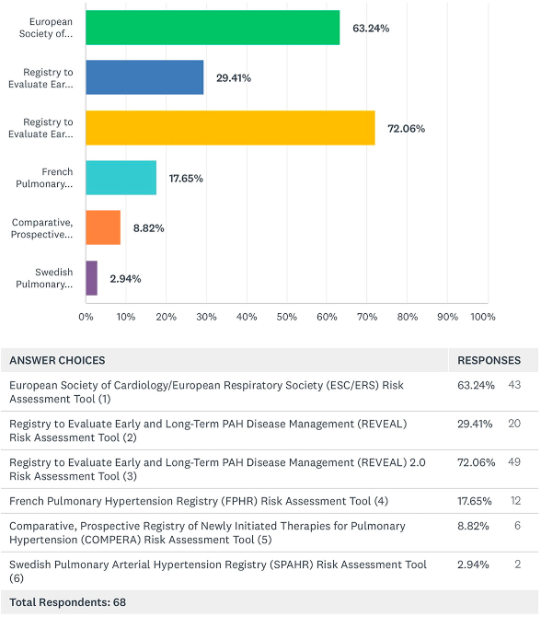
What RA Tools Are Physicians Using?
ERS/ESC
REVEAL
REVEAL 2.0
A total of 68 clinicians responded about the type of risk assessment tools used in the past year in their practice and many clinicians appear to use multiple scoring methods
REVEAL 2.0 was the most frequently used with 49 (72.06%) using it for risk assessment which was closely followed by the ESC/ERS tool by 43 (63.24%)
FPHR
COMPERA
SPAHR

Slide 8
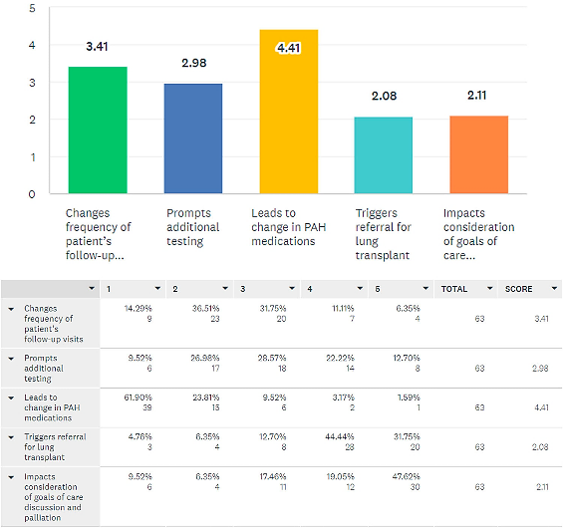
Impact of Risk Assessment During Baseline PAH Patient Evaluations on the Elements of Patient Care
66 (97%) clinicians used these risk assessment tools for baseline assessment and 62 (91%) believed that it impacted their patient management
44 (65%) felt that it led to change in PAH treatment medications, 6 (9%) felt that it prompted additional testing or changed the frequency of follow up visits, 5 (7%) felt that it prompted goals of care/palliative care discussions and 2 (3%) suggested it triggered lung transplant referral
In contrast, 5 (7%) felt that using risk assessment tools did not affect their treatment decisions in a new patient evaluation

Slide 9
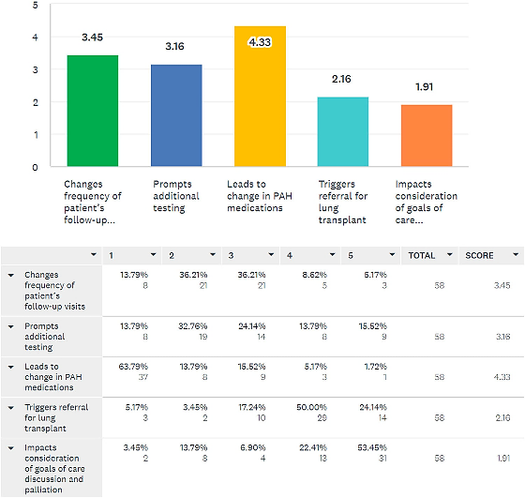
Use of RA Tools in Patient Follow-Up Evaluations
61 (54%) responded to questions regarding use of risk stratification tools during follow up visits
57 (93%) responded favorably to using RA tools during follow up visits and felt it impacted their patient management
31 (51%) used these tools on every follow up visit, 16 (26%) used them only after change in clinical status, 12 (20%) used them at a predetermined interval (6 months follow up) and 2 (3%) used it only after medication change
A total of 41 (67%) documented each visit risk assessment score in patients’ medical records, while 20 (33%) did not document it in medical records
40 (66%) felt that it led to changes in PAH medications, 6 (10%) felt that it changed frequency of follow up visits, 5 (8%) reported it prompted additional testing or transplant referral

Slide 10
Risk Assessment Tools and EMR
A total of 60 (54%) clinicians responded about the EMR system information
48 (80%) of those respondents believed that having RA tools incorporated in the EMR would improve patient care by facilitating tracking and comparison of patients’ risk assessments during patient encounters
On the other hand, 6 (10%) were unsure or felt it would not make a difference if risk tools were embedded in their EMR
41 (68%) felt the greatest barrier to the use of risk assessment tools on initial or follow up visits was availability of RA in EMR
12 (20%) clinicians felt that the time taken to calculate the risk score during each visit was the most significant impediment to regular use
3 (5%) believed that performing risk assessment has little impact on patient care

Slide 11
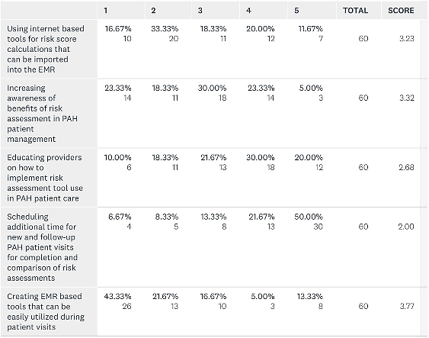
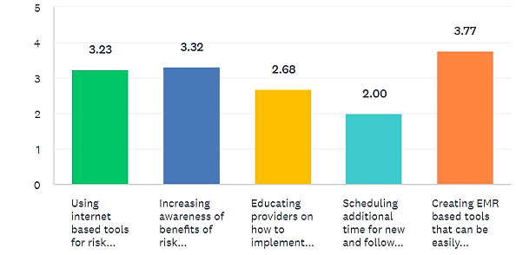
Interventions That Clinicians Believe May Improve Utilization of RA Tools in PAH Patient Care

Slide 12
Summary
Only 63% of respondents use RA tools routinely in their clinical practice
A majority of respondents felt that risk scores influenced initial and subsequent management of medications for PAH
Fewer felt that risk scores informed other aspects of care, such as frequency of follow up, recommended testing, or referrals to palliative care or lung transplantation
Most respondents felt that lack of integration of risk tool calculators in the EMR impacted their ability to use these tools in clinical practice

Slide 13
Conclusions
Survey suggests that when employed, these tools are largely used to guide medical therapies, but not routinely utilized to guide follow up or referral to palliative care or transplantation
EMR integration appears to be one of the major impediments to implementation of these tools
Educational programs to increase awareness of the clinical impact of formal risk assessment in routine PAH care represents a potential strategy for increasing the utilization of routine risk assessment by PAH providers

Slide 14
Limitations
Survey targeted global PAH clinicians but the findings are largely representative of the US based care due to limited participation from the international participants
Vast majority of respondents in the survey were pulmonologists, reflecting the membership of the ACCP; whether practice patterns by other subspecialists who care for PAH patients differ remains unknown
Inviting respondents via email to take part in an online survey could potentially introduce selection bias towards responders with a greater interest in or awareness of PAH risk assessment tools

