Slide 1
Long-term Effects of Inhaled Treprostinil in Patients with Pulmonary Hypertension Due to Interstitial Lung Disease: The INCREASE Study Open-label Extension
Waxman A¹; Restrepo R²; Thenappan T³; Engel P⁴; Bajwa A⁵; Ravichandran A⁶; Feldman J⁷; Case A⁸; Tapson VF⁹; Smith P¹⁰; Deng C¹⁰; Shen E¹⁰; Nathan SD¹¹
¹Brigham and Women’s Hospital; ²University of South Florida; ³University of Minnesota; ⁴The Christ Hospital Health Network; ⁵Ascension Medical Group; ⁶Ascension Medical Group; ⁷Arizona Pulmonary Specialists; ⁸Piedmont Health; ⁹Cedars-Sinai;
¹⁰United Therapeutics; ¹¹Inova Fairfax Hospital
Presented by
Steven D. Nathan, MD
Medical Director, Advanced Lung Disease and Transplant Program
Inova Fairfax Hospital
Falls Church, VA

Slide 2
Disclaimer
The views and opinions expressed in this educational activity are those of the faculty and do not necessarily represent the views of TotalCME, Inc., the CME providers, or the companies providing educational grants. This presentation is not intended to define an exclusive course of patient management; the participant should use their clinical judgment, knowledge, experience, and diagnostic skills in applying or adopting for professional use any of the information provided herein. Any procedures, medications, or other courses of diagnosis or treatment discussed or suggested in this activity should not be used by clinicians without evaluation of their patient's conditions and possible contraindications or dangers in use, review of any applicable manufacturer’s product information, and comparison with recommendations of other authorities. Links to other sites may be provided as additional sources of information.

Slide 3
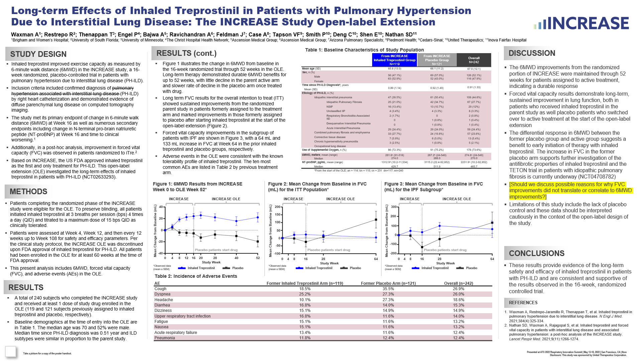

Slide 4
Introduction
Inhaled treprostinil (iTre) improved exercise capacity as measured by
6-minute walk distance (6MWD) in the INCREASE study, a 16-week randomized, placebo-controlled trial in patients with pulmonary hypertension due to interstitial lung disease (PH-ILD)
Numerous secondary endpoints were positive:
  (NT-proBNP) at Week 16
  Time to clinical worsening
A post-hoc analysis, improvement in the FVC for iTre group

Slide 5
Open Label Extension (OLE)
Patients completing the randomized phase of the INCREASE study were eligible for the OLE
Patients were assessed at Week 4, Week 12, and then every 12 weeks up to Week 108 for safety and efficacy parameters
INCREASE OLE was discontinued upon FDA approval of inhaled treprostinil for PH-ILD
All patients had been enrolled in the OLE for at least 60 weeks at the time of FDA approval
This present analysis includes 6MWD, forced vital capacity (FVC), and adverse events (AEs) in the OLE

Slide 6
Baseline Characteristics of Study Population
 | From INCREASE Inhaled Treprostinil Group N=119 | From INCREASE Placebo Group N=121 | Overall N=242
Mean age (SD) | 65.8 (13.0) | 68.1 (11.2) | 67.0 (12.1)
Sex, n (%) Male Female | 56 (47.1%) 63 (52.9%) | 69 (57.0%) 52 (43.0%) | 126 (52.1%) 116 (47.9%)
Time since PH-ILD Diagnosis*, years Mean (SD) | 0.89 (1.14) | 0.92 (1.49) | 0.91 (1.33)
Etiology of PH-ILD, n (%) Idiopathic interstitial pneumonia Idiopathic Pulmonary Fibrosis NSIP Unclassified IIP Respiratory Bronchiolitis-Associated IID Desquamative Interstitial Pneumonia Acute Interstitial Pneumonia Combined pulmonary fibrosis and emphysema Connective tissue disease Chronic hypersensitivity pneumonitis Occupational lung disease | 47 (39.5%) 25 (21.0%) 16 (13.4%) 4 (3.4%) 2 (1.7%) 0 0 29 (24.4%) 33 (27.7%) 7 (5.9%) 3 (2.5%) | 61 (50.4%) 42 (34.7%) 13 (10.7%) 4 (3.3%) 0 1 (0.8%) 1 (0.8%) 29 (24.0%) 24 (19.8%) 6 (5.0%) 1 (0.8%) | 108 (44.6%) 67 (27.7%) 29 (12%) 8 (3.3%) 2 (0.8%) 1 (0.4%) 1 (0.4%) 59 (24.4%) 57 (23.6%) 13 (5.4%) 5 (2.1%)
Use of Supplemental Oxygen, n (%) | 86 (72.3%) | 91 (75.2%) | 178 (73.6%)
6MWD, meters; mean (range) Median | 281.8ª (91-518) 274.0 | 267.2^{b} (24-549) 268.0 | 274.6^{c} (24-549) 270.0
NT-proBNP, pg/mL; mean (range) Median | 1312.9^{d} (10.2-11,534) 429.7 | 3115.2 (22.4-92,852) 511.9 | 2231.9e (10.2-92,852) 465.7
*From the start of the OLE; an = 114; bn = 115; cn = 231 dn=117; en=240

Slide 7
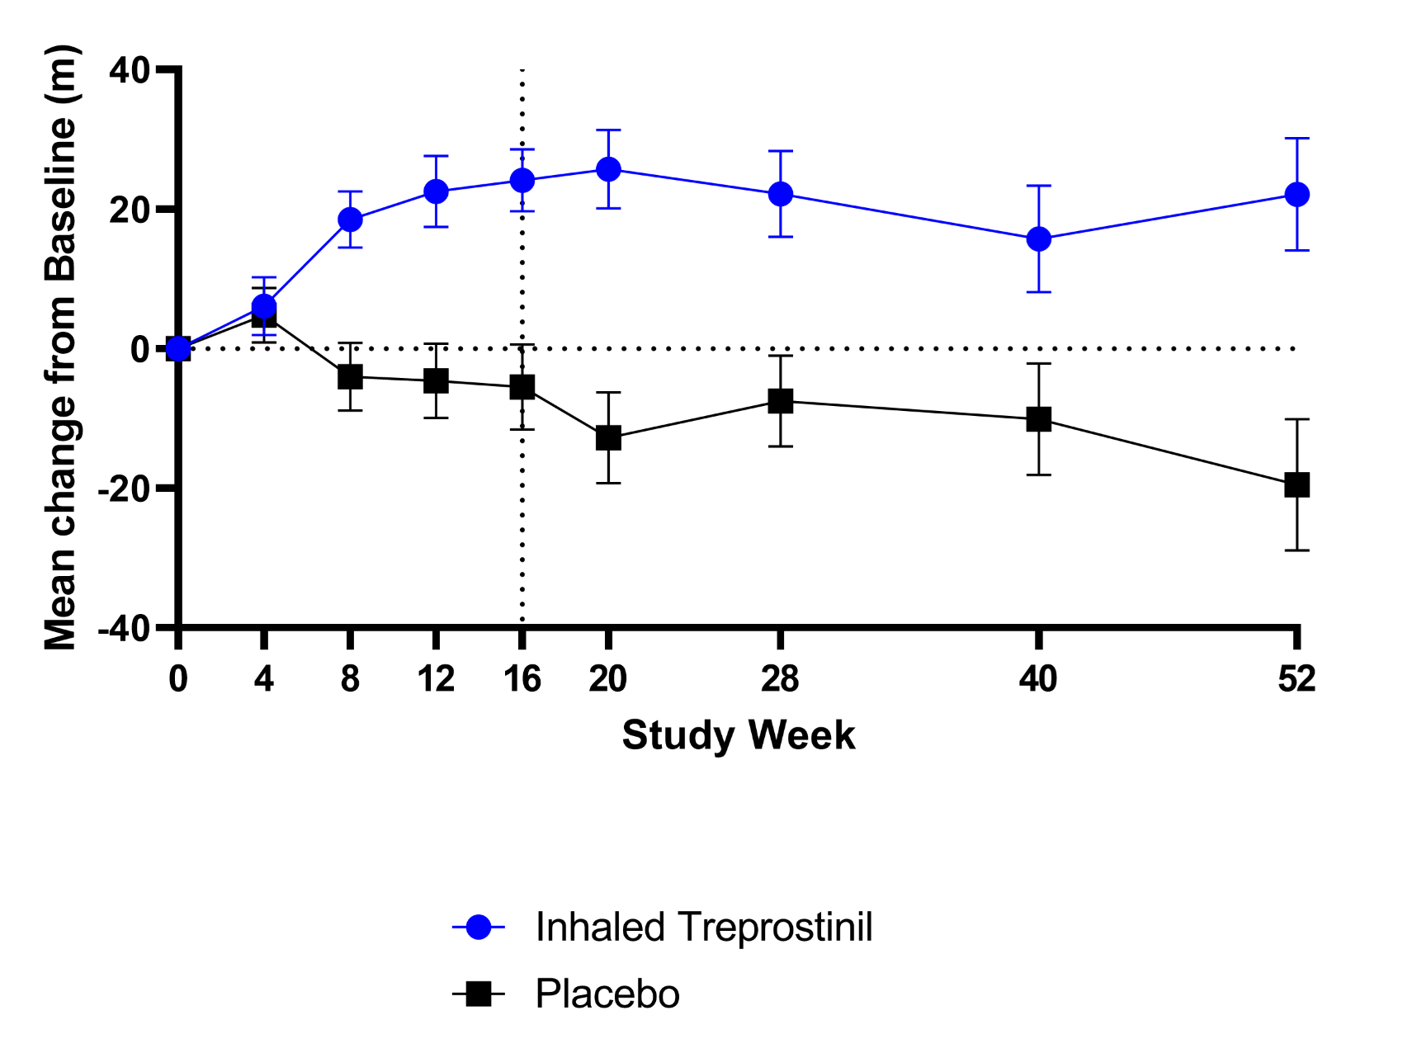
Results
6MWD Results from INCREASE Week 0 to OLE Week 52
INCREASE
INCREASE OLE
40
20
Mean Change from Baseline (mL)
0
-20
Placebo patients start drug
-40
0
4
8
12
16
20
28
40
52
*Observed data (mean ± SEM)
Study Week
Inhaled Treprostinil
Placebo

Slide 8
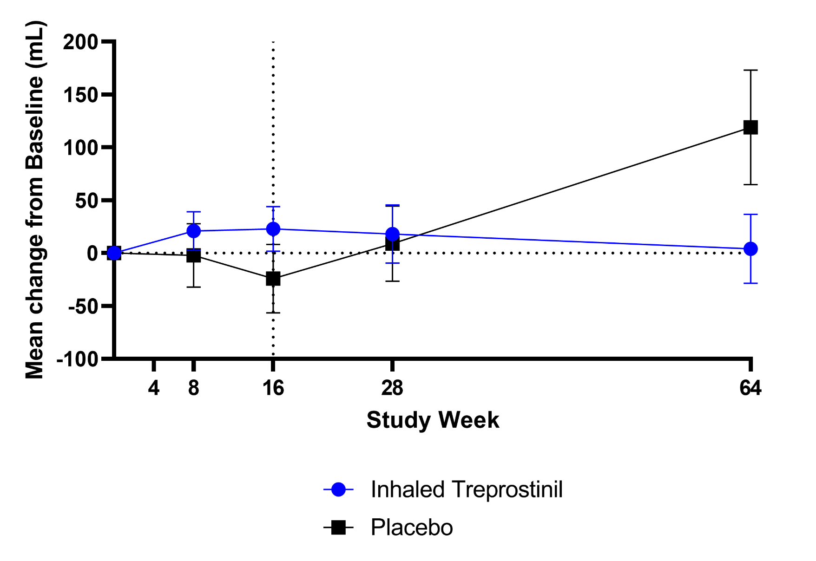
Results
Mean Change from Baseline in FVC (mL) for the ITT Population
INCREASE
INCREASE OLE
200
150
100
Mean Change from Baseline (mL)
50
0
-50
Placebo patients start drug
-100
0
4
8
16
28
64
*Observed data (mean ± SEM)
Study Week
Inhaled Treprostinil
Placebo

Slide 9
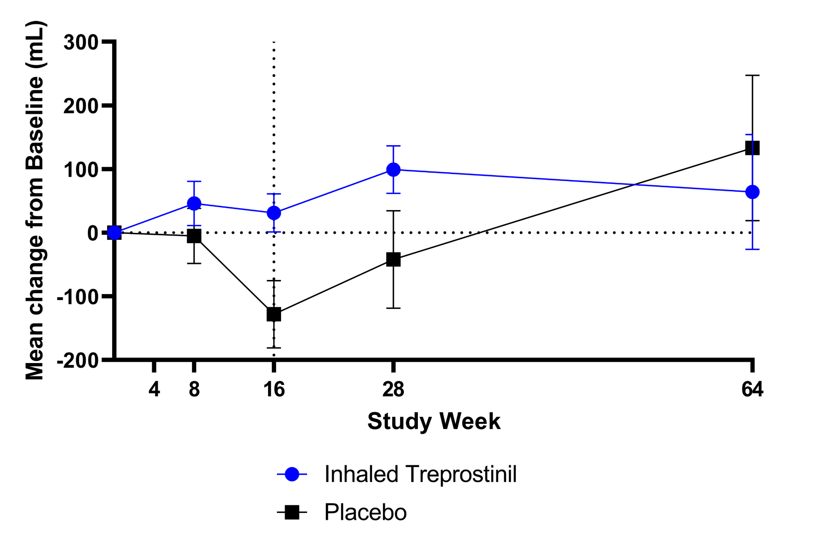
Results
Mean Change from Baseline in FVC (mL) for the IPF Subgroup
INCREASE
INCREASE OLE
300
200
100
Mean Change from Baseline (mL)
0
-100
Placebo patients start drug
-200
0
4
8
16
28
64
*Observed data (mean ± SEM)
Study Week
Inhaled Treprostinil
Placebo

Slide 10
Adverse Events
AE | Former Inhaled Treprostinil Arm (n=119) | Former Placebo Arm (n=121) | Overall (n=242)
Cough | 18.5% | 35.5% | 26.9%
Dyspnea | 25.2% | 27.3% | 26.0%
Headache | 10.1% | 27.3% | 18.6%
Diarrhea | 16.8% | 14.0% | 15.3%
Dizziness | 15.1% | 14.9% | 14.9%
Upper respiratory tract infection | 16.8% | 11.6% | 14.0%
Fatigue | 15.1% | 11.6% | 13.2%
Nausea | 15.1% | 11.6% | 13.2%
Acute respiratory failure | 13.4% | 11.6% | 12.4%
Pneumonia | 11.8% | 12.4% | 12.4%

Slide 11
Conclusions
The 6MWD improvements were maintained through 52 weeks for patients assigned to active treatment
Differential response in 6MWD between the former placebo group and active group suggests a benefit to early initiation of therapy with inhaled treprostinil
Sustained improvement in FVC, both in patients who received inhaled treprostinil in the parent study as well placebo patients
  The increase in FVC in the former placebo arm supports further investigation of the antifibrotic properties of inhaled treprostinil
Limitations:
  Lack of placebo control
  Data should be interpreted cautiously in the context of the open-label design

