Slide 1
Change in REVEAL Lite 2 Risk Score Predicts Outcomes in Patients With Pulmonary Arterial Hypertension in the PATENT Study
Raymond L. Benza, MD; Athenaîs Boucly, MD; Harrison W. Farber, MD; Adaani E. Frost, MD; Hossein-Ardeschir Ghofrani, MD; Marius M. Hoeper, MD; Marc Lambelet, Dipl.Math; Claudia Rahner; Sameer Bansilal, MD; Sylvia Nikkho, MD; Christian Meier, MD; and Olivier Sitbon, MD, PhD
Jean Elwing, MD Professor of Medicine Director, Pulmonary Hypertension Program Division of Pulmonary, Critical Care and Sleep Medicine University of Cincinnati Cincinnati, OH

Slide 2
Background
Regular risk assessment of patients with PAH using a multidimensional approach is recommended and can aid clinicians in determining individual clinical management plans and optimizing patient outcomes to attain the overall treatment goal of achieving low-risk status¹
Several effective risk assessment tools, using a range of different variables, have been developed, including risk equations from the French Pulmonary Hypertension Registry (FPHN),² the Comparative Prospective Registry of Newly Initiated Therapies for Pulmonary Hypertension (COMPERA),³ the Swedish PAH risk score,⁴ and the Registry to Evaluate Early and Long-Term PAH Disease Management (REVEAL, RRS)⁵
Recently, an updated version of REVEAL (RRS 2.0, REVEAL Lite 2) was developed to further refine risk prediction⁶
REVEAL Lite reduced the number of variables from the 12 used in RRS to 6 non-invasive variables and excluded some non-modifiable variable

Slide 3
Study Rationale
Riociguat is a soluble guanylate cyclase stimulator approved for the treatment of PAH and inoperable or persistent/recurrent chronic thromboembolic pulmonary hypertension^{1–3}
In the PATENT-1 and PATENT-2 studies of riociguat in patients with PAH, 12 weeks of riociguat decreased RRS⁴ and RRS 2.0⁵
Lower RRS and RRS 2.0 were associated with an improvement in survival and clinical worsening-free survival (CWFS) in the long-term extension, PATENT-2
This post hoc analysis of the PATENT studies aimed to investigate the effect of riociguat on REVEAL Lite 2 scores and the association of REVEAL Lite 2 and long-term outcomes in patients with PAH⁶
Ghofrani HA, et al. N Engl J Med. 2013;369(4):319-29.
Ghofrani HA, et al. N Engl J Med. 2013;369(4):330-40.
Benza RL, et al. Int J Cardiol. 2021;332:189-92
Rubin LJ, et al. Eur Respir J. 2015;45(5):1303-13.
Ghofrani HA, et al. Lancet Respir Med. 2016;4(5):361-71.
Benza RL, et al. J Heart Lung Transplant. 2022;41(3):411-420.

Slide 4
Methods
PATENT-1 was a randomized, double-blind, 12-week, placebo-controlled study of riociguat in patients with PAH (up to 2.5 mg three times daily) 2.5 mg-max three times daily (three times a day) or an exploratory dose capped at 1.5 mg three times daily (max three times a day), or placebo
PATENT-2 was an open-label extension in which all patients received riociguat (up to 2.5 mg three times daily)
All patients who completed PATENT-1 and enrolled in PATENT-2 were included in this analysis

Slide 5
REVEAL Lite Risk Assessment of Long-Term Outcomes
REVEAL Lite 2 was developed using data from the REVEAL registry of patients, consisting of all WHO Group I PAH subgroups except for pulmonary hypertension (PH) of the newborn
The 6 parameters used in REVEAL Lite 2 were:
Renal insufficiency (score +1 if estimated glomerular filtration rate [eGFR] is <60 mL/min/1.73 m2 or renal insufficiency is present in the judgment of the clinician if eGFR is not available)
WHO/New York Heart Association Functional Class (FC) (score −1 if FC I; +1 if FC III; +2 if FC IV)
Systolic blood pressure (score +1 if <110 mm Hg)
Heart rate (score +1 if >96 bpm)
6-minute walking distance (6MWD) (score −2 if ≥440 m; −1 if 320 to <440 m; +1 if <165 m)
N-terminal prohormone of brain natriuretic peptide (score −2 if <300 pg/mL; +2 if ≥1100 pg/mL)
For this analysis, REVEAL Lite 2 scores were calculated at baseline (i.e., PATENT-1 baseline), PATENT-1 Week 12, and PATENT-2 Week 12
Missing values of score components for the later visits (i.e., PATENT-1 Week 12 and PATENT-2 Week 12) were imputed using the last observation carried forward

Slide 6
REVEAL Lite Risk Assessment of Long-Term Outcomes
Patients were stratified into three risk strata based on their REVEAL Lite 2 scores at baseline and at PATENT-1 Week 12:
Low (score 1–5), intermediate (score 6–7), and high (score ≥8)¹
REVEAL Lite 2 risk strata were based on REVEAL 2.0 risk scores, using a subpopulation of patients in REVEAL who had survived for ≥1 year after enrollment²
Change in REVEAL Lite 2 scores and risk strata for the riociguat 2.5 mg–max and placebo groups in PATENT-1 were assessed as previously described for the RRS³
Kaplan–Meier estimates were used to calculate survival and CWFS was measured from the start of PATENT-2 and included pooled data from patients in PATENT-1 receiving riociguat up to 2.5 mg tid, those receiving riociguat 1.5 mg, and those receiving placebo
Clinical worsening was defined as the first occurrence of any of the following events: death, heart/lung transplantation, atrial septostomy, hospitalization due to worsening of PH, start of new specific PH treatment, persistent decrease of >15% from baseline in 6MWD, and persistent worsening of WHO FC

Slide 7
Assessment of Long-term Outcomes
Associations between REVEAL Lite 2 scores at baseline and at PATENT-1 Week 12 with survival and with CWFS were assessed using a Cox proportional hazards model, including the REVEAL Lite 2 score at baseline or at PATENT-1 Week 12 and the study treatment as covariates
The relationships between change in score from baseline to PATENT-1 Week 12 and survival and CWFS were assessed using a Cox proportional hazards model, including baseline, the change from baseline in REVEAL Lite 2 score, and the study treatment as covariates
Concordance indices (C-indices) were calculated for prediction of survival or CWFS within 1 year after the start of PATENT-2 and were based on the original RRS and on REVEAL Lite 2 at baseline and Week 12

Slide 8
PATENT-2 Patient Baseline Characteristics
A total of 443 patients were treated in PATENT-1:
254 patients in the riociguat 2.5 mg–max group, 63 patients in the 1.5 mg–max group, and 126 patients in the placebo group
The majority of these patients (396 / 89%) entered PATENT-2 and were included in the analysis
231 patients received riociguat 2.5 mg-max in PATENT-1, 56 patients received 1.5 mg-max, and 109 patients received placebo
Baseline characteristics of patients entering PATENT-2 were similar to those who entered PATENT-1

Slide 9
REVEAL Lite 2 Score from Baseline to PATENT-1 Week 12 and PATENT-2 Week 12
 | Riociguat 2.5 mg-max three times a day |  |  |  |  | Placebo
 | PATENT-1 Baseline (n = 231) | PATENT-1 Week 12 (n = 231) |  | Change from PATENT-1 Baseline |  | PATENT-1 Baseline (n = 109) | PATENT-1 Week 12 (n = 109) | Change from PATENT-1 Baseline |  | LS Mean Difference (95% CI)ª |  | Riociguat vs. Placebo p-valueª
REVEAL Lite 2 Score (mean, SD) | 6.0 ± 2.2 | 5.2 ± 2.3 |  | −0.8 ± 1.7 |  | 6.0 ± 2.1 | 6.1 ± 2.6 | 0.0 ± 1.6 |  | −0.8 (−1.2, −0.4) |  | 0.0004
 | Riociguat 2.5 mg-max three times a day (n = 224) |  |  |  |  |  | Former placebo (n = 107)
 | PATENT-1 Baseline (n = 231) |  | PATENT-2 Week 12 (n = 224) |  | Change from PATENT-1 Baseline |  | PATENT-1 Baseline (n = 109) | PATENT-2 Week 12 (n = 107) | PATENT-2 Week 12 (n = 107) | Change from PATENT-1 baseline | Change from PATENT-1 Baseline
REVEAL Lite 2 Score (mean, SD) | 6.0 ± 2.2 |  |  | 4.8 ± 2.4 |  | −1.1 ± 1.8 | 6.0 ± 2.1 |  | 5.2 ± 2.5 |  | −0.8 ± 2.0
Abbreviations: ANCOVA, analysis of covariance; CI, confidence interval; LS, least squares; SD, standard deviation; tid, three times daily. ªLS–Mean difference and F-test p-value for the treatment comparison are based on an ANCOVA model with baseline risk score value, treatment group, region, and type of pre-treatment (treatment-naîve; endothelin receptor antagonist/prostacyclin analogue) as fixed effects.
REVEAL Lite 2 score: REVEAL Lite 2 scores significantly improved with riociguat 2.5 mg-max three times a day at PATENT-1 Week 12 compared with placebo with a least-squares mean difference (95% confidence interval [CI]) of −0.8 (−1.2, −0.4; p = 0.0004) based on an ANCOVA model
At PATENT-2 Week 12, further improvements were observed with riociguat 2.5 mg-max three times a day

Slide 10
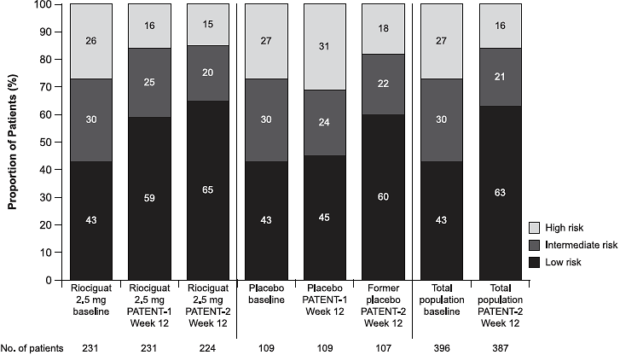
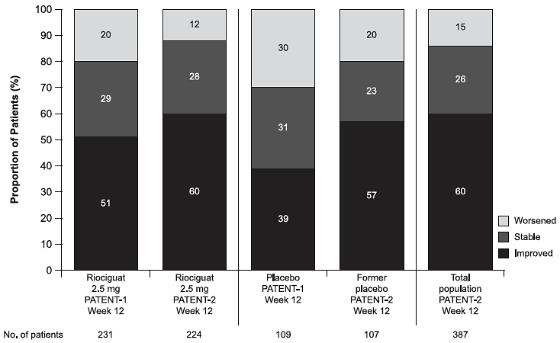
REVEAL Lite 2 Risk Strata
Riociguat 2.5 mg-max three times a day significantly improved the risk stratum at PATENT-1 Week 12 compared with placebo; stratified Wilcoxon test (p = 0.0005)
Former placebo patients showed improvements in the REVEAL Lite 2 score similar to those observed with riociguat 2.5 mg-max three times a day at PATENT-1 Week 12
Proportion of patients in the low, intermediate, and high REVEAL Lite 2 risk strata at baseline, PATENT-1 Week 12, and at PATENT-2 Week 12
Proportion of patients with improved, stable, and worsened REVEAL Lite 2 risk scores from baseline to PATENT-1 Week 12 and at PATENT-2 Week 12 compared with baseline
Riociguat
2.5 mg
PATENT-2
Week 12
Placebo
baseline
Riociguat
2.5 mg
PATENT-1
Week 12
Riociguat
2.5 mg
PATENT-2
Week 12
Riociguat
2.5 mg
Riociguat
2.5 mg
PATENT-1
Week 12
Placebo
baseline
Placebo
PATENT-1
Week 12
Former
Placebo
PATENT-2
Week 12
Total
population
baseline
Total
population
PATENT-2
Week 12
Placebo
PATENT-1
Week 12
Former
placebo
PATENT-2
Week 12
Total
population
PATENT-2
Week 12

Slide 11
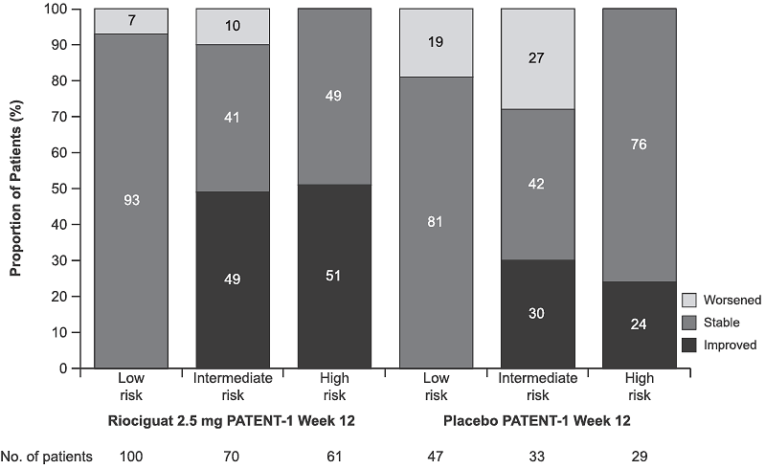
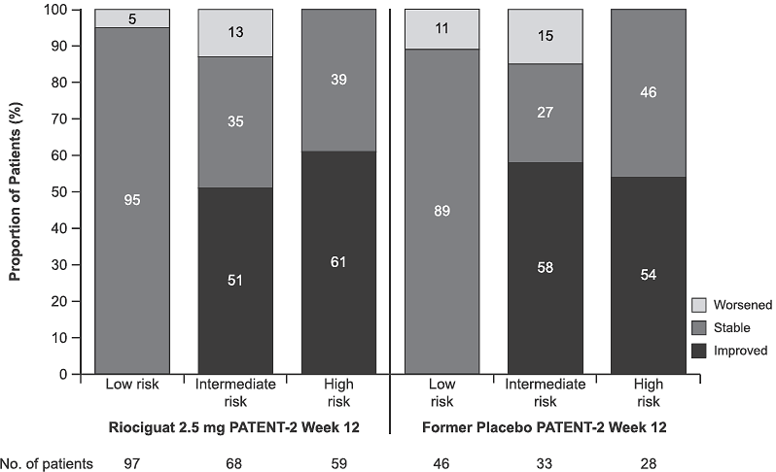
REVEAL Lite 2 Risk Strata
In each risk stratum, a higher proportion of patients receiving riociguat 2.5 mg-max three times a day either stabilized or improved risk stratum from baseline to PATENT-1 Week 12, compared with placebo
Former placebo patients experienced improvements in risk strata that were similar to those observed in riociguat 2.5 mg-max three times a day patients at PATENT-1 Week 12
Proportion of patients who improved or worsened REVEAL Lite 2 risk stratum, or remained stable (baseline to PATENT-1 Week 12)
Proportion of patients who improved or worsened REVEAL Lite 2 risk stratum, or remained stable (baseline to PATENT-2 Week 12)

Slide 12
REVEAL Lite 2: Long-Term Outcomes
Cox Proportional Hazards Model for Survival and Clinical Worsening-Free Survival by REVEAL Lite 2 Score at Baseline and PATENT-1 Week 12
 | Survival |  | Clinical Worsening-Free Survival
 | Hazard Ratioª (95% CI) | p-value | Hazard Ratioª (95% CI) | p-value
1-point difference in REVEAL Lite 2 score at PATENT-1 baseline^{b} | 0.79 (0.71, 0.87) | <0.0001 | 0.79 (0.73, 0.85) | <0.0001
1-point difference in REVEAL Lite 2 score at PATENT-1 Week 12^{b} | 0.76 (0.70, 0.83) | <0.0001 | 0.76 (0.71, 0.82) | <0.0001
1-point decrease in REVEAL Lite 2 score from PATENT-1 baseline to PATENT-1 Week 12^{c} | 0.77 (0.67, 0.89) | 0.0002 | 0.79 (0.71, 0.87) | <0.0001
Abbreviation: CI, confidence interval. ªHazard ratio describes the risk of dying or experiencing a clinical worsening event at any time in PATENT-2 for a patient with a given risk score compared with a patient whose risk score is increased by 1 point. ^{b}Model includes risk score at baseline/Week 12 and main study treatment as covariates. ^{c}Model includes baseline and change from baseline of risk score as well as main study treatment as covariates. Day 0 of survival time considered in this analysis was the start of PATENT-2.
Notes:
A Cox proportional hazards model adjusted for main study treatment showed that REVEAL Lite 2 scores at baseline (p < 0.0001) and PATENT-1
Week 12 (p < 0.0001) were significantly associated with survival (Table 3). A 1-point difference in REVEAL Lite 2 score at PATENT-1 baseline or Week 12 was associated
with 21% and 24% reductions in the relative risk of death in PATENT-2, respectively. A Cox proportional hazards model including baseline, change from baseline at
PATENT-1 Week 12, and main study treatment as covariates, showed that change in REVEAL Lite 2 score from baseline to PATENT-1 Week 12 was significantly associated
with survival (p = 0.0002)

Slide 13
Long-term Outcomes
A 1-point difference in REVEAL Lite 2 score at PATENT-1 baseline or Week 12 was associated with 21% and 24% reductions, respectively, in the relative risk of death in PATENT-2
A Cox proportional hazards model including baseline, the change from baseline at PATENT-1 Week 12, and the main study treatment as covariates showed that changes in REVEAL Lite 2 scores from baseline to PATENT-1 Week 12 were significantly associated with survival (p = 0.0002)
A 1-point change in REVEAL Lite 2 score from baseline to PATENT-1 Week 12 was associated with a 23% reduction in the relative risk of death in PATENT-2
The C-indices for prediction of survival within 1 year after the start of PATENT-2, based on REVEAL Lite 2 at baseline and Week 12, were 0.57 (95% CI, 0.41–0.72) and 0.67 (0.54–0.80), respectively, and were consistent with those of the original RRS applied to the PATENT studies
Changes in REVEAL Lite 2 score from baseline to PATENT-1 Week 12 were also significantly associated with CWFS (all p < 0.0001)

Slide 14
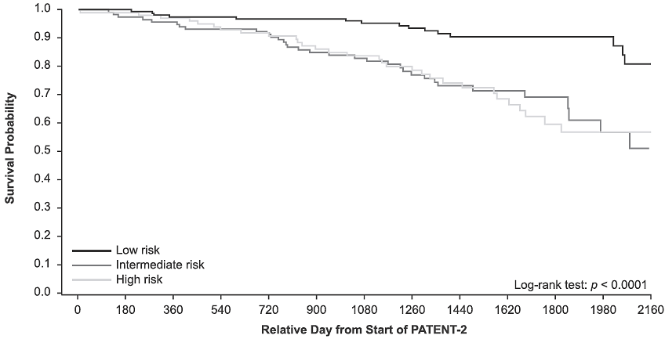
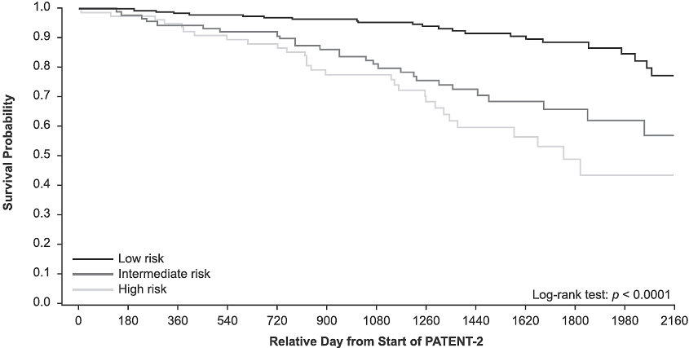
REVEAL Lite 2 Risk Strata
Kaplan–Meier Analyses for Survival by Stratified REVEAL Lite 2 Risk Strata
Stratification at Baseline
Stratification at PATENT-1 Week 12
Kaplan–Meier curves for survival were significantly different between risk strata at baseline (p < 0.0001) and PATENT-1 Week 12 (p < 0.0001), although curves for intermediate- and high-risk scores at baseline showed a similar risk in the observation period and for change in risk stratum from baseline at PATENT-1 Week 12 (p = 0.0062)
CWFS was significantly different across REVEAL Lite 2 risk strata when risk was assessed at baseline (p < 0.0001) and at PATENT-1 Week 12 (p < 0.0001)
Notes:
Kaplan-Meier curves for survival were significantly different between risk strata at baseline (p < 0.0001) and PATENT-1 Week 12
(p < 0.0001), although curves for intermediate and high risk scores at baseline showed a similar risk in the observation
period, and for change in risk stratum from baseline at PATENT-1 Week 12 (p = 0.0062). Similarly, CWFS was significantly different across
REVEAL Lite 2 risk strata when risk was assessed at baseline (p < 0.0001) and at PATENT-1 Week 12 (p < 0.0001)

Slide 15
Discussion
Analysis of REVEAL Lite 2 scores in patients from the PATENT studies revealed that riociguat significantly improved REVEAL Lite 2 scores and risk strata in patients with PAH, with more patients achieving low-risk status
REVEAL Lite 2 and original RRS scores at baseline and at Week 12 were significantly associated with survival and CWFS in patients with PAH receiving riociguat
Similar in concept to the French non-invasive risk stratification algorithm, REVEAL Lite 2 uses fewer risk variables than RRS and RRS 2.0 and supports the notion that this may be a viable methodology for accurate risk prediction in patients with PAH

Slide 16
Potential Study Limitations
C-indices should be interpreted with caution as there were only small numbers of patients in the intermediate- and high-risk categories, and a low number of events overall
The use of a condensed, three category model may have reduced the distinction between the intermediate- and high-risk groups
Due to the small number of patients and events in PATENT, a direct comparison between REVEAL Lite 2 and the FPHN non-invasive approach in PATENT is not statistically viable
Additional Limitations
Post hoc nature of the analyses
High proportion of patients in the low-risk stratum at baseline
Potential for survivor bias in PATENT-2 and the small number of patients in the intermediate- and high-risk categories

