Slide 1
Mild Pulmonary Hypertension and Premature Mortality Among 154,956 Men and Women Undergoing Routine Echocardiography
Rajan Saggar, MD
Professor of Medicine
Director, Pulmonary Hypertension Program
Co-Director, Pulmonary Vascular Disease Program,
Lung and Heart–Lung Transplant Program and Pulmonary Hypertension Program
David Geffen School of Medicine at UCLA
Los Angeles, CA

Slide 2
Rationale
Pulmonary hypertension is a chronic condition of increased blood pressure within the arteries of the lungs
Definitive diagnosis is made by the measurement of mean pulmonary artery pressure (mPAP) > 20mmHg via right heart catheterization
Estimated right ventricular systolic pressure (eRVSP) can be obtained non-invasively by echocardiography based on tricuspid regurgitant velocity (TRV)
eRVSP represents a pragmatic way to identify potential cases of pulmonary hypertension prior to further investigation

Slide 3
Background
2015 ESC/ERS guidelines for diagnosis and treatment of pulmonary hypertension recommend definitive investigation if eRVSP > 40 mmHg in the absence of significant respiratory pathology
A prior study of >150,000 subjects in the National Echocardiography Database of Australia demonstrated that RVSP >40 mmHg was associated with increased mortality
This study aimed to elucidate the association between eRVSP with mild-to-severe forms of pulmonary hypertension with premature mortality and associated life-years lost (LYL)

Slide 4
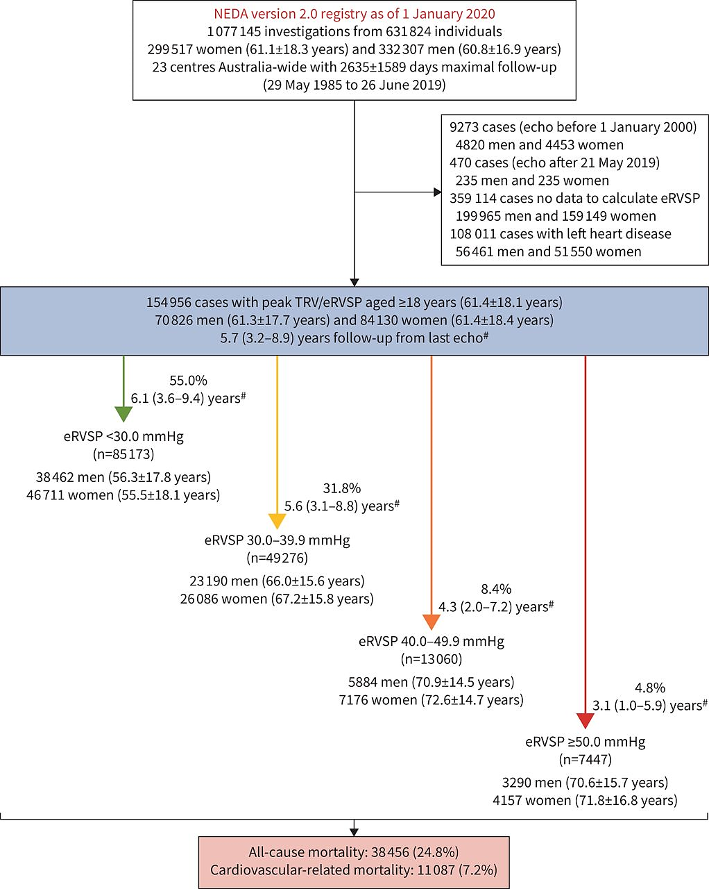
Methods
Retrospective analysis of observational cohort in Australia between Jan 2000 and May 2019
Aged >18 years with ≥1 echocardiogram and all variables of interest available
Exclusion criteria designed to exclude group 2 PH (left heart disease)
  LVEF < 55%
  E/e’ > 12
  LA volume index > 34 mL/m²
  Moderate-to-severe mitral or aortic valve disease

Slide 5
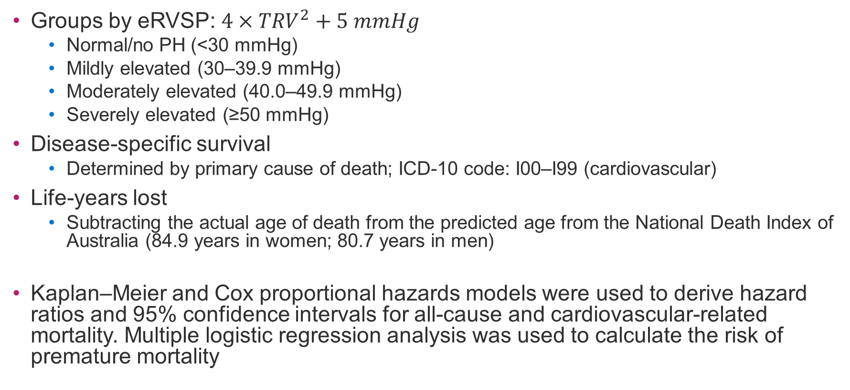
Methods, continued
Groups by eRVSP: $4×{TRV}^{2}+5 mmHg$
  Normal/no PH (<30 mmHg)
  Mildly elevated (30–39.9 mmHg)
  Moderately elevated (40.0–49.9 mmHg)
  Severely elevated (≥50 mmHg)
Disease-specific survival
  Determined by primary cause of death; ICD-10 code: I00–I99 (cardiovascular)
Life-years lost
  Subtracting the actual age of death from the predicted age from the National Death Index of Australia (84.9 years in women; 80.7 years in men)
Kaplan–Meier and Cox proportional hazards models were used to derive hazard ratios and 95% confidence intervals for all-cause and cardiovascular-related mortality. Multiple logistic regression analysis was used to calculate the risk of premature mortality

Slide 6
Results: Baseline Characteristics
Sex-specific profile
Profile according to increasing eRVSP
 | Total Subjects (n) | Men (n=70,826) | Women (n=84,130) | <30mmHg (n=85,173) | 30–39.9 mmHg (n=49,276) | 40–49.9 mmHg (n=13,060) | ≥50 mmHg (n=7,447)
Age |  | 61.3±17.7 | 61.4±18.4 | 55.9±18.0 | 66.6±15.7 | 71.8±14.6 | 71.3±16.3
Women (%) | 84,130 |  |  | 54.8% | 52.9% | 54.9% | 55.8%
BMI (kg/m²) | 113,144 | 27.16±5.07 | 27.01±6.53 | 26.62 ±5.52 | 27.76±6.13 | 27.83 ±6.96 | 27.39±7.11
eRVSP (mmHg) | 154,956 | 30.86±10.08 | 30.83±10.49 | 24.44±3.58 | 33.67±2.83 | 43.94±2.80 | 62.42±13.28
Peak TRV (m/s) | 154,956 | 2.50±0.45 | 2.50±0.47 | 2.19±0.22 | 2.67±0.13 | 3.12±0.11 | 3.77±0.40
RA dilation | 12,449 | 6913 (9.8) | 5536 (6.6) | 4240 (5.0) | 4577 (9.3) | 1904 (14.6) | 1728 (23.2)
RV dilation | 110,865 | 6094 (12.0) | 4524 (7.5) | 2882 (4.6) | 3060 (8.7) | 2049 (23.4) | 2627 (51.4)
Impaired RV function | 110,865 | 1081 (2.1) | 891 (1.5) | 453 (0.7) | 491 (1.4) | 400 (4.6) | 628 (12.3)
Data are presented as mean±sd, median (interquartile range), or n (%), unless otherwise stated. eRVSP: estimated right ventricular systolic pressure; BMI: body mass index; RA: right atrial; TRV: tricuspid regurgitation velocity; RV: right ventricular. #: assuming RA pressure 5 mmHg.

Slide 7
Results
Survival Profile and Adjusted Risk for Mortality According to Estimated Right Ventricular Systolic Pressure (eRVSP)
eRVSP level# | Time-specific mortality |  | Cause-specific mortality during entire follow-up
 | 1-year mortality (n=150, 062) | 5-year mortality (n=99,372) | All-cause mortality (n=154,956) | Cardiovascular-related mortality (n=154,956) | Respiratory-related mortality (n=154,956)
All individuals | 13,035 (8.7) | 30,169 (30.4) | 38,456 (24.8) | 11,087 (7.2) | 4228 (2.7)
Normal (n=85 ,173) | 3242/82,143 (3.9) Reference | 8538/51,195 (16.7) Reference | 11,612 (13.6) Reference | 2952 (3.5) Reference | 834 (1.0) Reference
Mildly elevated (n=49, 276) | 4735/47,823 (9.9) OR 2.84 (2.77–2.92) | 11,544/32,530 (35.5) OR 2.75 (2.66–2.84) | 15,249 (30.9) HR 2.55 (2.49–2.61) | 4248 (8.6) HR 2.78 (2.65–2.91) | 1539 (3.1) HR 3.56 (3.27–3.87)
Moderately elevated (n=13, 060) | 2684/12,782 (21.0) OR 6.74 (6.47–7.01) | 5654/9695 (58.3) OR 6.99 (6.67–7.32) | 6721 (51.5) HR 5.20 (5.04–5.36) | 2158 (16.5) HR 6.46 (6.11–6.83) | 982 (7.5) HR 10.40 (9.48–10.40)
Severely elevated (n=7447) | 2374/7314 (32.5) OR 12.13 (11.51–12.79) | 4433/5952 (74.5) OR 14.58 (13.69–15.53) | 4874 (65.4) HR 8.28 (8.00–8.56) | 1729 (23.2) HR 11.24 (10.59–11.94) | 873 (11.7) HR 20.10 (18.26–22.11)
Data are presented as n (%) or n/N (%), unless otherwise indicated; 95% confidence intervals are indicated for hazard ratios and odds ratios. #: normal, <30.0 mmHg; mildly elevated, 30.0–39.9 mmHg; moderately elevated, 40.0–49.9 mmHg; severely elevated, ≥50.0 mmHg.

Slide 8
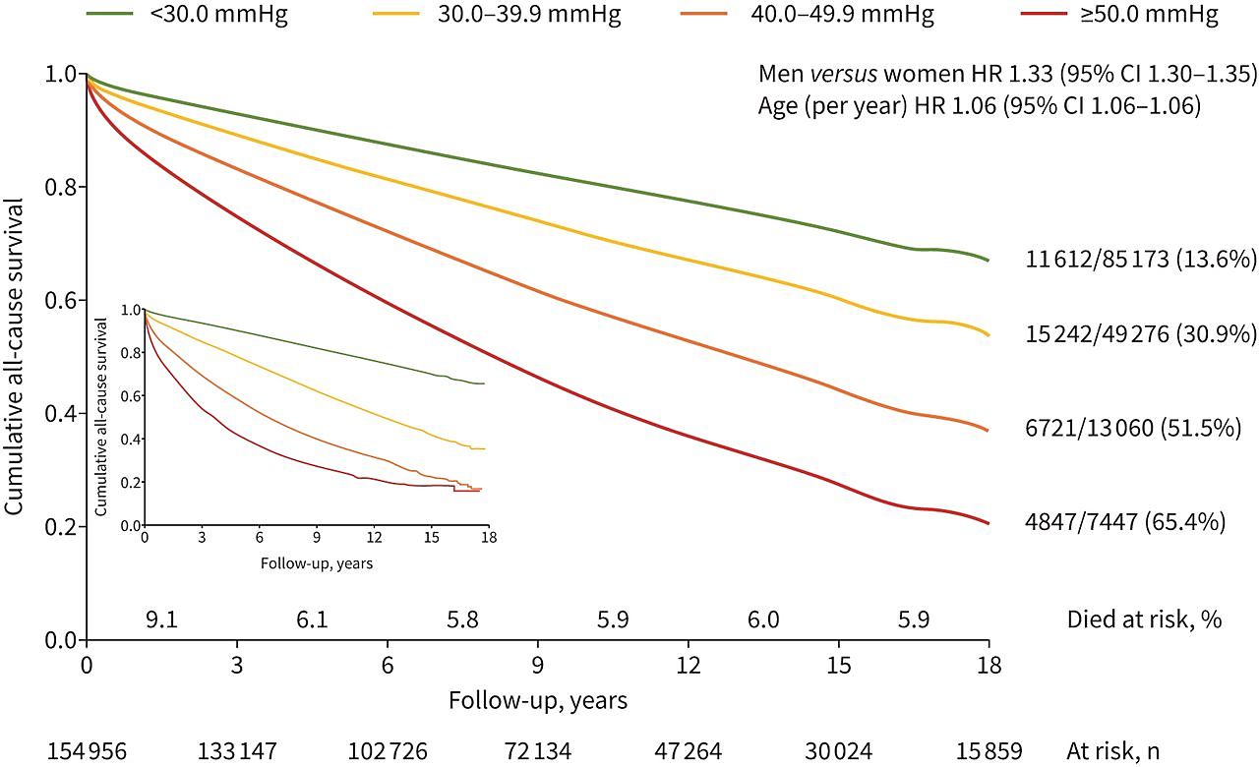
Results
Age and Sex-Adjusted All-Cause Mortality Per Estimated Right Ventricular Systolic Pressure (eRVSP) Group
The main graph shows age and sex-adjusted curves for all-cause mortality during long-term follow-up for each of the four pre-specified eRVSP groups (hazard ratios shown in top right corner; p < 0.001 for both)
Overall numbers at risk (in 3-year intervals) and mortality rate during these specific intervals are shown below and above the x-axis, respectively
Inset shows the unadjusted Kaplan–Meier survival curves

Slide 9
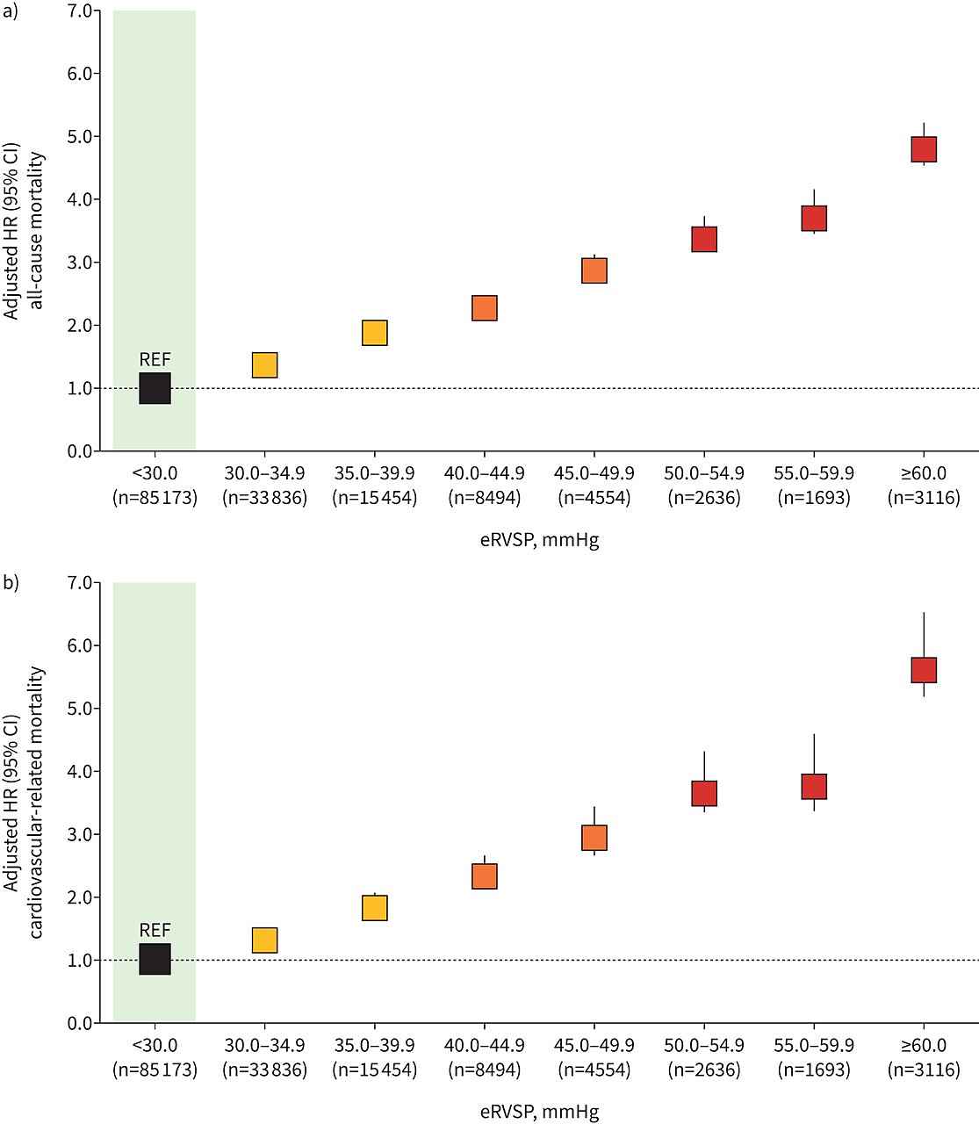
Results
Age and Sex-Adjusted Risk of Mortality Per 5 mmHg Estimated eRVSP Increase
All-Cause Mortality
Patients with eRVSP 35.0–39.9 mmHg were almost twice as likely to die from all causes (HR 1.90; 95% CI, 1.84–1.96) and cardiovascular disease (HR 1.85; 95% CI, 1.74–1.97) (p < 0.001)
The risk of mortality rose among those with eRVSP ≥ 50.0 mmHg (HR 4.79; 95% CI, 4.57–5.02 and HR 5.63; 95% CI, 5.20–6.11) for all-cause and cardiovascular-related mortality, respectively
Cardiovascular-Related
Mortality

Slide 10
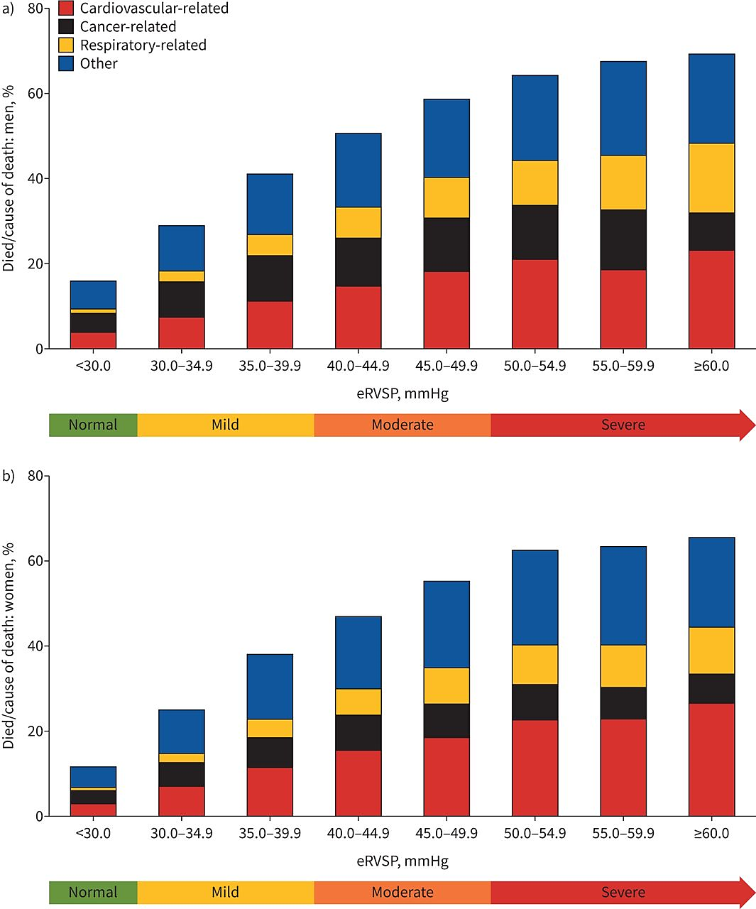
Results
Pattern of Cause-Specific Mortality With Increasing eRVSP for
a) Men and b) Women
The proportion of malignancy-related deaths declined with rising eRVSP as the proportion of cardiovascular- and respiratory-related deaths increased

Slide 11
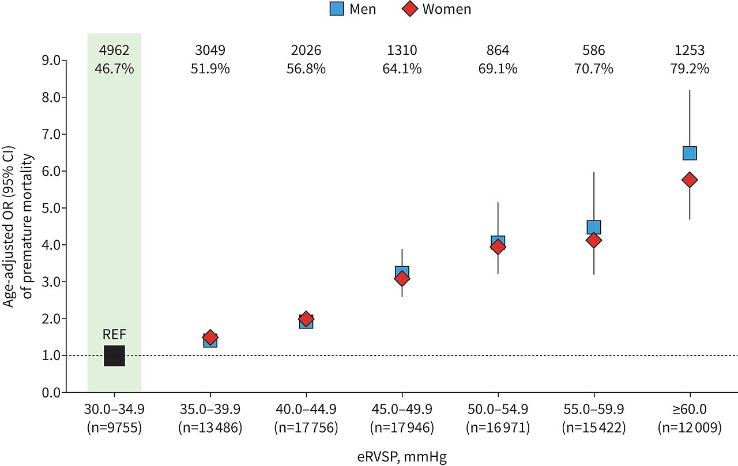
Results: Premature Mortality
54% of men and 55% of women died prematurely
Each 5 mmHg increase in eRVSP was associated with increasingly more premature mortality
For every 1000 cases at risk, the rate of premature mortality increased by three (0.5%), 32 (6.2%) and 53 (9.8%) cases for those with eRVSP of 30.0–39.9, 40.0–49.9 and ≥50.0 mmHg, respectively

Slide 12
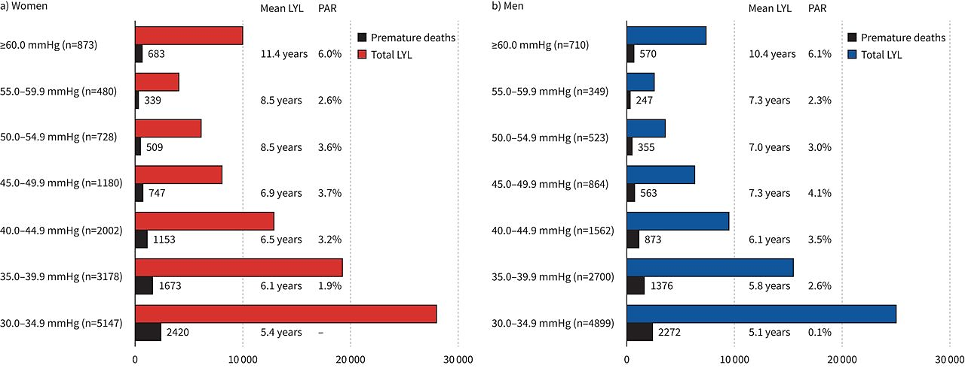
Results: Sex-Specific Pattern of Premature Mortality and Life-Years Lost (LYL) With Increasing eRVSP

Slide 13
Discussion
In 154,956 patients referred for echocardiography, milder forms of pulmonary hypertension defined by eRVSP and the absence of left heart disease were associated with an increased risk of mortality in both women and men and may contribute to premature mortality and life-years lost
>50% of premature deaths had eRVSPs ≥30 mmHg
Authors suggest that the current cutoff of eRVSP at > 40 mmHg may not capture all those patients at risk and that eRVSP ≥ 30 mmHg may merit investigation

Slide 14
Limitations and Conclusions
Limited generalizability – patients were being investigated for pre-existing cardiopulmonary conditions. All patients were within Australia
Unable to review echocardiographic images or other functional parameters
Retrospective cohort study reliant on accurate input of data for echo parameters and ICD-10 cause of death
Lack of comorbidity data, medication therapy data, hospitalizations, and confirmatory data or parameters to estimate pulmonary vascular resistance
This large echocardiographic database study demonstrates increased mortality associated with mildly elevated eRVSP

