Slide 1
Should We Make Active Surveillance More Active for Localized Prostate Cancer?
Neeraj Agarwal, MD, FASCO
Professor of Medicine
Senior Director for Clinical Translation, Huntsman Cancer Institute (HCI)
Presidential Endowed Chair of Cancer Research
Director, Center of Investigational Therapeutics
Director, Genitourinary Oncology Program
Huntsman Cancer Institute, University of Utah (NCI-CCC)
Salt Lake City, UT

Slide 2
Resource Information
About This Resource
These slides are one component of a continuing education program available online at MedEd On The Go titled Prostate Cancer: Focusing Androgen Receptor Inhibitors on High-Risk Localized & Locally Advanced Disease
Program Learning Objectives:
Describe the risk of developing metastases and cancer-related mortality based on risk stratification in localized prostate cancer
Assess the evolving changes in guideline recommendations for high-risk localized and locally advanced prostate cancer and where ARIs fit into these recommendations
Evaluate the efficacy and safety of second-generation ARI therapy in patients with newly diagnosed prostate cancer who have high-risk localized or locally advanced disease
Employ effective multidisciplinary adverse effect management strategies to improve ARI treatment adherence
MedEd On The Go®
www.mededonthego.com
This content or portions thereof may not be published, posted online or used in presentations without permission.
This content can be saved for personal use (non-commercial use only) with credit given to the resource authors.
To contact us regarding inaccuracies, omissions or permissions please email us at support@MedEdOTG.com

Slide 3
Disclaimer
The views and opinions expressed in this educational activity are those of the faculty and do not necessarily represent the views of Total CME, LLC, the CME providers, or the companies providing educational grants. This presentation is not intended to define an exclusive course of patient management; the participant should use their clinical judgment, knowledge, experience, and diagnostic skills in applying or adopting for professional use any of the information provided herein. Any procedures, medications, or other courses of diagnosis or treatment discussed or suggested in this activity should not be used by clinicians without evaluation of their patient's conditions and possible contraindications or dangers in use, review of any applicable manufacturer’s product information, and comparison with recommendations of other authorities. Links to other sites may be provided as additional sources of information.

Slide 4
Active Surveillance
Active surveillance involves actively monitoring the course of disease with the expectation to intervene with curative intent if the cancer progresses
Candidacy for Active Surveillance:
Preferred for patients with very-low-risk prostate cancer and a life expectancy ≥10 years
Preferred for most patients with low-risk prostate cancer and a life expectancy ≥10 years
Could also be considered in patients with favorable intermediate-risk prostate cancer and a life expectancy >10 years
NCCN Guidelines Prostate Cancer version 1, 2023 (PROS-F p1 of 5).

Slide 5
Active Surveillance Program
Patients who choose active surveillance should have regular follow-up, and key principles include:
PSA no more often than every 6 months unless clinically indicated
DRE no more often than every 12 months unless clinically indicated
Repeat prostate biopsy no more often than every 12 months unless clinically indicated
Consider repeat mpMRI no more often than every 12 months unless clinically indicated
In patients with a suspicious lesion on mpMRI, MRI-ultrasound fusion biopsy improves the detection of higher grade (Grade Group ≥2) cancers
Patients should be transitioned to observation when life expectancy is less than 10 years
Repeat molecular tumor analysis is discouraged
The intensity of surveillance may be tailored based on patient life expectancy and risk of reclassification
PSA, prostate-specific antigen.
NCCN Guidelines Prostate Cancer version 1, 2023 (PROS-F p2 of 5).

Slide 6
Enzalutamide Versus AS in Patients with Low-Risk or Intermediate-Risk Localized PC: ENACT
Stratification factors
Cancer risk (low vs intermediate)
Type of follow-up biopsy (mpMRI- targeted vs non–mpMRI-targeted)
Key Eligibility
Men aged ≥ 18 years with histologically proven PC
Low risk PC (T1c-T2a, PSA<10, N0, M0, GS ≤ 6,) OR intermediate risk PC [T2b-T2c, PSA<20, N0, M0. GS ≤7 (3+4 pattern only)]
ECOG ≤2 & estimated life expectancy >5 yrs
No prior radiotherapy, surgery, chemotherapy, or hormonal therapy for PC
No prior use of 5α reductase inhibitor within 1 month of screening or total use, within the last 2 yrs of >3 months
No h/o seizures or condition predisposing to seizures
R A N D O M I Z E D
n=227
Enzalutamide 160 mg qd +
Active Surveillance
Efficacy end points
Primary:
Pathological or therapeutic PC progression
Secondary:
Incidence of negative biopsy results at 1 and 2 years
Percentage of cancer-positive cores at 1 and 2 years
Time to PSA progression
Patient-reported outcomes assessed via questionnaires
Placebo
+
Active Surveillance
AS, active surveillance; ECOG, Eastern Cooperative Oncology Group; h/o, history of; PSA, prostate-specific antigen. www.clinicaltrials.gov: (NCT02799745)

Slide 7
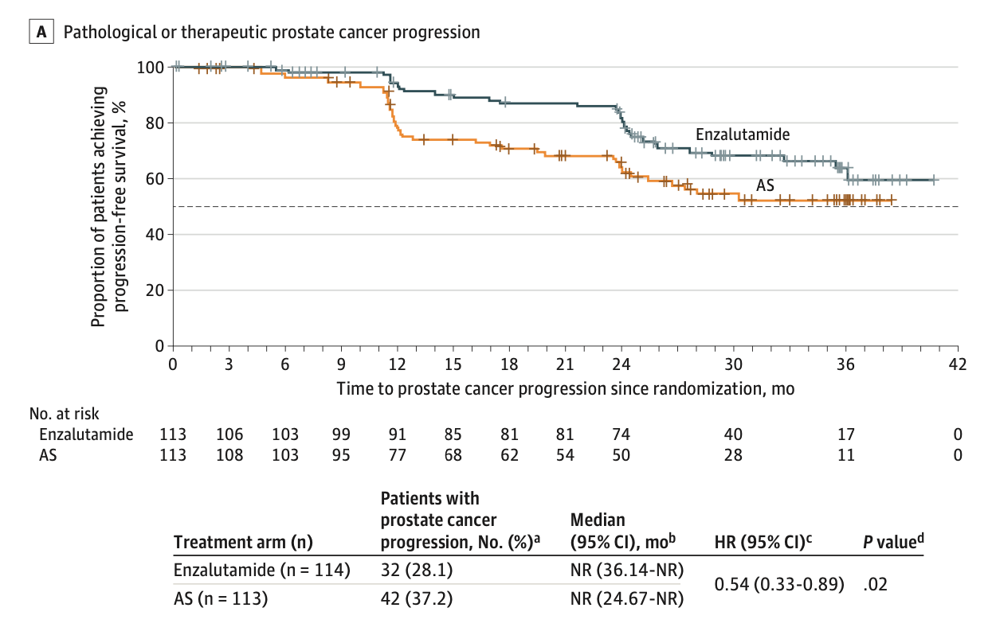
ENACT Results
Primary Endpoint
Disease progression was observed in 32 patients (28.1%) receiving treatment with enzalutamide and 42 (37.2%) of those undergoing AS (Fig A)
The median time to pathological or therapeutic prostate cancer progression was not reached in either treatment arm
Treatment with enzalutamide significantly reduced the risk of prostate cancer progression by 46% versus AS (HR, 0.54; 95% CI, 0.33-0.89; P = .02)
The incidence of pathological or therapeutic prostate cancer progression was lower with enzalutamide (7.9%) versus AS (23.0%) at 1 year (odds ratio [OR], 0.3; 95% CI, 0.11-0.60; P < .01)
At 2 years, incidence was similar between treatment arms (16.0% with enzalutamide vs 16.4% with AS; OR, 0.9; 95% CI, 0.36-2.24; P = .81)
CI, confidence interval; HR, hazard ratio; NR, not reported; OR, odds ratio.
Shore ND, et al. JAMA Oncol. 2022;8(8):1128-36.

Slide 8
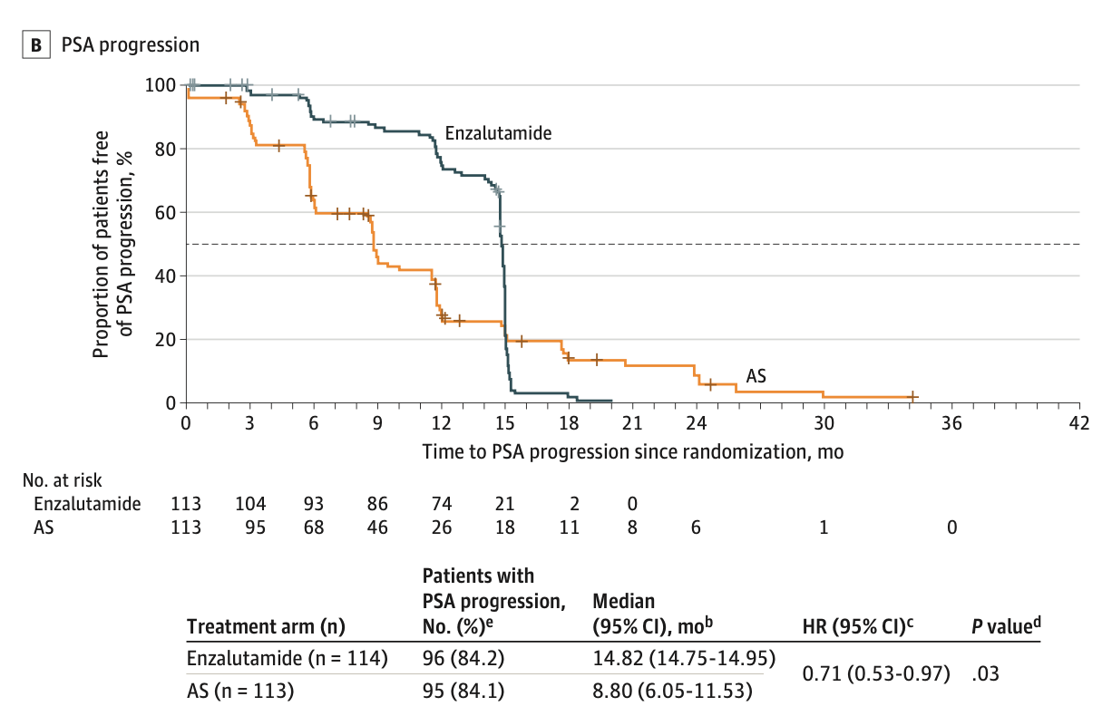
ENACT Results
Secondary Endpoints
The odds of a negative biopsy result at 1 year were significantly increased following treatment with enzalutamide versus AS (OR, 3.5; 95% CI, 1.76-6.92; P < .001). However, at 2 years, the difference was not statistically significant
The mean percentage of cancer positive cores at 1 year was significantly lower with enzalutamide than AS (difference in least squares mean [SE], −10.07 [2.40]; 95% CI, −14.79 to −5.34; P < .001; Table 2). However, at 2 years, the difference was not statistically significant
Time to PSA progression was significantly delayed by 6 months with treatment with enzalutamide versus AS (HR, 0.71; 95% CI, 0.53-0.97; P = .03; Figure B)
The odds of a secondary rise in serum PSA levels at 1 year were significantly reduced with treatment with enzalutamide versus AS (OR, 0.1; 95% CI, 0.08-0.26; P < .001), but not at 2 years
Treatment with enzalutamide was not associated with clinically significant worsening of PROs, except sexual and physical function, which resolved by month 24 after treatment cessation
AS, active surveillance; PRO, patient reported outcomes; PSA, prostate-specific antibody.
N Shore et al. JAMA Oncol. 2022;8(8):1128-1136.

Slide 9
Conclusions from the Trial Investigators
Enzalutamide monotherapy was well tolerated and achieved a significant treatment response in patients with low-risk or intermediate-risk localized prostate cancer
Enzalutamide may offer an alternative short-term treatment option for this patient population

Slide 10
Looking for more resources on this topic?
CME/CE in minutes
Congress highlights
Late-breaking data
Quizzes
Webinars
In-person events
Slides & resources
www.MedEdOTG.com

