Slide 1
Metastatic TNBC: Utilizing Biology and Health Disparities to Inform Shared Decision Making
Sara A. Hurvitz, MD, FACP
Professor of Medicine
University of California
Los Angeles, CA

Slide 2



Resource Information
About This Resource
These slides are one component of a continuing education program available online at MedEd On The Go titled Triple-Negative Breast Cancer (TNBC): Choosing the Right ADC for the Right Patient
Program Learning Objectives:
Explain the rationale for varying levels of ADC target positivity required for ADC efficacy and treatment eligibility
Identify patients with TNBC who are optimal candidates for ADCs
Develop evidence-based treatment strategies using ADCs in metastatic TNBC
Apply knowledge of barriers to access, care, and treatment that exist in the care of minority patients diagnosed with metastatic TNBC
Differentiate advantages of ADCs in special populations of patients with metastatic TNBC
Identify strategies for improving adherence through adverse effect management
MedEd On The Go®
www.mededonthego.com
This content or portions thereof may not be published, posted online or used in presentations without permission.
This content can be saved for personal use (non-commercial use only) with credit given to the resource authors.
To contact us regarding inaccuracies, omissions or permissions please email us at support@MedEdOTG.com

Slide 3
Disclaimer
The views and opinions expressed in this educational activity are those of the faculty and do not necessarily represent the views of Total CME, LLC, the CME providers, or the companies providing educational grants. This presentation is not intended to define an exclusive course of patient management; the participant should use their clinical judgment, knowledge, experience, and diagnostic skills in applying or adopting for professional use any of the information provided herein. Any procedures, medications, or other courses of diagnosis or treatment discussed or suggested in this activity should not be used by clinicians without evaluation of their patient's conditions and possible contraindications or dangers in use, review of any applicable manufacturer’s product information, and comparison with recommendations of other authorities. Links to other sites may be provided as additional sources of information.

Slide 4
TNBC Incidence in African American Women
TNBC subtype is twice as prevalent in African American women than in American women of European descent (33.3% vs 14.9%)¹
Probability of TNBC incidence was 3-fold higher in African American women than in American women of European descent irrespective of age and obesity²
  31% before 50 years versus 29% after 50 years
  29% obese versus 31% non-obese
Both Hispanic and non-Hispanic African American women have earlier onset of disease³
  Median age 54 and 57 years, respectively, versus 64 years for non-Hispanic white women
Non-Hispanic African American women <44 years of age have the highest lifetime TNBC incidence rates and higher rates of stage III and IV disease³

Slide 5
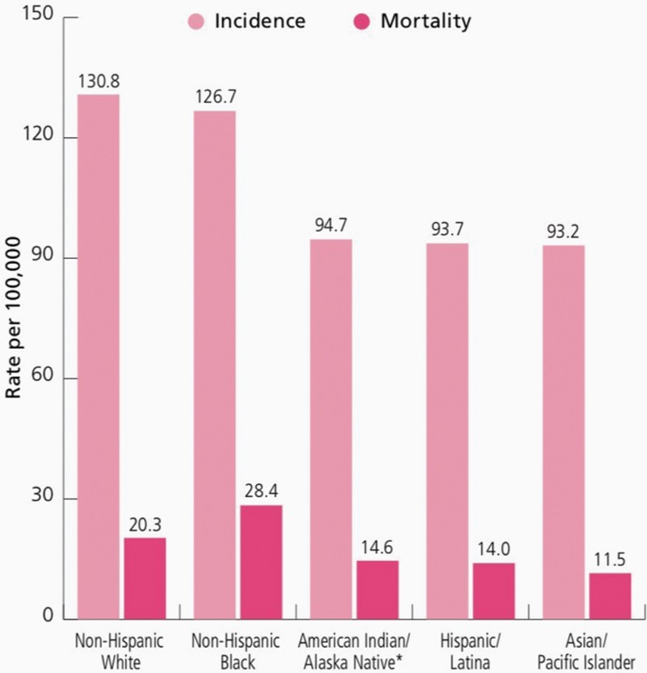
African American Women with TNBC Have Higher Mortality
Female breast cancer incidence (2012–2016) and death (2013–2017) rates by race/ethnicity in the US
Median age at death due to breast cancer:
  68 yrs all women
  70 yrs white women
  63 yrs African American women

Slide 6
Disparities in Treatment
In a retrospective analysis, compared to non-Hispanic White women, African American women:¹
  Were more likely to be single
  Had larger tumors at diagnosis
  Had a 30% to 40% higher risk of being diagnosed at stage II-IV TNBC
  Were 60% more likely to receive non-guideline concordant primary treatment
In a population-based cohort study of 23,213 patients with TNBC, compared to white women, African American women:²
  Had lower odds of receiving surgery (OR, 0.69) or chemotherapy (OR, 0.89)
  Had higher breast cancer mortality (HR, 1.28)

Slide 7
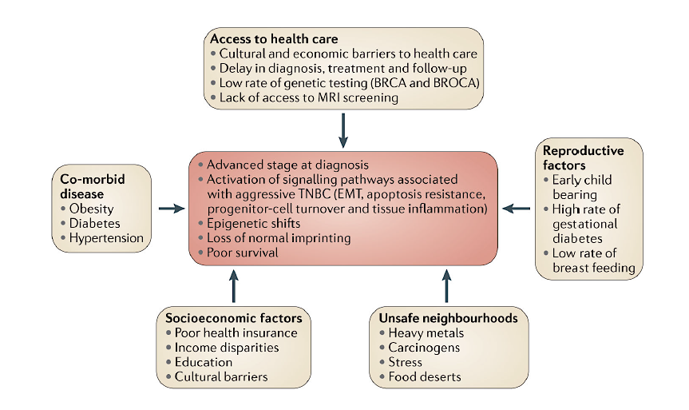
Disparities in Diagnosis and Treatment
Socioeconomic Factors Contributing to Disparity in TNBC
Modifiable risk factors for TNBC may be more prevalent in certain at-risk groups
Low SES and less-generous insurance associated with diagnosis at advanced stage for all women
Outcomes in African American women influenced by underlying disease characteristics as well as SES and patterns of care
Low SES African American women more likely to receive inappropriate treatment versus higher SES NHW

Slide 8
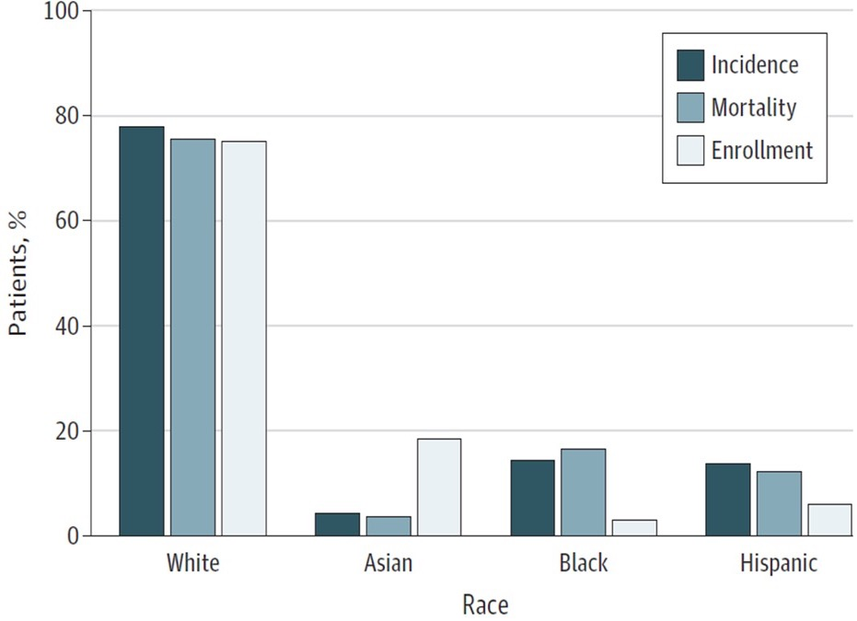
Clinical Trial Participation
Relative proportion among US patients with cancer compared with trial participants in FDA approval trials between July 2008 and June 2018.
Trial participation is low among African American patients and highest among Asian patients
In a survey of 358 trials, African Americans represented:
  12.1% of total cancer population
  9.0% of participations in SWOG trials
  2.9% of participants in pharmaceutical
  company sponsored trials

Slide 9
ASCENT: Patient Characteristics
 | SG (n=235) | TPC (n =233)
Female—no. (%) | 233 (99) | 233 (100)
Median age—yr (range) | 54 (29-82) | 53 (27-81)
Race or ethnic group—no. (%)
White | 188 (80) | 181 (78)
Black | 28 (12) | 28 (12)
Asian | 9 (4) | 9 (4)
Other or not specified | 10 (4) | 15 (6)
ECOG PS—no. (%)
0 | 108 (46) | 98 (42)
1 | 127 (54) | 135 (58)
BRCA 1/2 mutational status—no. (%)
Positive | 16 (7) | 18 (8)
Negative | 133 (57) | 125 (54)
Unknown | 86 (37) | 90 (39)
TNBC at initial diagnosis
Yes | 165 (70) | 157 (67)
No | 70 (30) | 76 (33)
 | SG (n=235) | TPC (n=233)
Previous anticancer regimens —median no. (range) | 4 (2-17) | 4 (2-14)
Most common previous chemotherapy—no. (%)
Taxane‡ | 235 (100) | 233 (100)
Anthracycline§ | 191 (81) | 193 (83)
Cyclophosphamide | 192 (82) | 192 (82)
Carboplatin | 147 (63) | 160 (69)
Capecitabine | 147 (63) | 159 (68)
Previous PARP inhibitor—no. (%) | 17 (7) | 18 (8)
Previous use of checkpoint inhibitors—no. (%) | 67 (29) | 60 (26)
Most common sites of disease—no. (%)
Lung only | 108 (46) | 97 (42)
Liver | 98 (42) | 101 (43)
Bone | 48 (20) | 55 (24)
PARP, poly-ADP ribose polymerase; SG, Sacituzumab govitecan; TPC, treatment of physician’s choice.
Bardia A, et al. N Engl J Med. 2021;384(16):1529-41.

Slide 10
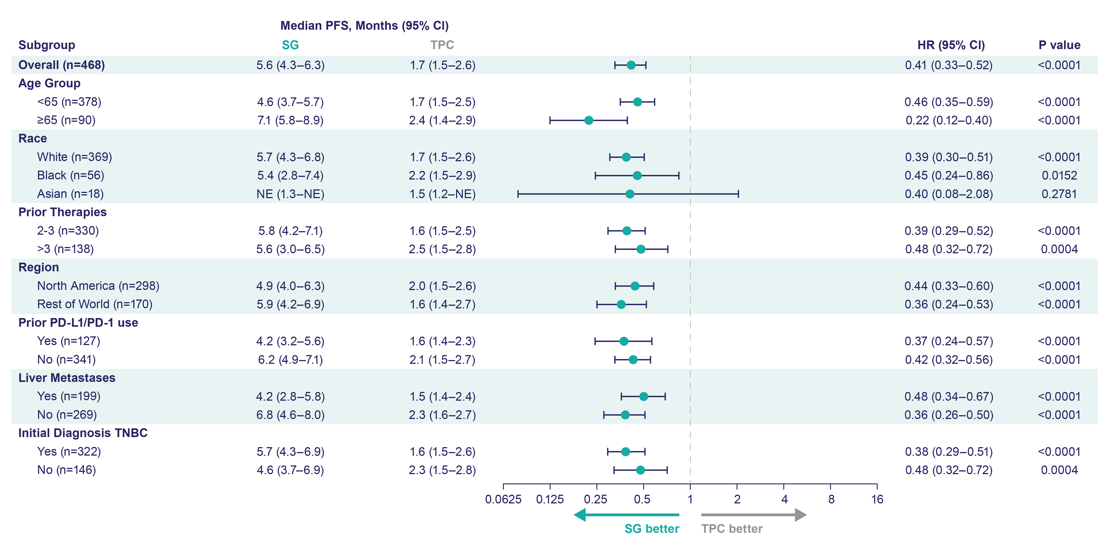
Progression-Free Survival by Subgroup
Assessed by independent central review in brain metastases-negative population.
CI, confidence interval; PD-1, programmed cell death-1; PD-L1, programmed cell death-ligand 1; PFS, progression-free survival.
Bardia A, et al. N Engl J Med. 2021;384(16):1529-41.

Slide 11
Phase 3 ASCENT: Efficacy in ITT Population, Stratified for African American Patients
62/529 pts enrolled in ASCENT were African American (12%; 28 SG vs 34 TPC)
African American patients derived PFS and OS benefits similar to those in overall population
The safety profile of SG in this subgroup was consistent with that in the full trial population
ITT, intent to treat; OS, overall survival.
Carey L, et al. SABCS 2021. Poster P05-16-07.

Slide 12



Looking for more resources
on this topic?
CME/CE in minutes
Congress highlights
Late-breaking data
Quizzes
Webinars
In-person events
Slides & resources
www.MedEdOTG.com

