Slide 1
How Do We Identify Patients With Localized Prostate Cancer Who Are at Increased Risk for Developing Metastatic Disease?
Rana R. McKay, MD
Associate Professor of Medicine and Urology
Associate Director, Translational Sciences
Disease Team Co-Lead, Genitourinary Oncology Program
Moores Cancer Center
La Jolla, CA

Slide 2
Resource Information
About This Resource
These slides are one component of a continuing education program available online at MedEd On The Go titled Prostate Cancer: Focusing Androgen Receptor Inhibitors on High-Risk Localized & Locally Advanced Disease
Program Learning Objectives:
Describe the risk of developing metastases and cancer-related mortality based on risk stratification in localized prostate cancer
Assess the evolving changes in guideline recommendations for high-risk localized and locally advanced prostate cancer and where ARIs fit into these recommendations
Evaluate the efficacy and safety of second-generation ARI therapy in patients with newly diagnosed prostate cancer who have high-risk localized or locally advanced disease
Employ effective multidisciplinary adverse effect management strategies to improve ARI treatment adherence
MedEd On The Go®
www.mededonthego.com
This content or portions thereof may not be published, posted online or used in presentations without permission.
This content can be saved for personal use (non-commercial use only) with credit given to the resource authors.
To contact us regarding inaccuracies, omissions or permissions please email us at support@MedEdOTG.com

Slide 3
Disclaimer
The views and opinions expressed in this educational activity are those of the faculty and do not necessarily represent the views of Total CME, LLC, the CME providers, or the companies providing educational grants. This presentation is not intended to define an exclusive course of patient management; the participant should use their clinical judgment, knowledge, experience, and diagnostic skills in applying or adopting for professional use any of the information provided herein. Any procedures, medications, or other courses of diagnosis or treatment discussed or suggested in this activity should not be used by clinicians without evaluation of their patient's conditions and possible contraindications or dangers in use, review of any applicable manufacturer’s product information, and comparison with recommendations of other authorities. Links to other sites may be provided as additional sources of information.

Slide 4
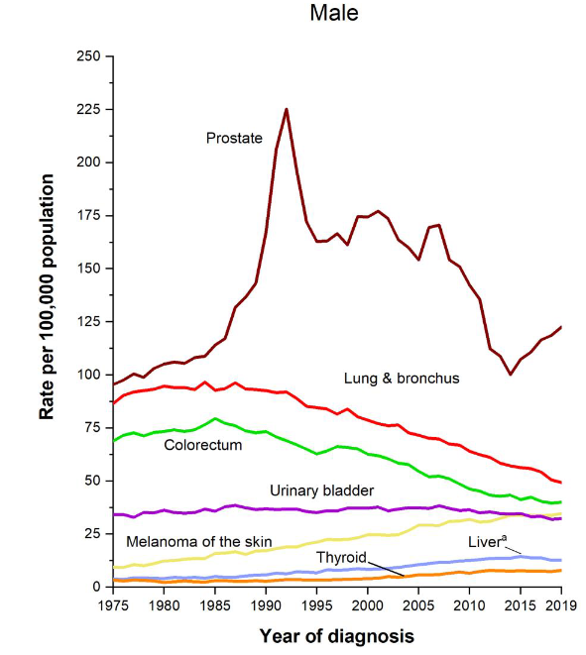
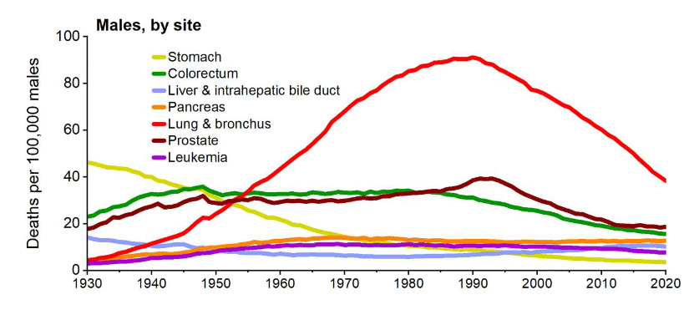
Prostate Cancer is a Common Malignancy
Most Common Cancer Among Men with Increasing Incidence
Second Leading Cause of Cancer Death in Men
Siegel RL, et al. Cancer Statistics. 2023;73(1):17-48.

Slide 5
Patterns of Presentation*
15%
*Using D’Amico criteria.
Cooperberg MR, et al. J Clin Oncol. 2010;28(7):1117-23; Eggener SE, et al. J Urol. 2011;185(3):869-75.

Slide 6
Factors that Impact Outcomes
Stage
Gleason score and pathologic features
PSA
Molecular features
PSA, prostate-specific antigen.

Slide 7
High-Risk Prostate Cancer Is Associated with Negative Outcomes
Increased Mortality in High-Risk Prostate Cancer
High-Risk Feature | 15-Year PCSM
PSA > 20 ng/mL | 22%
Gleason 8-10 | 34%
cT3 | 38%
High-risk disease | 19%
PCSM, prostate cancer-specific mortality.
Cooperberg MR, et al. J Clin Oncol. 2010;28(7):1117-23;Eggener SE, et al. J Urol. 2011;185(3):869-75.

Slide 8
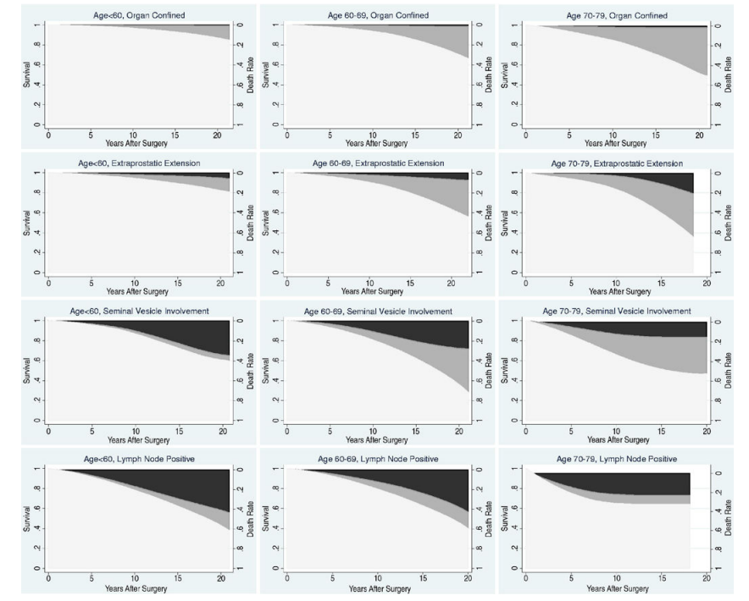
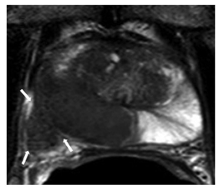
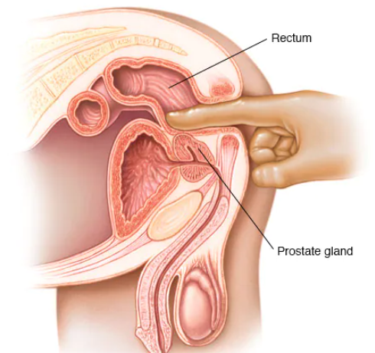
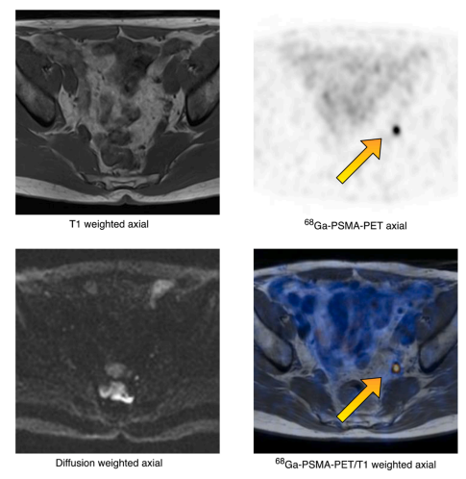
Impact of Stage on Outcomes
Digital rectal
examination
Multi-parametric prostate MRI
PSMA PET
MRI, magnetic resonance imaging; PET, positron emission tomography; PSMA, prostate-specific membrane antigen.
Eggener SE, et al. J Urol. 2011;185(3):869-75; Skawran SM, et al. Eur J Radiol. 2022;146:110044.

Slide 9
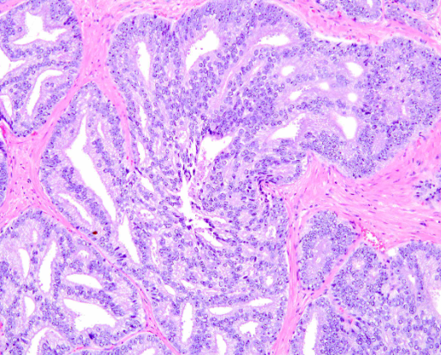
Impact of Pathologic Features
Gleason Grading
Intraductal Carcinoma
Slide provided courtesy of Dr. McKay.

Slide 10
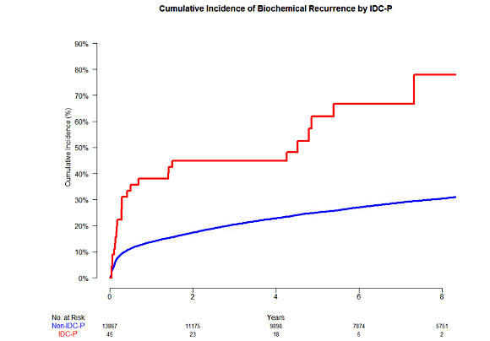
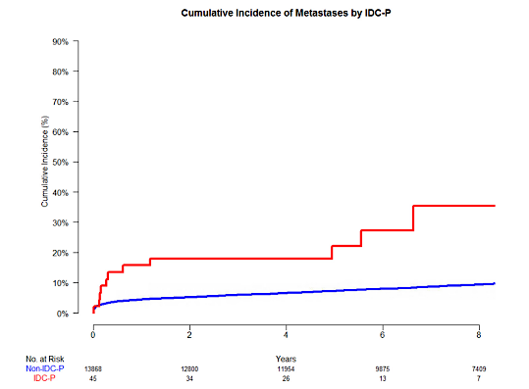
Impact of Pathologic Features
Nelson TJ et al, Clinical GU Cancers, 2023.

Slide 11
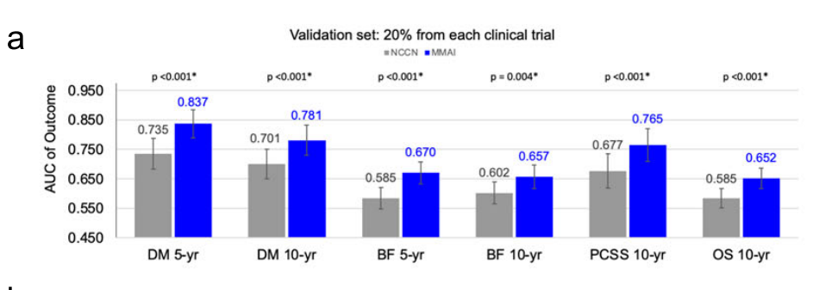
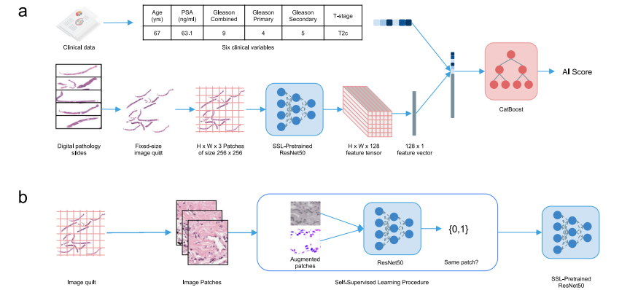
Pathologic Artificial Intelligence
Esteva A et al. NPJ Digital Medicine, 2022;5(71);4.

Slide 12
NCCN Risk Stratification to Guide Clinical Decision Making
Risk Group | Clinical/Pathologic Features
Very low | Has all of the following: cT1c Grade Group 1 PSA <10 ng/mL Fewer than 3 prostate biopsy fragments/cores positive, ≤50% cancer in each fragment/core PSA density <0.15 ng/mL/g
Low | Has all of the following but does not qualify for very low risk: cT1-cT2a Grade Group 1 PSA <10 ng/mL
Intermediate | Has all of the following: No high-risk group features No very-high-risk group features Has one or more intermediate risk factors (IRFs): cT2b-cT2c Grade Group 2 or 3 PSA 10-20 ng/mL | Favorable intermediate | Has all of the following: 1 IRF Grade Group 1 or 2 <50% biopsy cores positive (eg, <6 of 12 cores)
 |  | Unfavorable intermediate | Has one or more of the following: 2 or 3 IRFs Grade Group 3 ≥ 50% biopsy cores positive (eg, ≥6 of 12 cores)
High | Has no very-high-risk features and has exactly one high-risk feature: cT3a OR Grade Group 4 or Grade Group 5 OR PSA >20 ng/mL
Very High | Has at least one of the following: cT3b-cT4 Primary Gleason pattern 5 2 or 3 high-risk features >4 cores with Grade Group 4 or 5
IRF, intermediate-risk factor.

Slide 13
Tools to Aid in Risk Stratification
Category | Tool | Prognostic | Predictive | Endpoint Trained | Level of Evidence
Clinical | NCCN | Yes | No | Modified from D’Amico trained for BCR | 1
 | STAR-CAP¹ | Yes | No | PCSM | 3
 | CAPRA² | Yes | No | BCR | 3
 | MSKCC³ | Yes | No | PBCR and PCSM | 3
AI | ArteraAI Prostate | Yes | No | BCR, DM, PCSM | 1
Gene Expression | Decipher | Yes | No | DM | 1
 | Prolaris⁴ | Yes | No | Not specifically trained | 3
 | Oncotype | Yes | No | Adverse pathology | 3
Germline | HRR | Uncertain | No | Not specifically trained | 4
¹STAR-CAP – Age, T stage, N stage, Gleason, % positive cores, PSA; ²CAPRA score – Age, PSA, Gleason, T stage, % positive cores; ³MSKCC – Age, PSA, Gleason, T stage, % positive cores; ⁴Prolaris – Composite of CAPRA and Cell Cycle Progression score.
BCR, biochemical recurrence; CAPRA, Cancer of the Prostate Risk Assessment; HRR, homologous recombination repair; MSKCC, Memorial Sloan Kettering Cancer Center; STAR-CAP, international staging collaboration for cancer of the prostate.
National Comprehensive Cancer Network. Prostate Cancer (Version 1.2023).

Slide 14
Conclusions
The majority of patients with prostate cancer present with localized disease
A subset of patients have high-risk features that are associated with an increased risk of prostate cancer death
Risk stratification largely depends on clinical parameters, including PSA, Gleason score, and stage
Additional tools that integrate molecular features and pathologic AI are being further integrated in risk stratification

Slide 15
Looking for more resources on this topic?
CME/CE in minutes
Congress highlights
Late-breaking data
Quizzes
Webinars
In-person events
Slides & resources
www.MedEdOTG.com

