Slide 1
Case Study: Adjusting STOP-BANG Screening Criteria for Minority Ethnic Groups
Christina Finch, MD
Clinical Sleep Physician and Associate Professor
University of California San Diego
San Diego, CA

Slide 2



Resource Information
About This Resource
These slides are one component of a continuing education program available online at MedEd On The Go titled Obstructive Sleep Apnea: Emerging Therapies for Excessive Daytime Sleepiness
Program Learning Objectives:
Utilize validated diagnostic tools when assessing residual EDS due to OSA.
Understand the burden, risk factors, and prevalence of EDS due to OSA.
Develop an evidence-based, comprehensive treatment plan for the management of EDS due to OSA.
MedEd On The Go®
www.mededonthego.com
This content or portions thereof may not be published, posted online or used in presentations without permission.
This content can be saved for personal use (non-commercial use only) with credit given to the resource authors.
To contact us regarding inaccuracies, omissions or permissions please email us at support@MedEdOTG.com

Slide 3
Disclaimer
The views and opinions expressed in this educational activity are those of the faculty and do not necessarily represent the views of Total CME, LLC, the CME providers, or the companies providing educational grants. This presentation is not intended to define an exclusive course of patient management; the participant should use their clinical judgment, knowledge, experience, and diagnostic skills in applying or adopting for professional use any of the information provided herein. Any procedures, medications, or other courses of diagnosis or treatment discussed or suggested in this activity should not be used by clinicians without evaluation of their patient's conditions and possible contraindications or dangers in use, review of any applicable manufacturer’s product information, and comparison with recommendations of other authorities. Links to other sites may be provided as additional sources of information.

Slide 4
Case Study
A 65-year-old Asian female with BMI of 33 and neck circumference of 38 cm (15 in) presents to her PCP office with complaints of fatigue. As part of her thorough workup, a STOP-BANG screening is completed and found to be negative
After a year of ongoing fatigue despite negative workup, she is finally referred to Sleep Medicine at her daughter’s request after concerning overnight breathing was noted during a recent visit
She is diagnosed with severe sleep apnea and symptoms greatly improve following initiation of CPAP
What contributed to this patient’s delay in diagnosis?

Slide 5
STOP-BANG Questionnaire
Subjective history “STOP”
  Snoring
  Tiredness
  Observed apnea
  High blood Pressure
Objective findings “BANG”
  BMI >35
  Age >50
  Neck circumference >40 cm (16 in)
  Male Gender
Scoring model based on yes/no (1/0) with total scores range 0 to 8
≥3 has shown a high sensitivity for detecting OSA (93% and 100% for moderate and severe OSA, respectively)
  0 to 2: Low risk
  3 to 4: Intermediate risk
  5 to 8: High risk

Slide 6
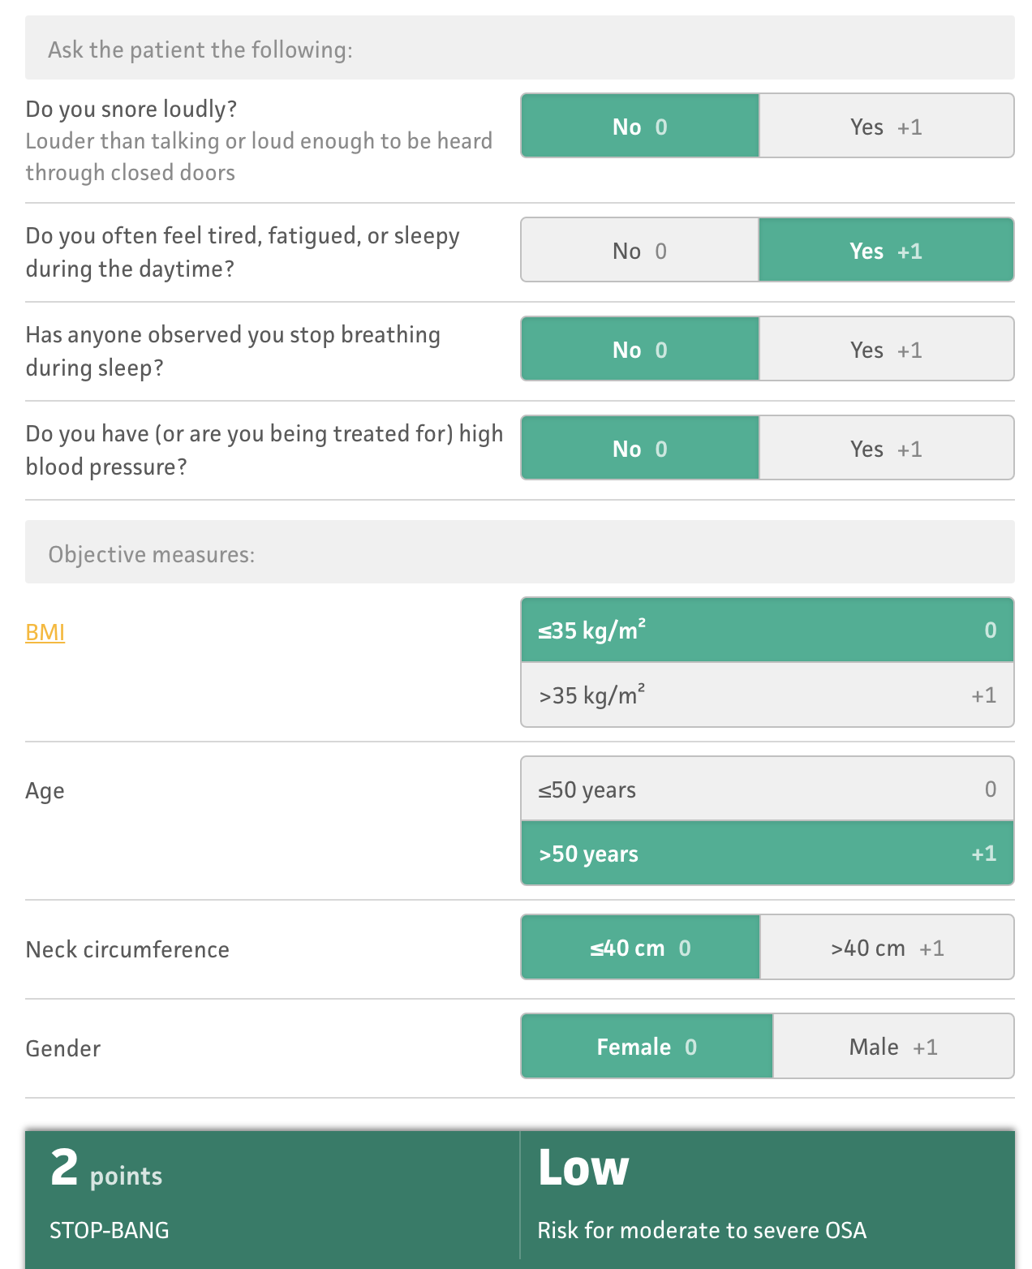
Patient’s STOP-BANG Questionnaire Results
From MDCalc:
Our patient:
Female
BMI: 33
Neck circumference: 38 cm (15 in)
Denies snoring
Past medical history negative for hypertension

Slide 7
Potential Barriers to Improving Screening Across Ethnicities
Original STOP-BANG questionnaire cutoff values were defined based on Caucasian populations
  Our patient is Asian
  Different cutoff values in different ethnicities, including African Americans, could produce different screening outcomes¹

Slide 8
Potential Barriers to Improving Screening Across Ethnicities:
Neck Circumference
Validation of neck circumference component of STOP-BANG in Asian men and women living in Singapore¹
  Retrospective analysis
  Diagnostic polysomnography used for testing
  Optimal neck circumference predictive for OSA was found to be 39 cm in males and 35 cm in females, with a sensitivity of 83.4% and 84.6% respectively
    Versus existing STOP-BANG criteria (40 cm): Sensitivity for males 71% and 32% females
  Conclusion:
    Asian males: Continue current cutoff value of 40 cm
    Asian females: Screening cutoff should be lowered to 35 cm

Slide 9
Potential Barriers to Improving Screening Across Ethnicities:
BMI
Diagnostic performance of the STOP-BANG questionnaire as a screening tool for obstructive sleep apnea in different ethnic groups¹
  The predictive parameters of STOP-BANG scores were calculated against the apnea-hypopnea index from 4 ethnic groups (Chinese, Indian, Malay, and Caucasian) undergoing preoperative screening for OSA
  Conclusion:
    For predicting moderate-to-severe OSA, BMI thresholds of 27.5 for Chinese and Indian patients and 35 for Malay and Caucasian patients are recommended

Slide 10
Potential Barriers to Improving Screening Across Ethnicities:
Gender
OSA is not strongly associated with sex in older adults
  Women after menopause have similar risk as men
  Premenopausal women have a lower risk of OSA than men
Interpretation of the STOP-BANG questionnaire is nuanced for midlife women
  Given the nature of its questions (female=0 points), a lower score may be predictive of more severe OSA in women, necessitating use of a lower threshold to trigger further testing
Future research that focuses on assessment of additional predictors of OSA not included in the STOP-BANG as screening tools could reduce underestimation of OSA in older women

Slide 11
Returning to Our Case: Adjusting the STOP-BANG Questionnaire
Our patient: Tired 65-year-old Asian female with BMI of 33 and neck circumference of 38 cm (15 in)
Recorded:
Subjective history “STOP”
  Snoring
  Tiredness
  Observed apnea
  High blood Pressure
Objective findings “BANG”
  BMI >35
  Age >50
  Neck circumference >40 cm (16 in)
  Male Gender
Likely more accurate:
Subjective history “STOP”
  Snoring
  Tiredness
  Observed apnea
  High blood Pressure
Objective findings “BANG”
  BMI >30*
  Age >50 *
  Neck circumference >35 cm (13.5 in)*
  Gender risk equal after menopause
Score total: 2 (low risk)
Score total: 5 (high risk)
The standard STOP-BANG questionnaire can underestimate OSA risk in minority groups, possibly significantly so, leading to delayed diagnosis and treatment

Slide 12



Looking for more resources
on this topic?
CME/CE in minutes
Congress highlights
Late-breaking data
Quizzes
Webinars
In-person events
Slides & resources
www.MedEdOTG.com

