Slide 1
Rationale for Tyrosine Kinase Inhibitors In Non-Advanced Systemic Mastocytosis
Cem Akin, MD, PhD
Professor of Medicine
University of Michigan
Ann Arbor, MI

Slide 2



Resource Information
About This Resource
These slides are one component of a continuing education program available online at MedEd On The Go titled Non-Advanced Systemic Mastocytosis - When the Best Supportive Care is Not Enough
Program Learning Objectives:
Describe the most recent updates to the World Health Organization (WHO) and NCCN guidelines on classifying non-advanced SM
Explain the advantages and limitations of each criterion and test that are relevant to nonAdvSM
Discuss how to use information from validated assessments for patient symptom reporting and risk stratification to enhance clinical assessment and inform treatment decisions
Explain which specialists are best suited to dealing with each type of symptom common to patients with nonAdvSM
Formulate approaches to provide optimal management of patients with nonAdvSM
MedEd On The Go®
www.mededonthego.com
This content or portions thereof may not be published, posted online or used in presentations without permission.
This content can be saved for personal use (non-commercial use only) with credit given to the resource authors.
To contact us regarding inaccuracies, omissions or permissions please email us at support@MedEdOTG.com

Slide 3
Disclaimer
The views and opinions expressed in this educational activity are those of the faculty and do not necessarily represent the views of Total CME, LLC, the CME providers, or the companies providing educational grants. This presentation is not intended to define an exclusive course of patient management; the participant should use their clinical judgment, knowledge, experience, and diagnostic skills in applying or adopting for professional use any of the information provided herein. Any procedures, medications, or other courses of diagnosis or treatment discussed or suggested in this activity should not be used by clinicians without evaluation of their patient's conditions and possible contraindications or dangers in use, review of any applicable manufacturer’s product information, and comparison with recommendations of other authorities. Links to other sites may be provided as additional sources of information.

Slide 4
Impact on Quality of Life in Patients with Mast Cell Disorders

Slide 5
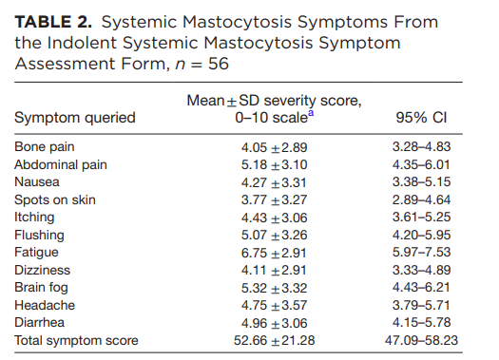
Symptom Burden in Systemic Mastocytosis

Slide 6
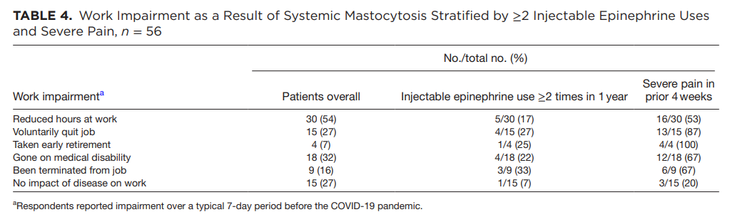
Symptom Burden in Systemic Mastocytosis

Slide 7
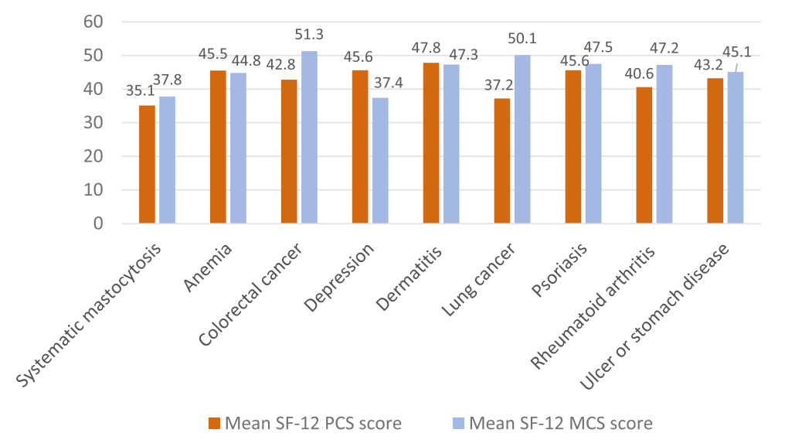
Symptom Burden in Systemic Mastocytosis
Comparison to Other Diagnoses
Systemic mastocytosis

Slide 8

Cytoreductive Treatment of Systemic Mastocytosis
Indications:
  Advanced mastocytosis (approved)
  Indolent systemic mastocytosis refractory to symptomatic therapies (investigational)
Agents:
  IFN-$α$
  Cladribine
  Tyrosine kinase inhibitors

Slide 9
TKIs in Systemic Mastocytosis
WT KIT or non-codon D816V
  Imatinib (FDA indication for advanced systemic mastocytosis in 2006)
Both WT and D816V KIT
  Dasatinib (low clinical efficacy, side effects)
  Midostaurin (FDA indication for advanced systemic mastocytosis in 2017)
Primarily D816V KIT
  Avapritinib (FDA indication in advanced systemic mastocytosis in 2021; clinical trial in ISM)
  Elenestinib (BLU-263)
  Bezuclastinib

Slide 10
Avapritinib
KIT D816V biochemical IC₅₀
avapritinib* | imatinib* | masitinib# | midostaurin* | ripretinib#
0.27 nM | 8150 nM | >1000 nM | 2.9 nM | 2.6 nM

Slide 11
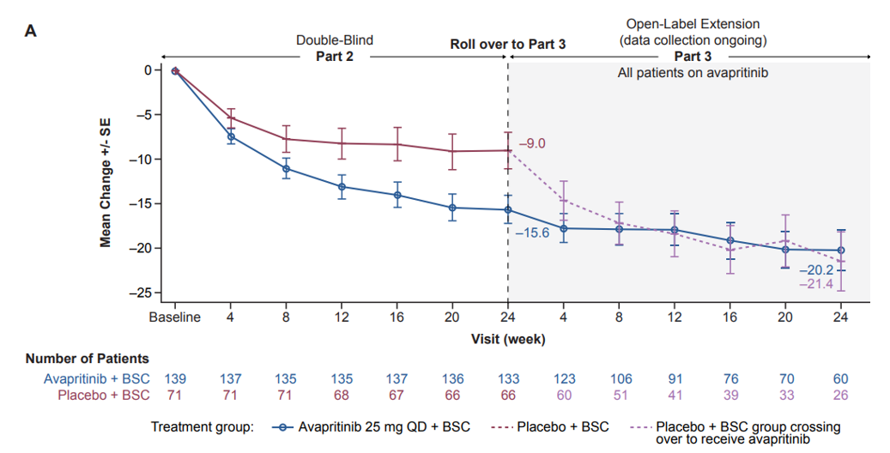
Avapritinib Versus Placebo in ISM: Effect on Symptom Scores (Primary Endpoint)

Slide 12
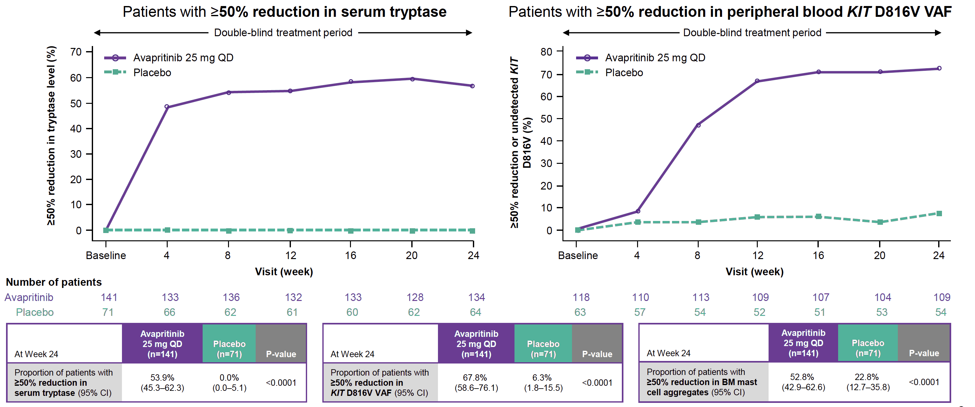
Mast Cell Cytoreduction Measured as Reduction in Biomarkers: PIONEER Trial
Patients with ≥50 reduction
in serum tryptase
Patients with ≥50 reduction in
peripheral blood KIT D816V VAF

Slide 13
Investigational KIT D816V Targeting TKIs in Non-advanced Systemic Mastocytosis
Elenestenib (BLU-263; clinical trial identifier NCT04910685)
  20-fold lower brain-to-plasma exposure as compared to avapritinib in rats
Bezuclastinib (CGT9486; clinical trial identifier NCT05186753)
  Does not cross brain blood barrier
  Does not inhibit PDGFRA, PDGFRB, CSFR1 and flt3
Mastinib (clinical trial identifier NCT04333108)
  Reduced severity of symptoms in patients with severely symptomatic indolent/smoldering systemic mastocytosis

Slide 14
Risk Versus Benefit Considerations in TKI Treatment of Patients with Indolent Systemic Mastocytosis
Improved symptoms
Improved quality-of-life
Decreased skin lesions
Decreased polypharmacy
Adverse events
Unknown long-term safety
Reproductive and/or teratogenic risk
Need for monitoring

Slide 15



Looking for more resources
on this topic?
CME/CE in minutes
Congress highlights
Late-breaking data
Quizzes
Webinars
In-person events
Slides & resources
www.MedEdOTG.com

