Slide 1
New Hope: Novel and Emerging Treatment Options for Rett Syndrome
Jeffrey L. Neul, MD, PhD
Director, Vanderbilt Kennedy Center
Annette Schaffer Eskind Professor
Vanderbilt University Medical Center
Nashville, TN

Slide 2
Disclaimer
The views and opinions expressed in this educational activity are those of the faculty and do not necessarily represent the views of TotalCME, Inc., the CME providers, or the companies providing educational grants. This presentation is not intended to define an exclusive course of patient management; the participant should use their clinical judgment, knowledge, experience, and diagnostic skills in applying or adopting for professional use any of the information provided herein. Any procedures, medications, or other courses of diagnosis or treatment discussed or suggested in this activity should not be used by clinicians without evaluation of their patient's conditions and possible contraindications or dangers in use, review of any applicable manufacturer’s product information, and comparison with recommendations of other authorities. Links to other sites may be provided as additional sources of information.

Slide 3



Resource Information
About This Resource
These slides are one component of a continuing education program available online at MedEd On The Go titled New Hope for Rett Syndrome: Novel Treatment Approaches
Program Learning Objectives:
Learn to clearly communicate information that is pertinent to the successful management of RS through each stage of the disease. enhanced patient outcomes and improvements in quality of life.
Increase the ability to recognize the subtle signs and symptoms of RS earlier.
Differentiate the pharmacodynamics and latest efficacy and safety clinical trial data associated with FDA-approved treatment for RTT.
Educate clinicians concerning the role of interprofessional team members in optimizing collaboration and communication to ensure patients with RS receive high-quality care that leads to enhanced patient outcomes and improvements in quality of life
MedEd On The Go®
www.mededonthego.com
This content or portions thereof may not be published, posted online or used in presentations without permission.
This content can be saved for personal use (non-commercial use only) with credit given to the resource authors.
To contact us regarding inaccuracies, omissions or permissions please email us at support@MedEdOTG.com

Slide 4
Demonstrated that the disorder is not irreversible.
Provided hope to develop disease modifying or reversing treatments.
Guy J, et al. Science. 2007;31(5815):1143-7; Lang M, et al. Hum Mol Genet. 2014;23(2):303-18; Robinson L, et al. Brain. 2012;135:2699-710.

Slide 5
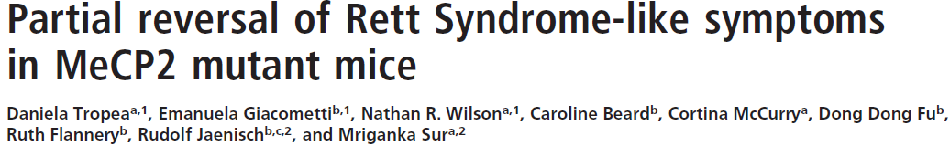
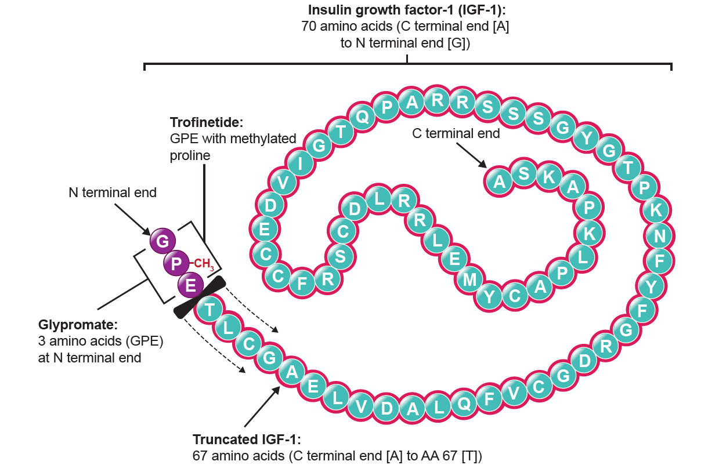
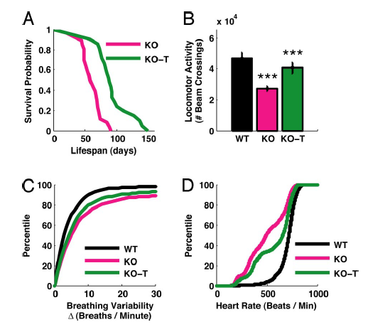
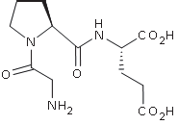
Disease Targeted/Modifying Therapies
Male Mecp2 mice treated with tripeptide from N-terminus of IGF-I
IGF-I [1-3] = Gly-Pro-Glu
GPE, glycine-proline-glutamate; IGF, insulin-like growth factor; KO, nontreated mice; KO-T, mice treated with IGF-I; WT, wild type.
Tropea D, et al. Proc Natl Acad Sci USA. 2009;106(6):2029-34.

Slide 6
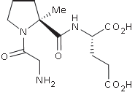
IGF-1 Related Trials in Rett Syndrome
Trofinetide
IGF-I [1-3]
Two phase 2 trials
  Safe
  Evidence of efficacy
Trofinetide
Glaze DG, et al. Pediatr Neurol. 2017;76:37-46.

Slide 7
Phase 3 Trial of Trofinetide – Lavender
Randomized, Double-blind, Placebo-controlled, Multi-center Study
Female, 5-20 years old, post regression
Participants randomized 1:1
Oral/gastrostomy tube
Coprimary efficacy endpoints
Change in caregiver scale (RSBQ)
Clinician improvement scale (CGI-I)
CGI-I, Clinical Global Impression – Improvement; CSBS-DP-IT, Communication and Symbolic Behavior Scales-Developmental Profile-Infant Toddler; OLE, open-label extension; RSBQ, Rett Syndrome Behaviour Questionnaire.
Neul JL, et al. Contemp Clin Trials. 2022;114:106704.

Slide 8
Phase 3 Trial of Trofinetide – Top Level Results
Caregiver scale - RSBQ
Clinician scale – CGI-I
RSBQ change from baseline to week 12:
p-value = 0.0175*
Effect Size = 0.37
CGI-I at Week 12:
p-value = 0.0030*
Effect Size = 0.47
Acadia Pharmaceuticals Inc. December 6, 2021. Accessed April 2023. https://acadia.com/media/news-releases/acadia-pharmaceuticals-announces-positive-top-line-results-from-the-pivotal-phase-3-lavender-trial-of-trofinetide-in-rett-syndrome/.

Slide 9
Phase 3 Trial of Trofinetide –
Treatment-Emergent Adverse Events
TEAE, n (%) | Placebo (n = 94) | Trofinetide (n = 93)
Any TEAE | 51 (54.3) | 86 (92.5)
Serious TEAE | 3 (3.2) | 3 (3.2)
TEAE leading to drug withdrawal Diarrhea | 2 (2.1) 0 | 16 (17.2) 12 (12.9)
Fatal TEAE | 0 | 0
Top TEAEs
(Majority mild to moderate severity)
Diarrhea –
80.7% trofinetide,
19.2% placebo
Vomiting –
27% trofinetide,
9.6% placebo
TEAE, treatment-emergent adverse event.
Acadia Pharmaceuticals Inc. December 6, 2021. Accessed April 2023. https://acadia.com/media/news-releases/acadia-pharmaceuticals-announces-positive-top-line-results-from-the-pivotal-phase-3-lavender-trial-of-trofinetide-in-rett-syndrome/.

Slide 10
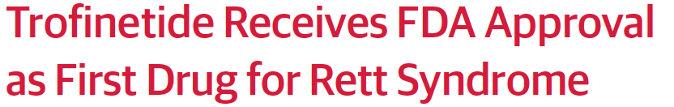
Trofinetide
Approved by FDA on March 12th, 2023
Treatment for people with Rett syndrome over 2 years old
Harris E. JAMA. March 22, 2023. Accessed April 2023. https://jamanetwork.com/journals/jama/fullarticle/2802886.

Slide 11
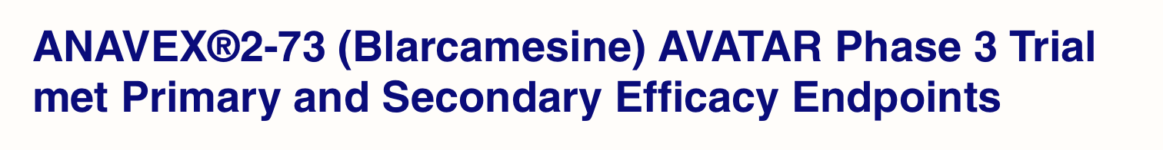
ANAVEX 2-73
Kaufmann WE, et al. Pharmacol Biochem Behav. 2019;187:172796; Anavex Life Sciences Corp. February 1, 2022. Accessed April 2023. https://www.anavex.com/post/anavex-2-73-blarcamesine-avatar-phase-3-trial-met-primary-and-secondary-efficacy-endpoints.

Slide 12
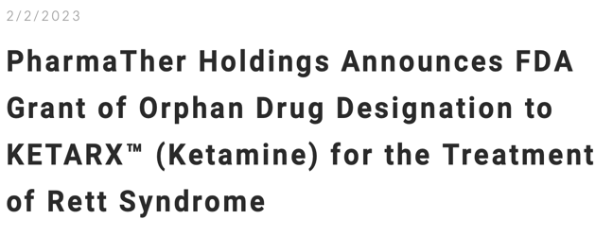



More Trials in Rett Syndrome
X-chromosome reactivation
Repurposing
DNA editing
Gene therapy
RNA editing
Carrette LLG, et al. Proc Natl Acad Sci USA. 2017;115(4)E668-E675; Croci S, et al. Eur J Hum Genet. 2020; 28:1231-42; Neurogene Inc. January 23, 2023. Accessed April 2023. https://www.neurogene.com/press-releases/neurogene-announces-fda-clearance-of-ind-for-ngn-401-gene-therapy-for-children-with-rett-syndrome/; PharmaTher Holdings Ltd. GlobalNewswire. February 2, 2023. Accessed April 2023. https://www.globenewswire.com/news-release/2023/02/02/2600358/0/en/PharmaTher-Holdings-Announces-FDA-Grant-of-Orphan-Drug-Designation-to-KETARX-Ketamine-for-the-Treatment-of-Rett-Syndrome.html; Sinnamon JR, et al. Proc Natl Acad Sci USA. 2017;114(44)E9395-E9402; Sinnamon JR, et al. Cell Rep. 2020;32(2):107878; Taysha GTx. March 29, 2022. Accessed April 2023. https://ir.tayshagtx.com/news-releases/news-release-details/taysha-gene-therapies-announces-initiation-clinical-0.

Slide 13
Closing Remarks
Mouse models of Rett syndrome reproduce many features of the disease
  Reversible/Modifiable
  Preclinical use of mouse models to identify new treatment approaches
Clinical trials have shown the potential to develop targeted therapies
  Trofinetide is first FDA approved drug for Rett syndrome
  Additional trials of small molecules underway
  Gene therapy trials announced and starting
  New approaches being developed pre-clinically

Slide 14




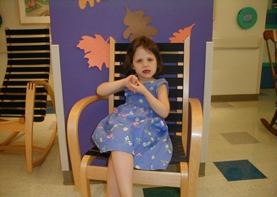
Thanks to my friends!

Slide 15



Looking for more resources
on this topic?
CME/CE in minutes
Congress highlights
Late-breaking data
Quizzes
Webinars
In-person events
Slides & resources
www.MedEdOTG.com

